Slide 1

Safety and Security of Small Satellites in Low Earth Orbit (LEO):
Small Satellite Workshop @ UTD
Kangkook Jee
Jun 29, 2026

Slide 2
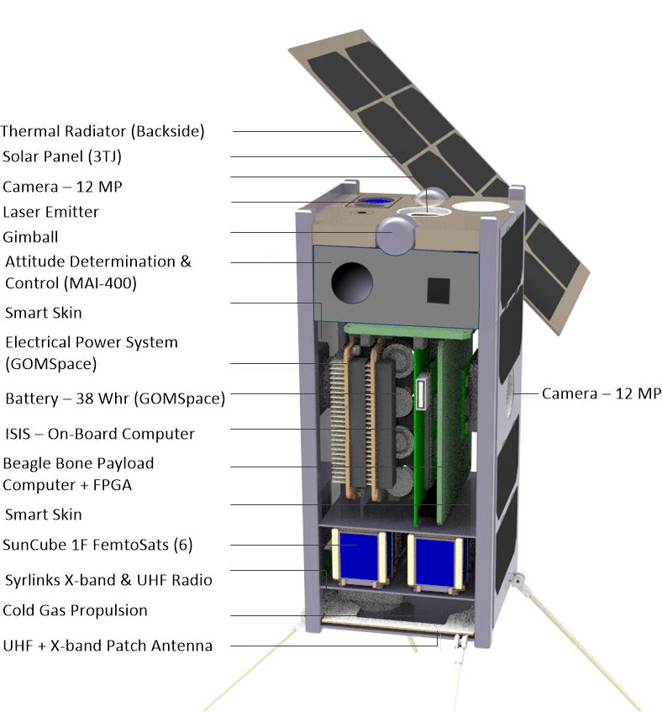
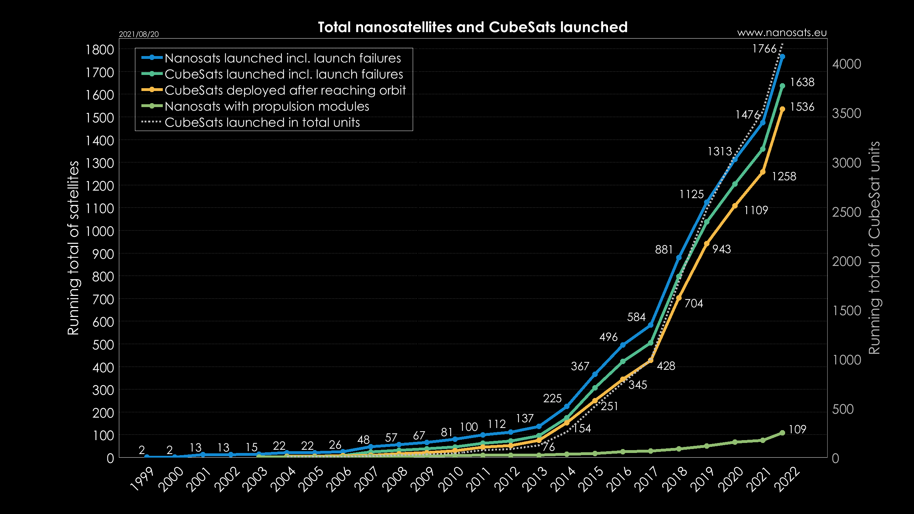
New Space Era
Two Enablers
  Re-usable booter technologies
  Ever-shrinking size of technologies
Standard 2U CubeSat
(1U: 10 cm × 10 cm × 11.35 cm)
Total count of CubeSats launched as of August 2021

Slide 3
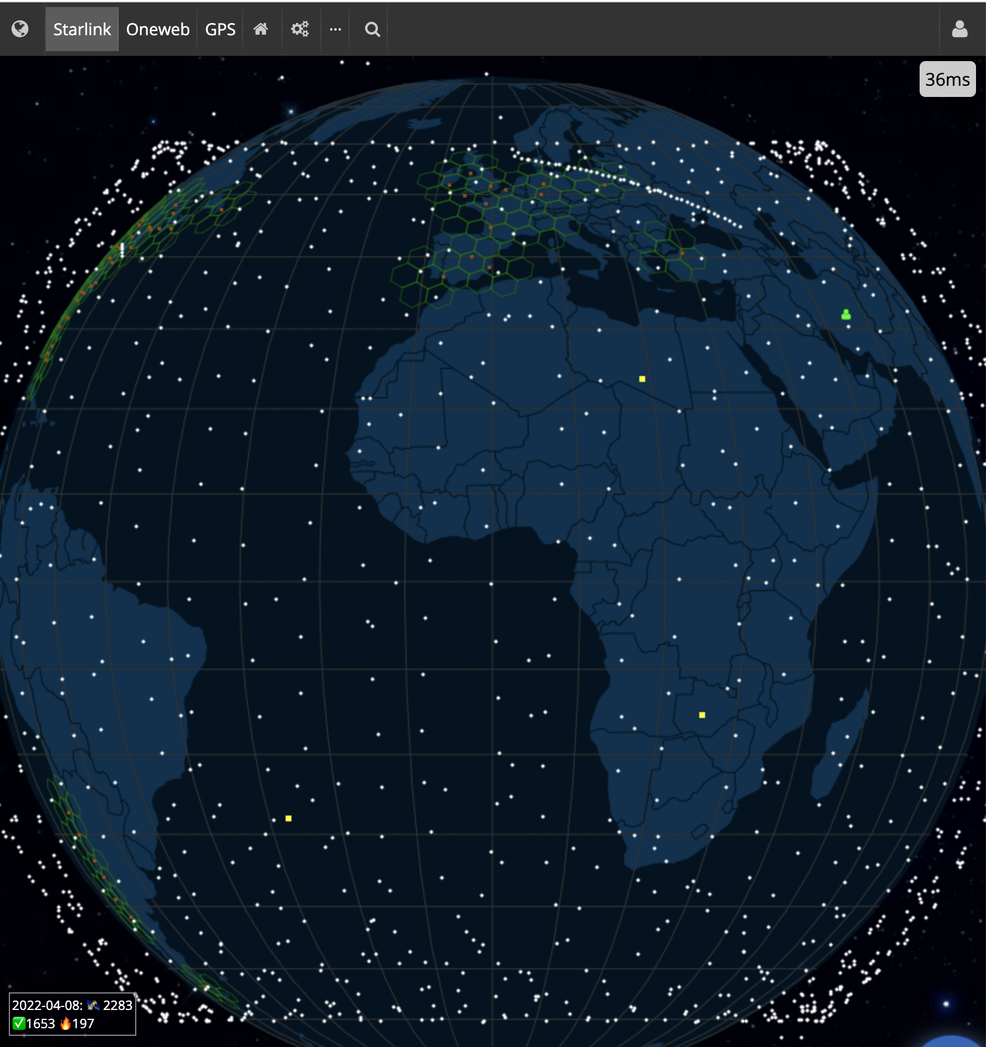
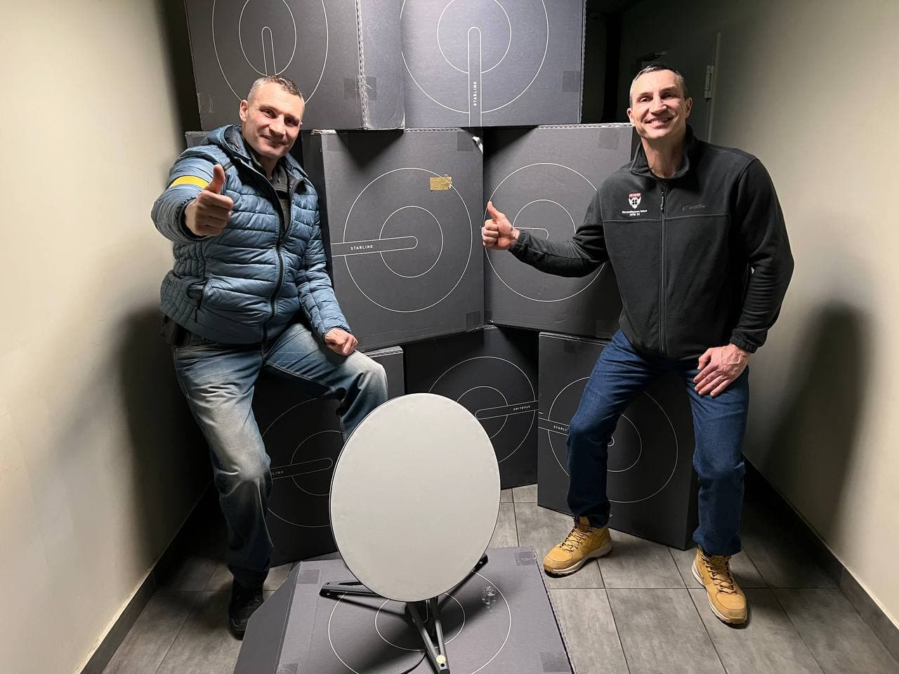
Case Study: Starlink@Ukraine
Starlink aims to be a world-wide Internet ISP
  Constellation with ~2000 on LEO (Low Earth Orbit)
  ~3000 more on their ways
Ukraine has been winning a propaganda campaign
If you were Putin, what would you do?
Starlink satellite map - https://satellitemap.space/
Notes:
https://satellitemap.space/

Slide 4
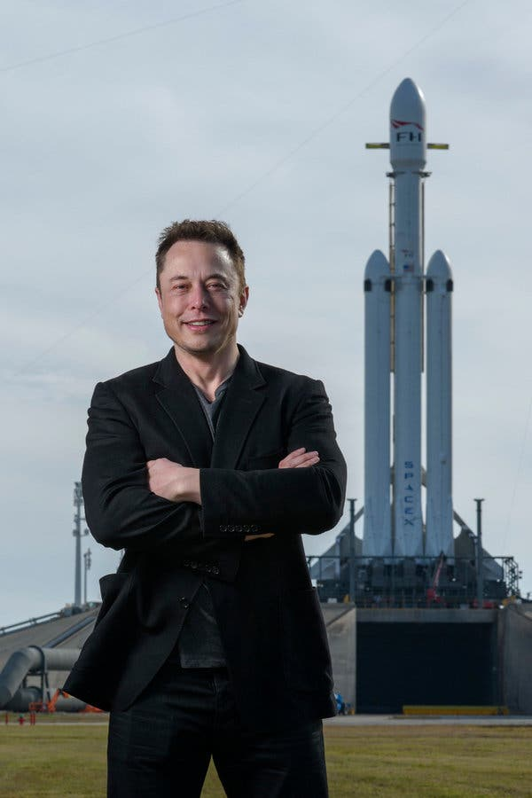
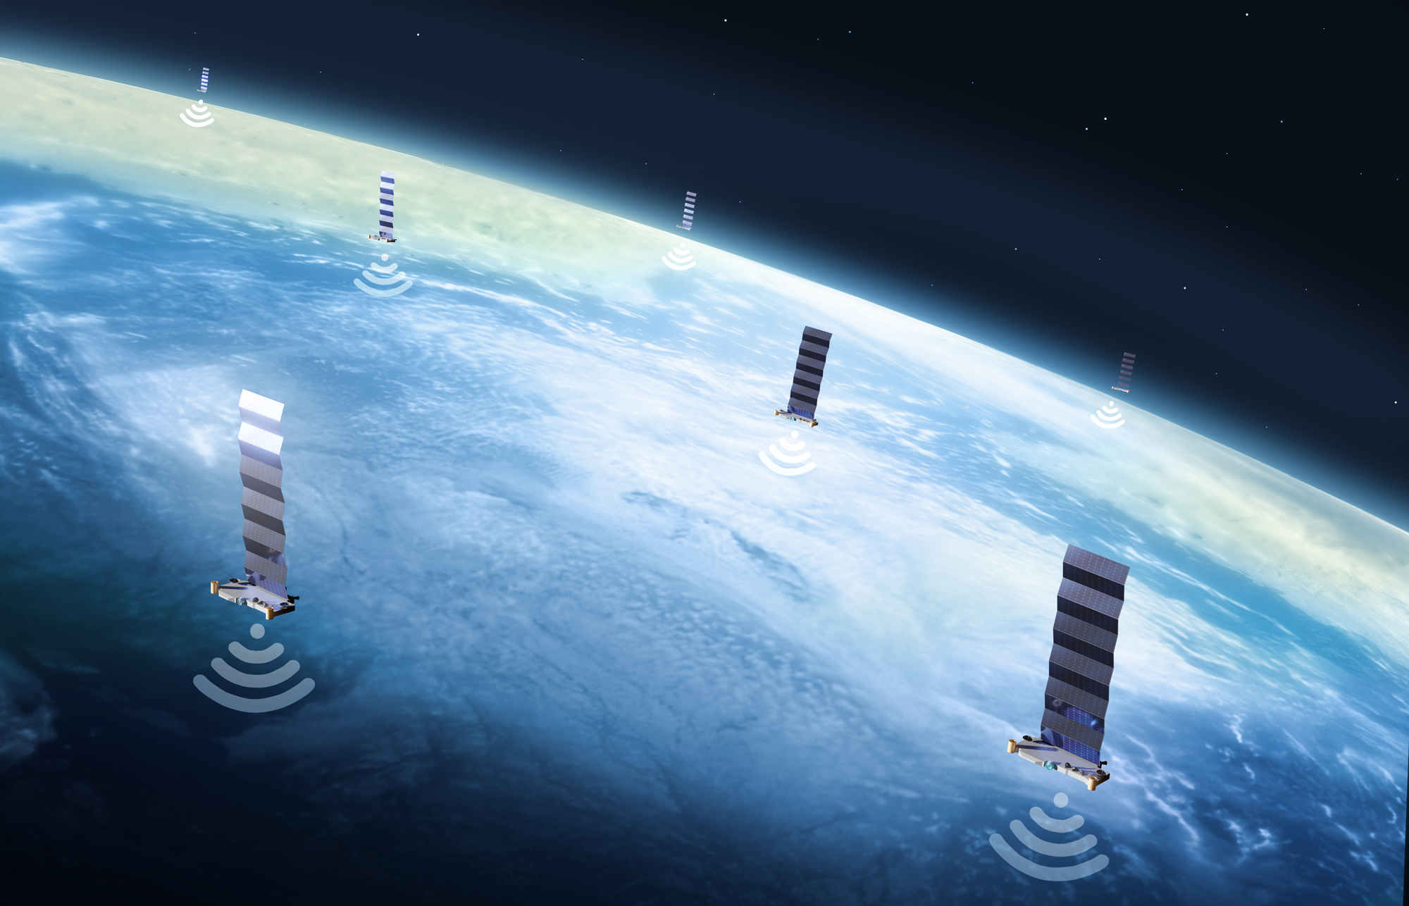
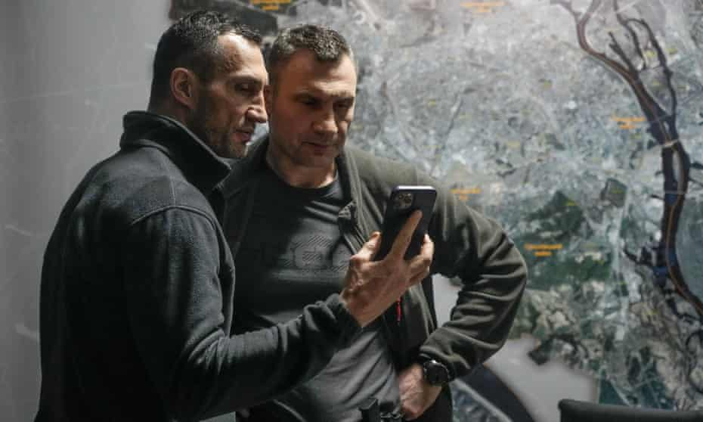
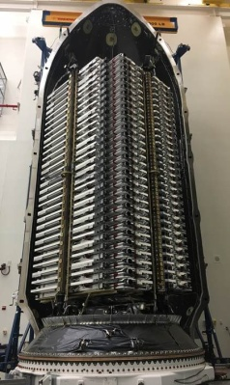
Starlink@Ukraine
People are still connected amongst war

Slide 5
Starlink@Ukraine
Starlink aims to be a world-wide Internet ISP
  Constellation with ~2000 on LEO (Low Earth Orbit)
  ~3000 more on their ways
Ukraine has been winning a propaganda campaign
If you were Putin, what would you do?
Starlink satellite map - https://satellitemap.space/
Notes:
https://satellitemap.space/

Slide 6
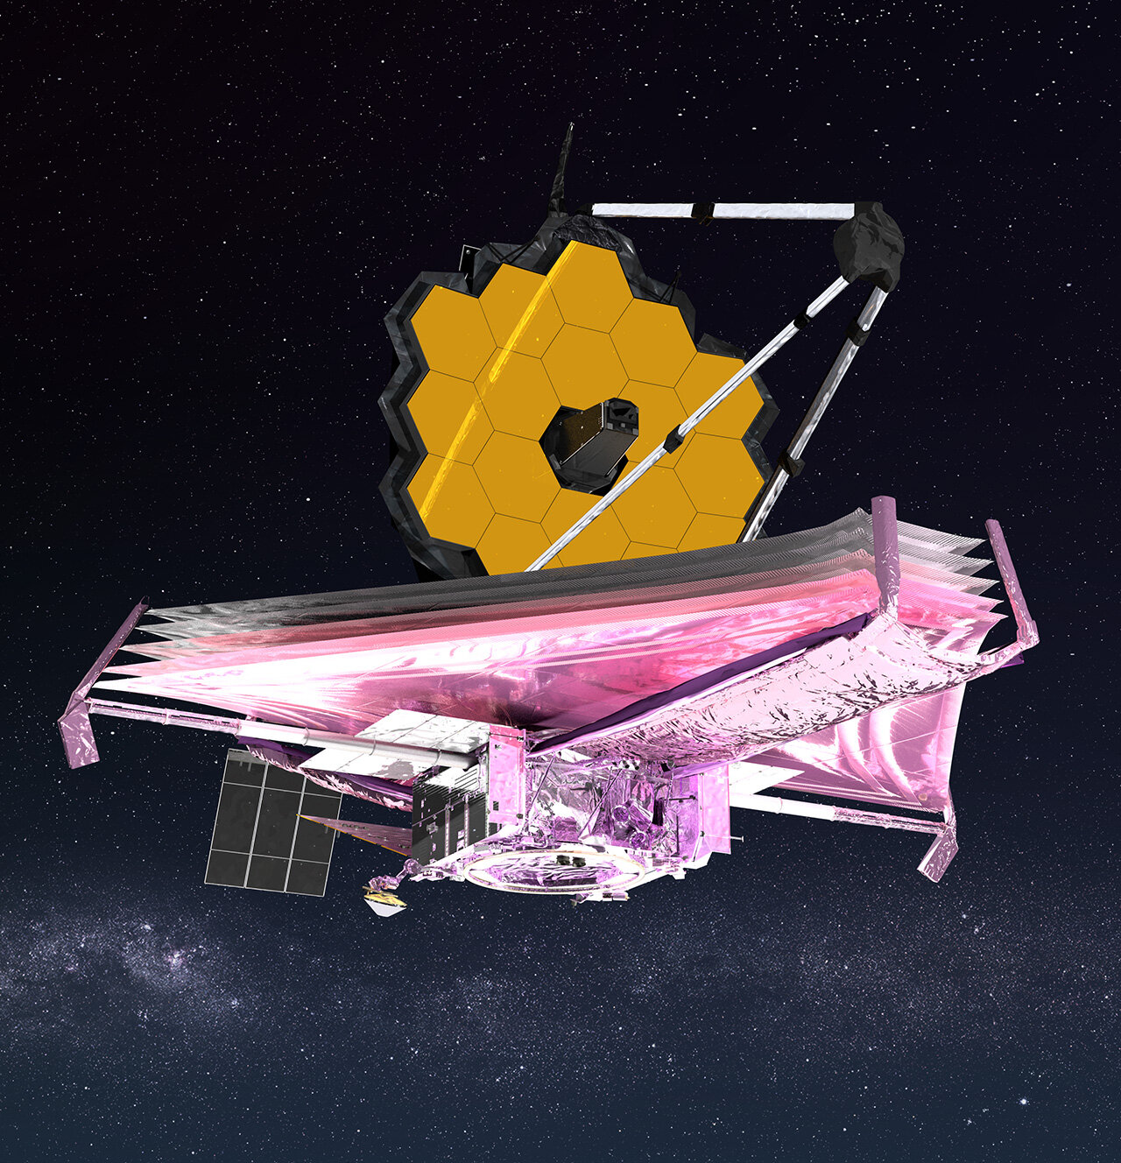
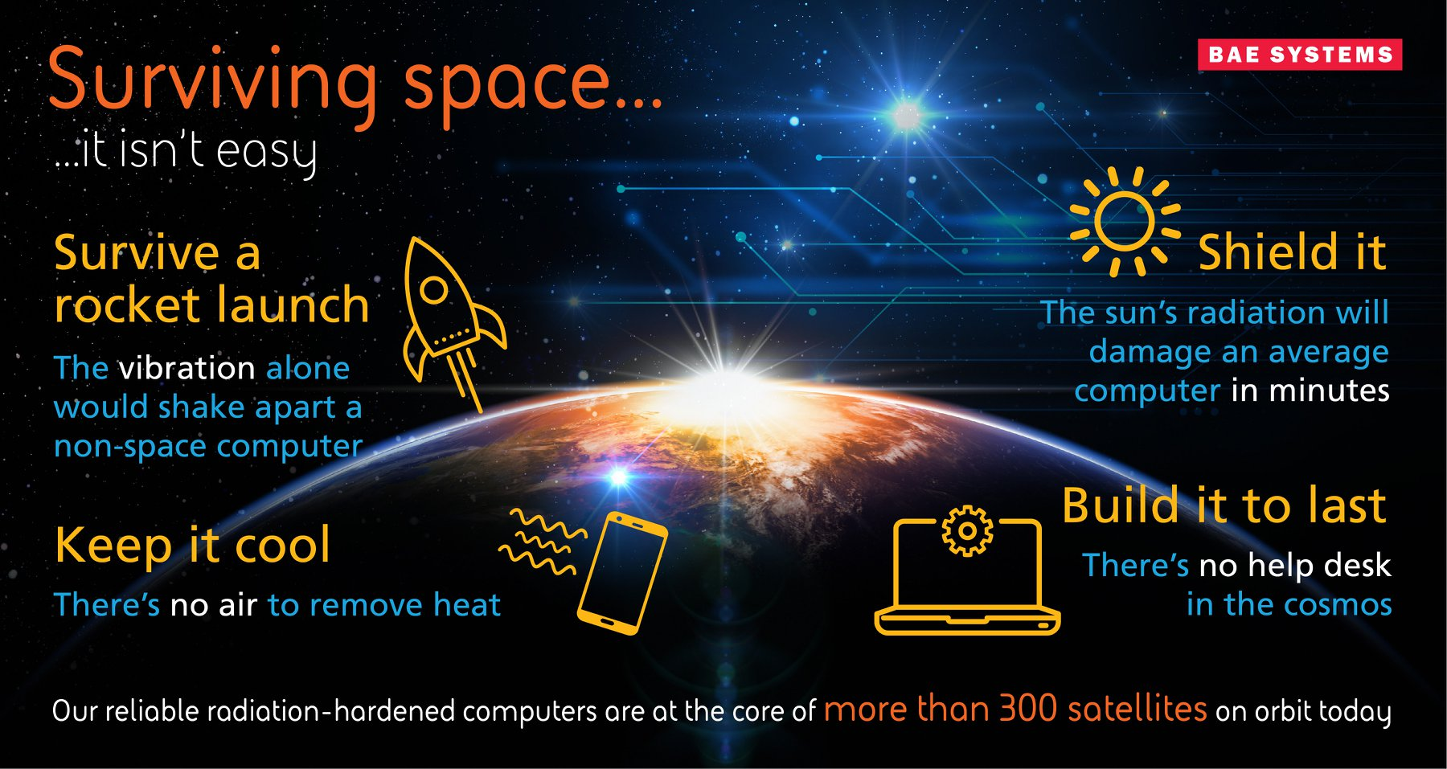
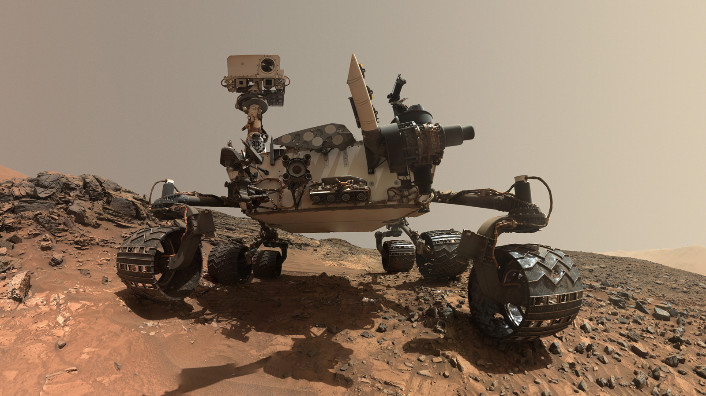
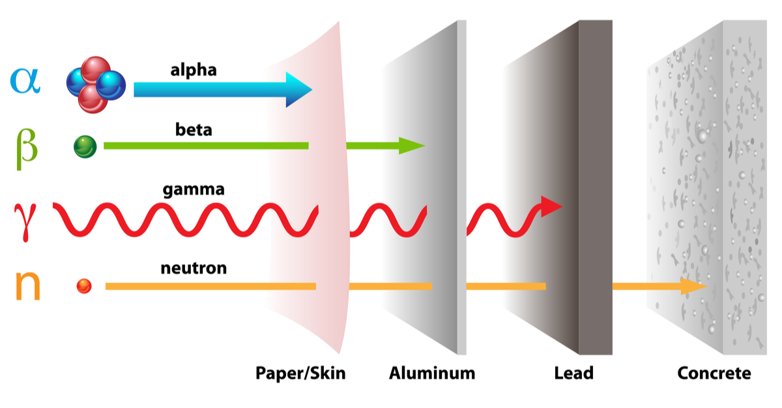
"Traditional" Space Electronics
Confirmed by a rigorous process
  E.g., Rad-hardening, ruggedized components
Image source: BAE systems

Slide 7

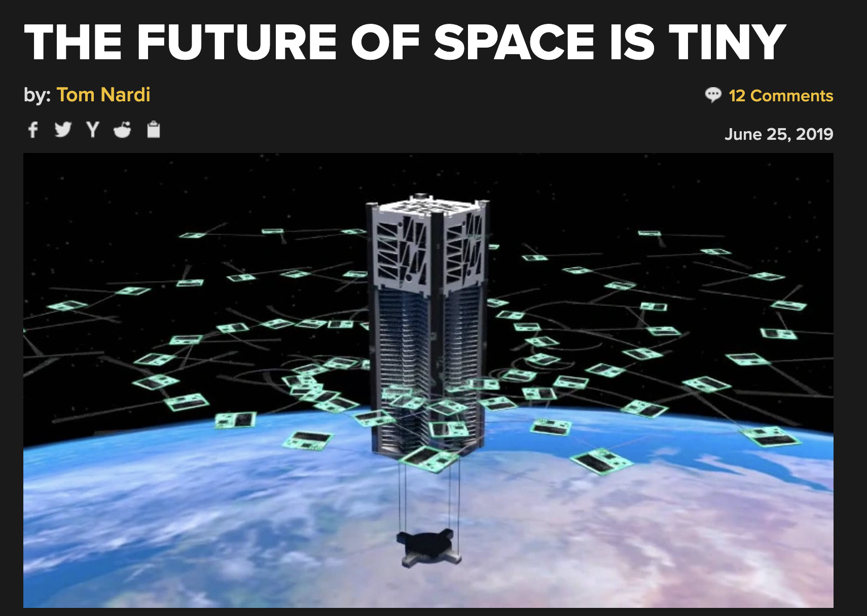
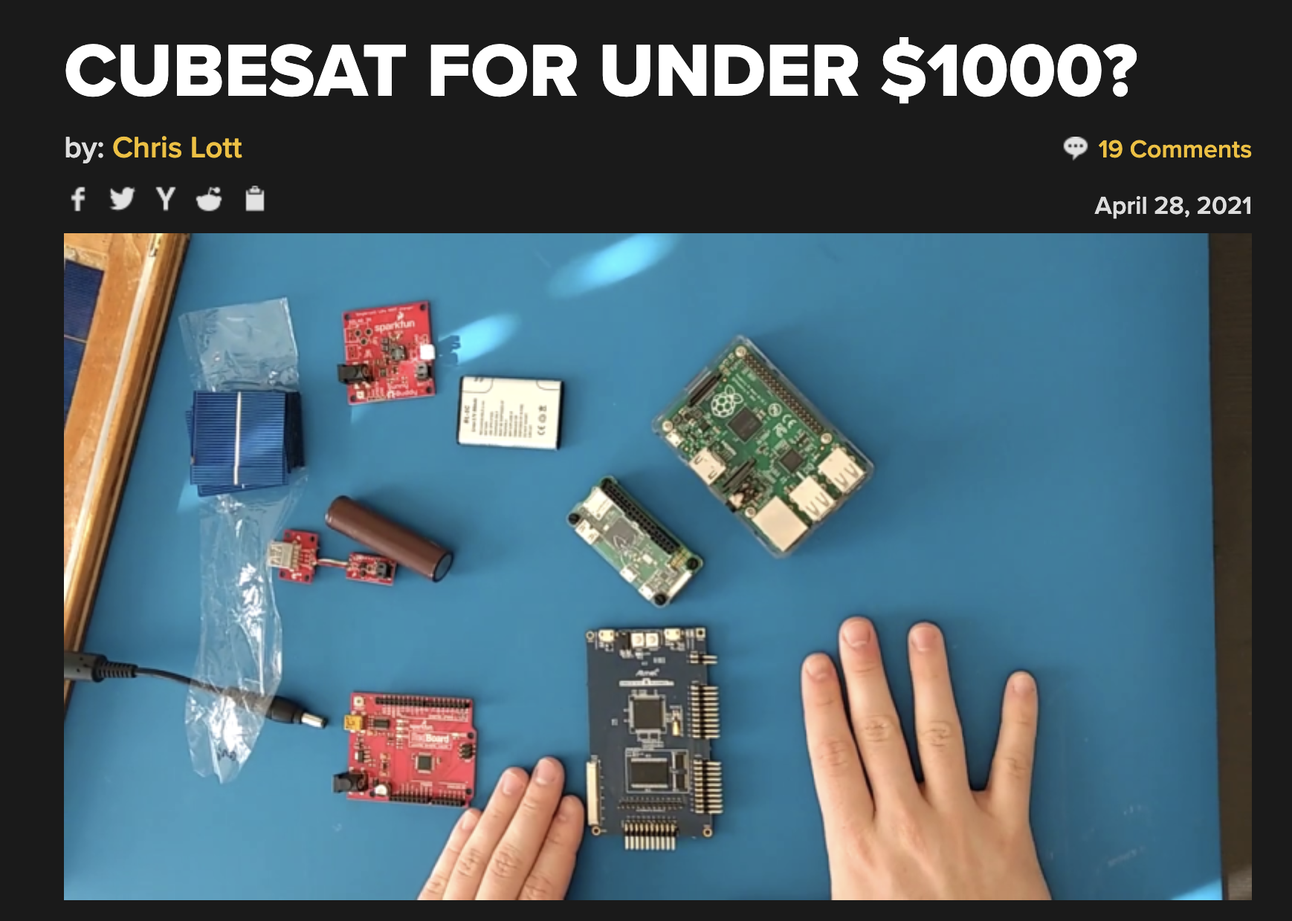
The Game is Turning into a New Phase
$2M to put your CubeSat on LEO
Big business for sweeping space debris

Slide 8
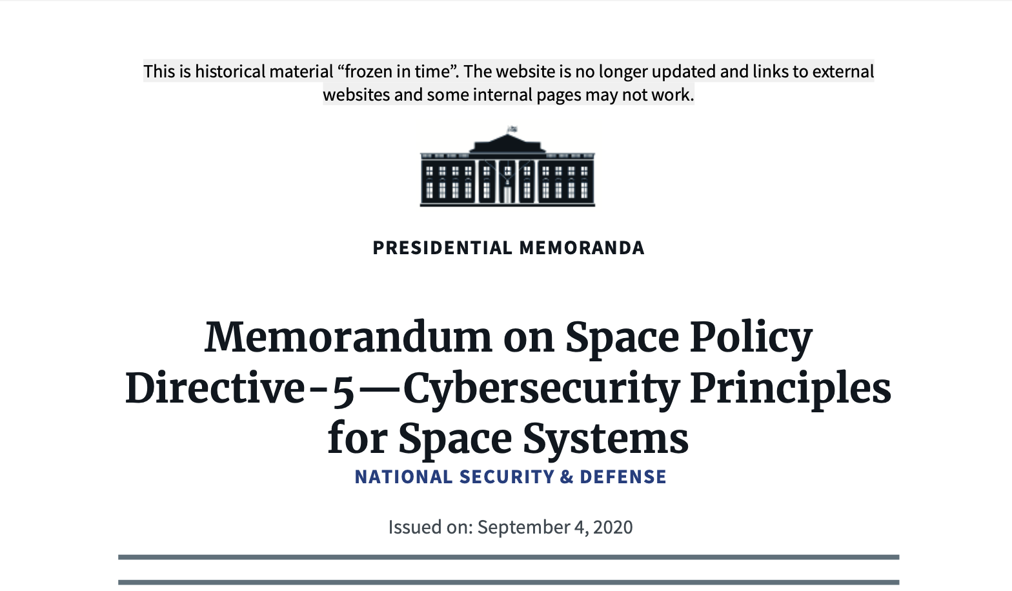
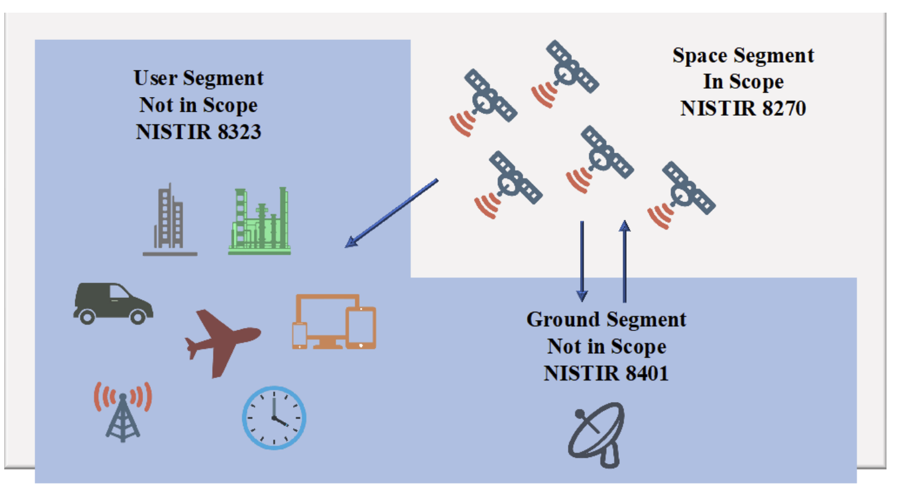
Space + Cyber Security
NIST-IR 8270: Introduction to Cybersecurity for Commercial Satellite Operations
NIST-IR 8323: Foundational PNT Profile: Applying the Cybersecurity Framework
for the Responsible Use of Positioning, Navigation, and Timing (PNT) Services
NIST-IR 8401:Satellite Ground Segment: Applying the Cybersecurity Framework
to Satellite Command and Control
NIST-IR 8441: Cybersecurity Framework Profile for Hybrid Satellite Networks (HSN)
memorandum on space policy direct 5
Notes:
TODO: update resource document
https://trumpwhitehouse.archives.gov/presidential-actions/memorandum-space-policy-directive-5-cybersecurity-principles-space-systems/
https://csrc.nist.gov/pubs/ir/8270/final
Satellite Ground Segment: Applying the Cybersecurity Framework to Satellite Command and Control
Introduction to Cybersecurity for Commercial Satellite Operations
Cybersecurity Framework Profile for Hybrid Satellite Networks (HSN)
Foundational PNT Profile: Applying the Cybersecurity Framework for the Responsible Use of Positioning, Navigation, and Timing (PNT) Services

Slide 9
Disclaimer
This is a failure story
  4+ years of endeavor without producing concrete outcomes
Safety and security of small satellites (or CubeSats) in LEO
  Space has many segments
  LEO, MEO, GEO, and deep space
  Private, public sectors, and academic and research communities

Slide 10



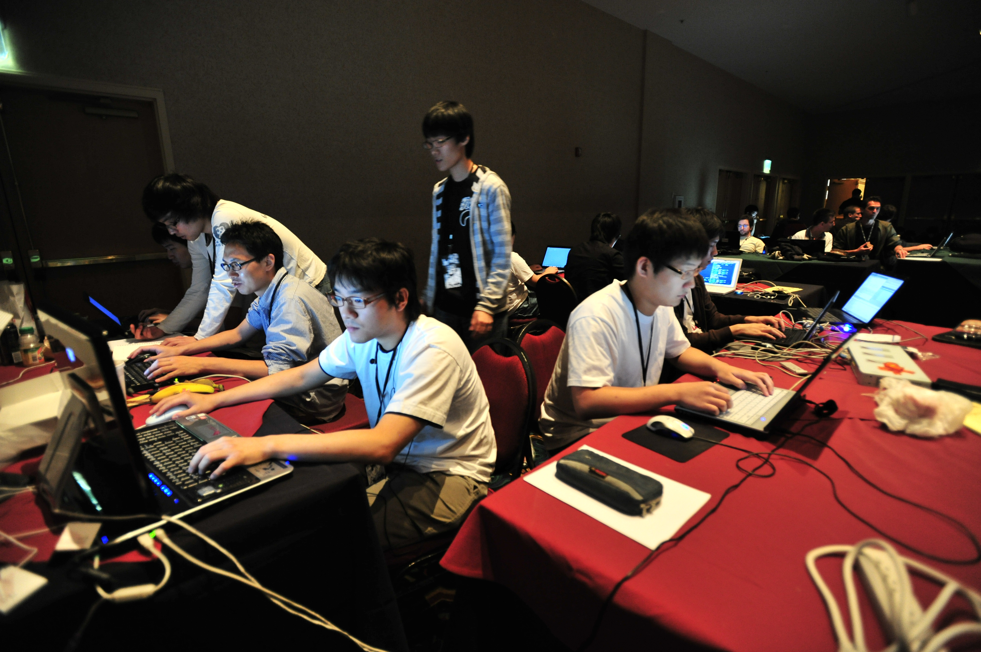
Who Am I?
10 years of industry experience
  IBM Korea, NEC Laboratory in America
  OS/JVM engineer
  EDR research, Pen-testing, and security analysis
Joined UT Dallas in 2019
  Specialized in system security
  Teaching binary reversing (CTF) courses

Slide 11
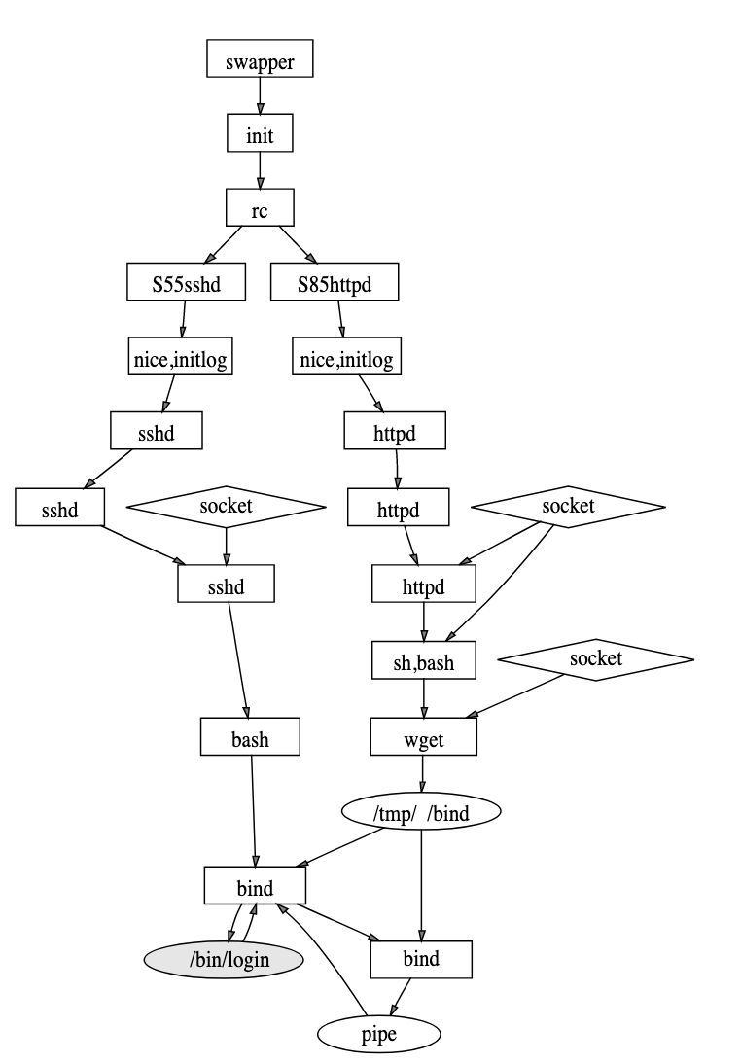
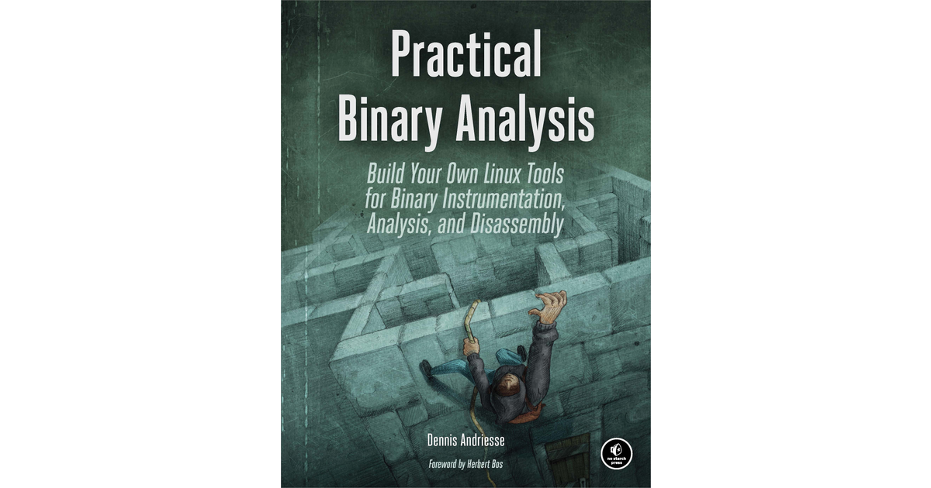
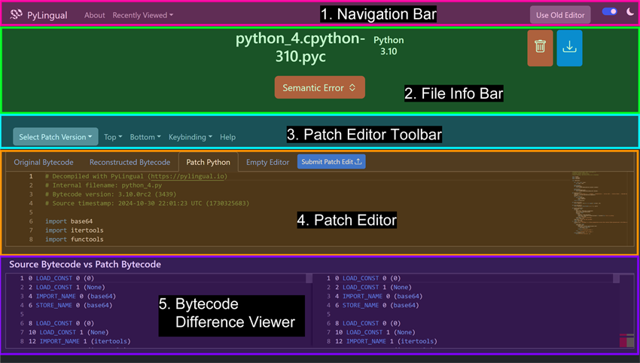
Who Am I?
System security researcher
  Binary-level information flow tracking: libdft
  Static and dynamic program (binary) analysis
Leveraging ML-techniques to automate security analysis
  Data-driven security research with large security graphs
    EDR, system provenance
  Decompilation of High-level Dynamic Languages (HDLs)
    PyLingual
Why SPACE?

Slide 12
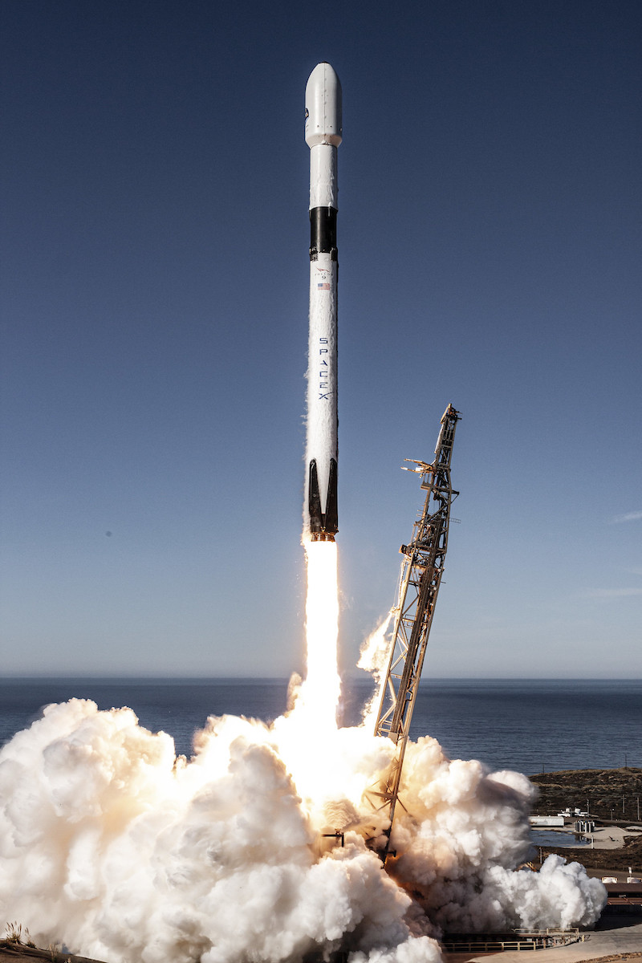
My Space Journey
How a system security researcher come to be a space enthusiast?
Lucky to have a chance to participate satellite project (6U CubeSat)
  1 year in preparation stage, 2 years of operation
  Planned to run various cybersecurity research
  Couldn’t say it was quite successful …
Still ALIVE on space
  Gap between cyber and aerospace communities
  Research opportunities
  Optimistic (or Naive) about space
This talk will be about …

Slide 13
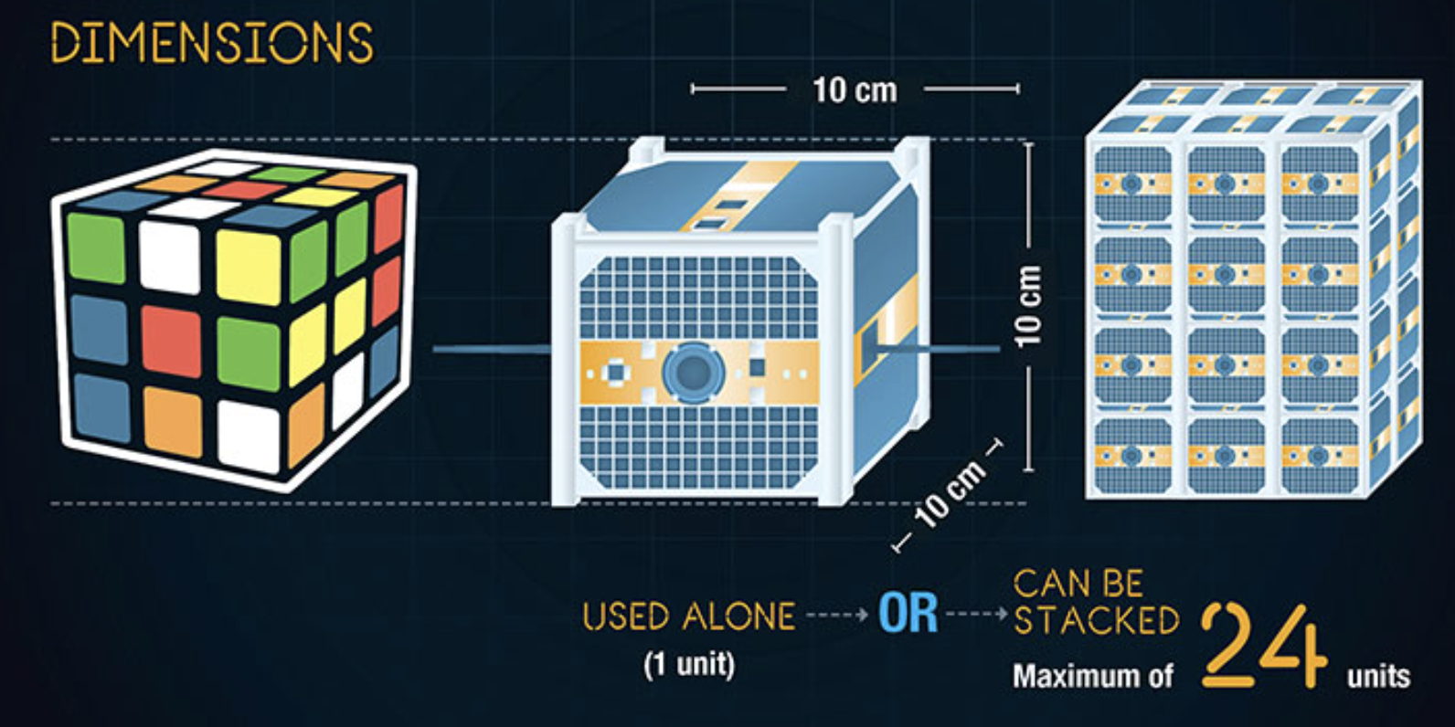
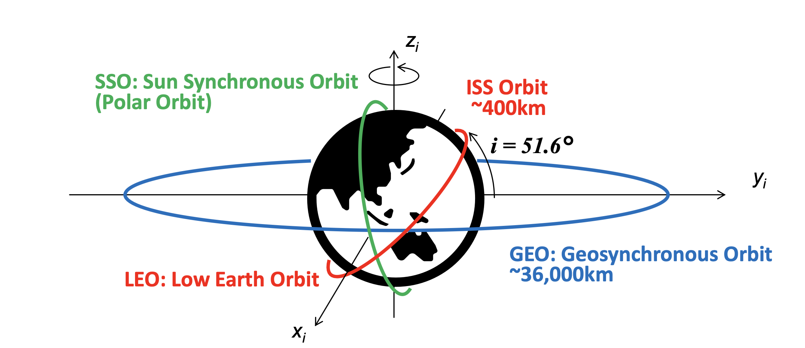
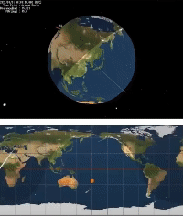
Context Reminder:
CubeSat in LEO
CubeSat
  Mico- or nanosatellites ( ~ 10 kg)
  For amateur and hobbyists (You may not find it super-relevant)
Low Earth Orbit (LEO)
  Popular destination among recent spacecraft projects
  (e.g., Starlink, ISS)
  Pros
    Inexpensive launch cost
    Short latency for terrestrial communication
  Cons
    Circle the earth every 90 minutes (~ 16x per day)
    Under close gravity interference
    Space debris

Slide 14
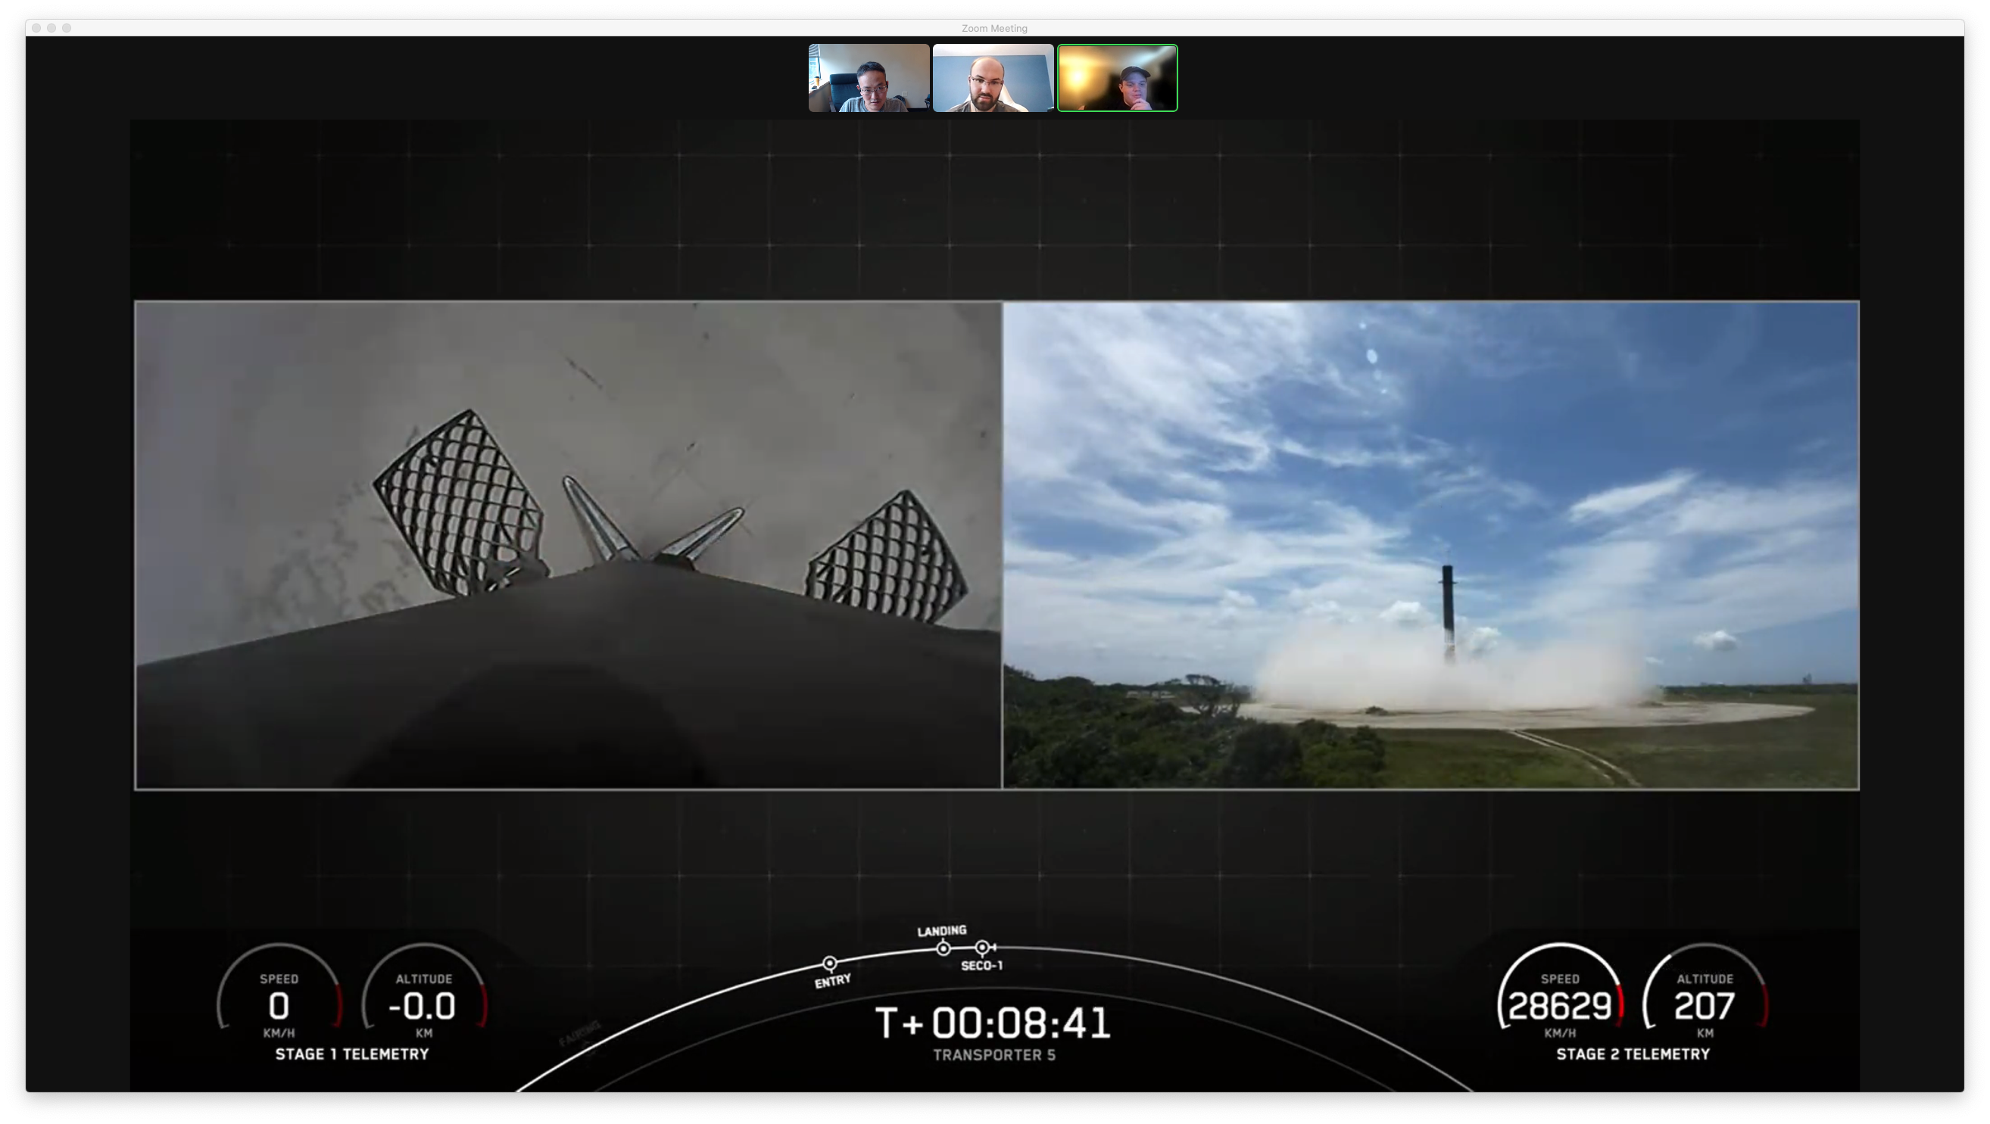



UTD + IBM Space Collaboration
Endurance CubeSat mission
  A new and exciting topic
Aim to make scientific contributions
Safety and Security
Notes:
https://endurancein.space/
https://www.vusec.net/

Slide 15
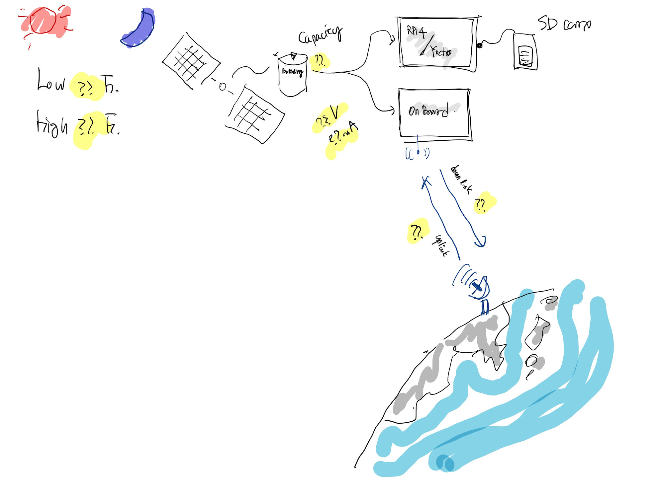
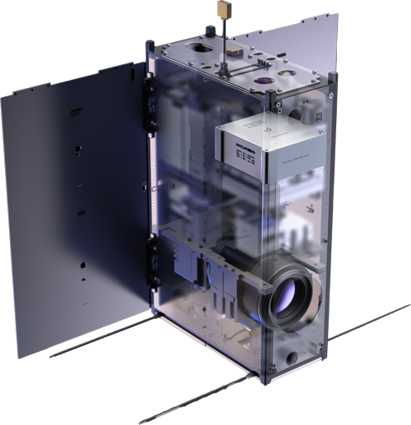
UTD + IBM Space Collaboration
CubeSat on LEO
  Low-Earth-Orbit (LEO)
  A unique testbed for safety and security using consumer grade electric device
IBM Space Tech + academic research collaboration
Unconventional use-case of edge-cloud computing model
  Different physics for space computing

Slide 16
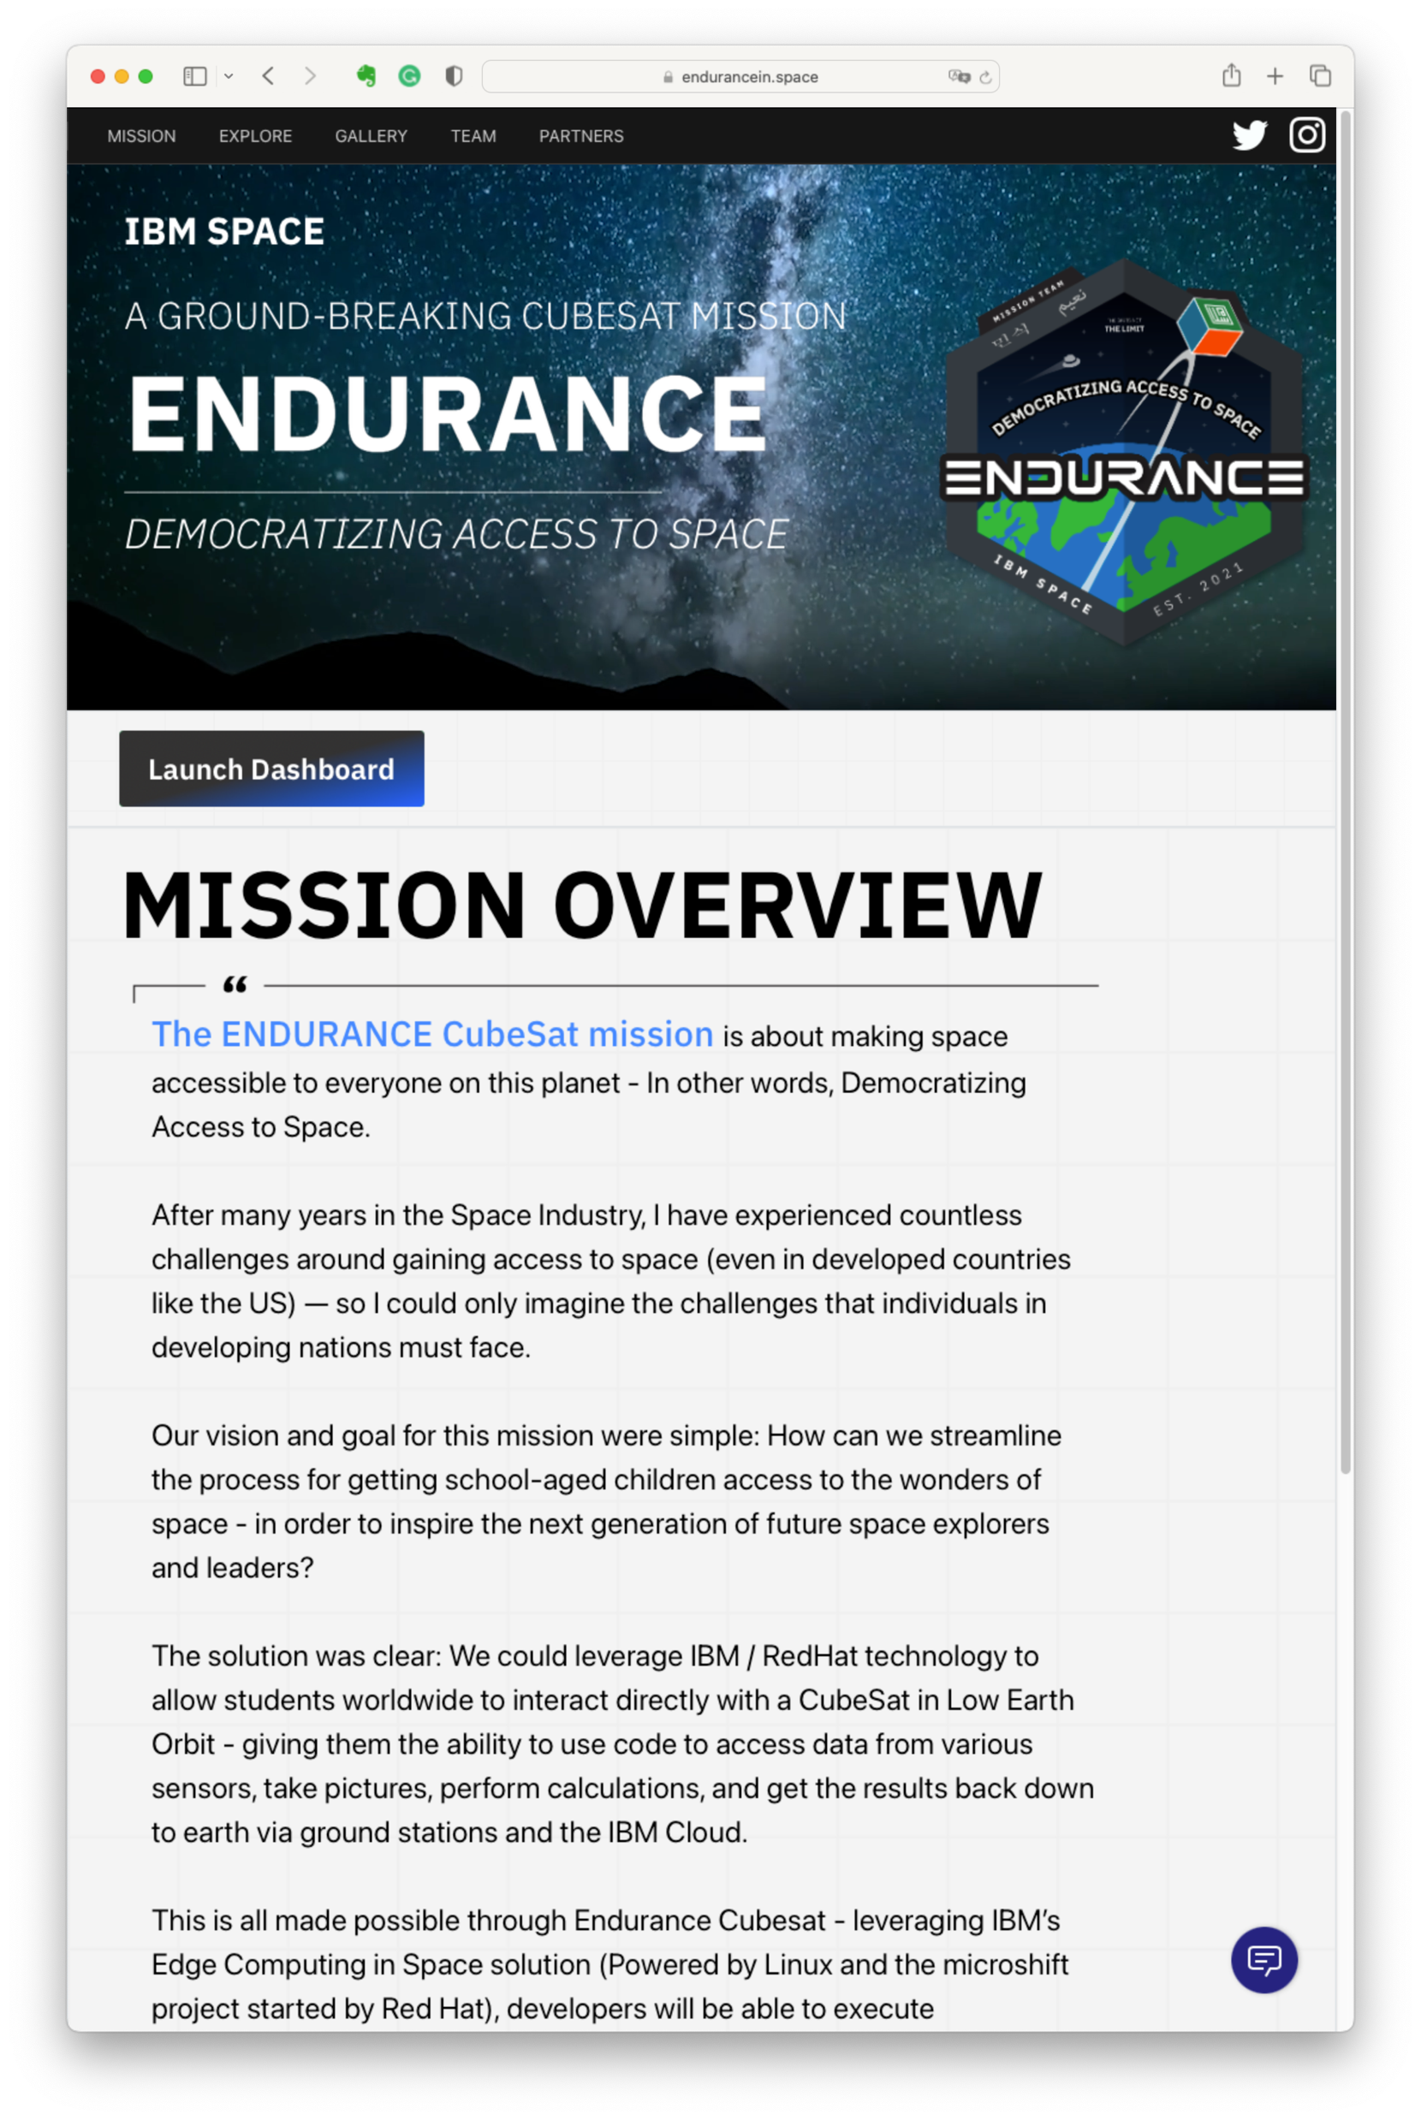
IBM Space: ENDURANCE
Notes:
ADCS (Attitude Determination and Control Systems)

Slide 17
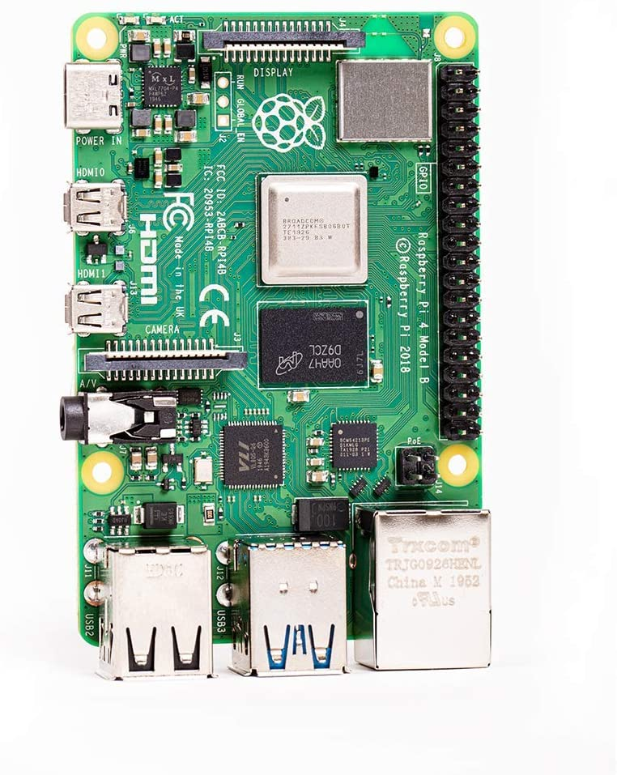
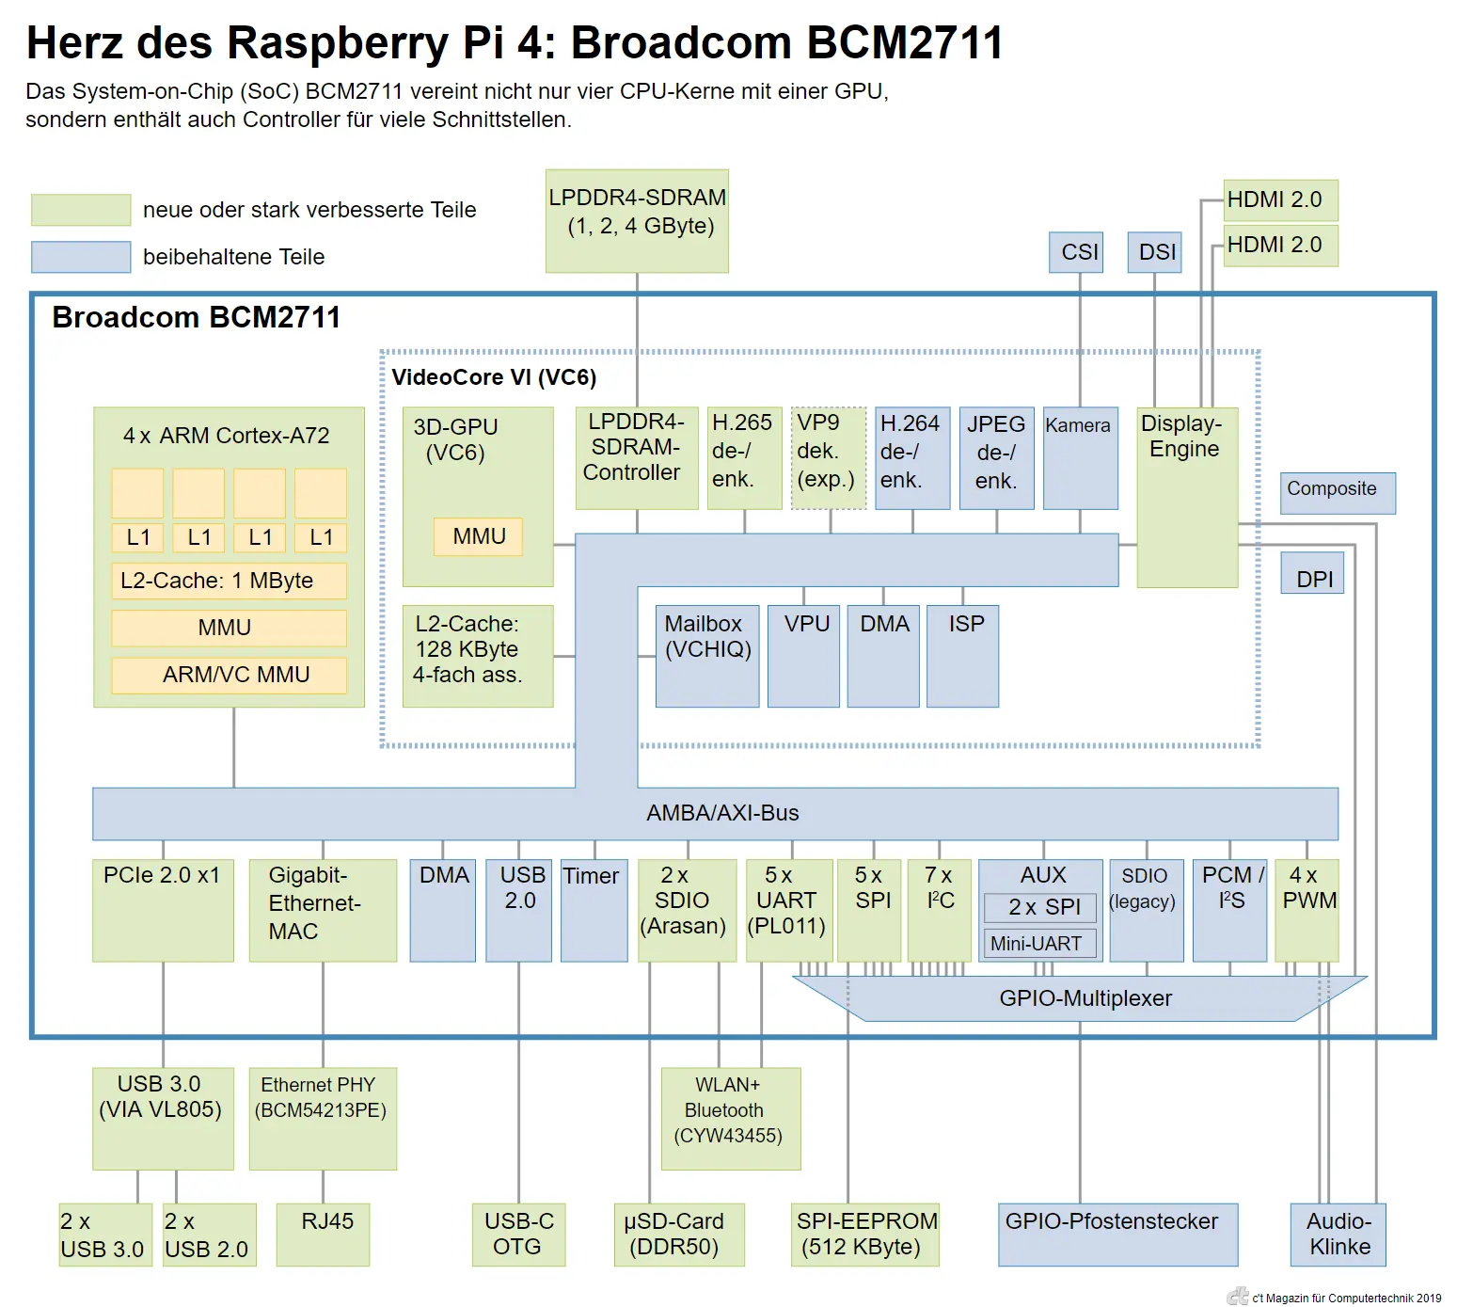
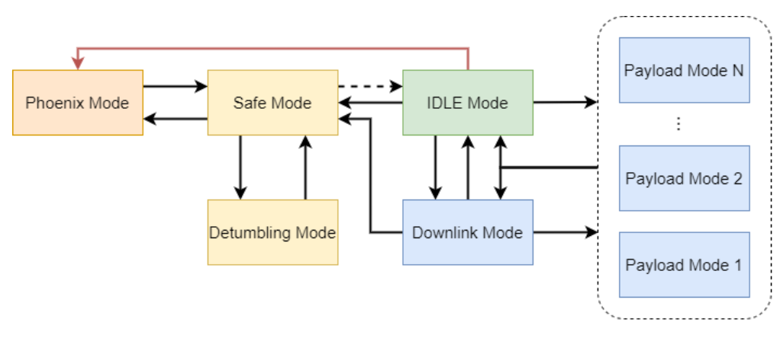
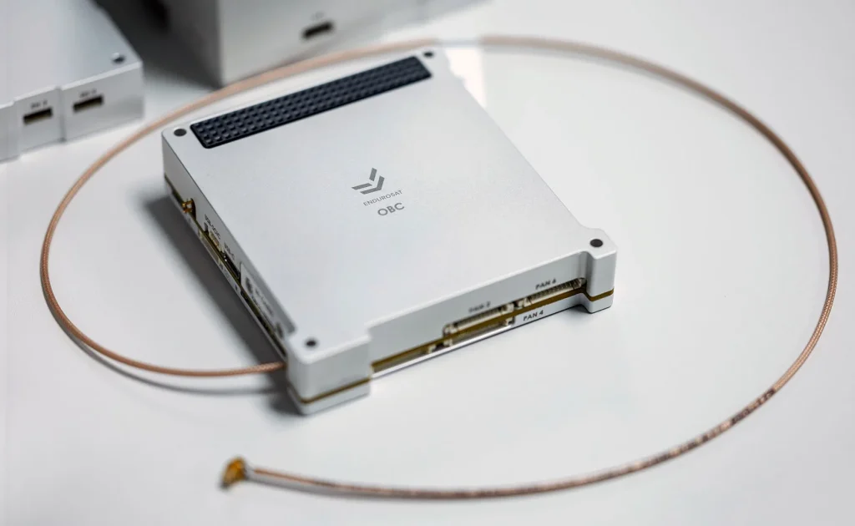
IBM Endurance
Raspberry Pi 4 (BCM 2711)
  Yoko Linux image customized for satellite operation
  Minimal power consumption
  Fast / seamless recovery
CubeSat Onboard Computer (OBC)
  Microcontroller (MCU) -based computer for payload operation
  Mainly concerns about Satellite operation + ground communications
Payload (Rpi4)
Notes:
https://www.endurosat.com/cubesat-store/cubesat-obc/onboard-computer-obc/

Slide 18

Endurance CubeSat OBC State Diagram
* Custom (in-house) control software

Slide 19
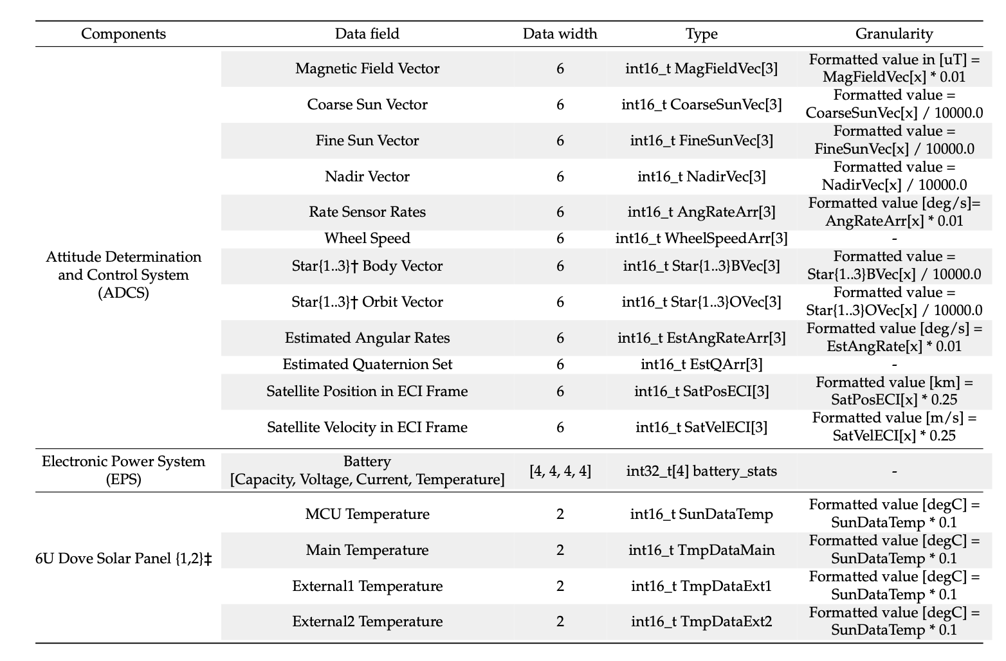
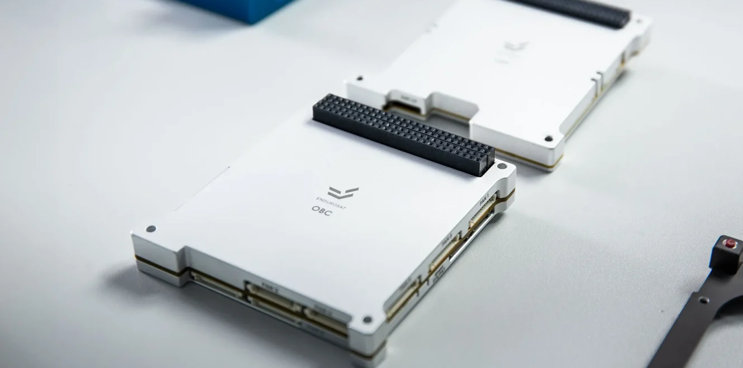
IBM Endurance Telemetry
Image source: EndureSat

Slide 20
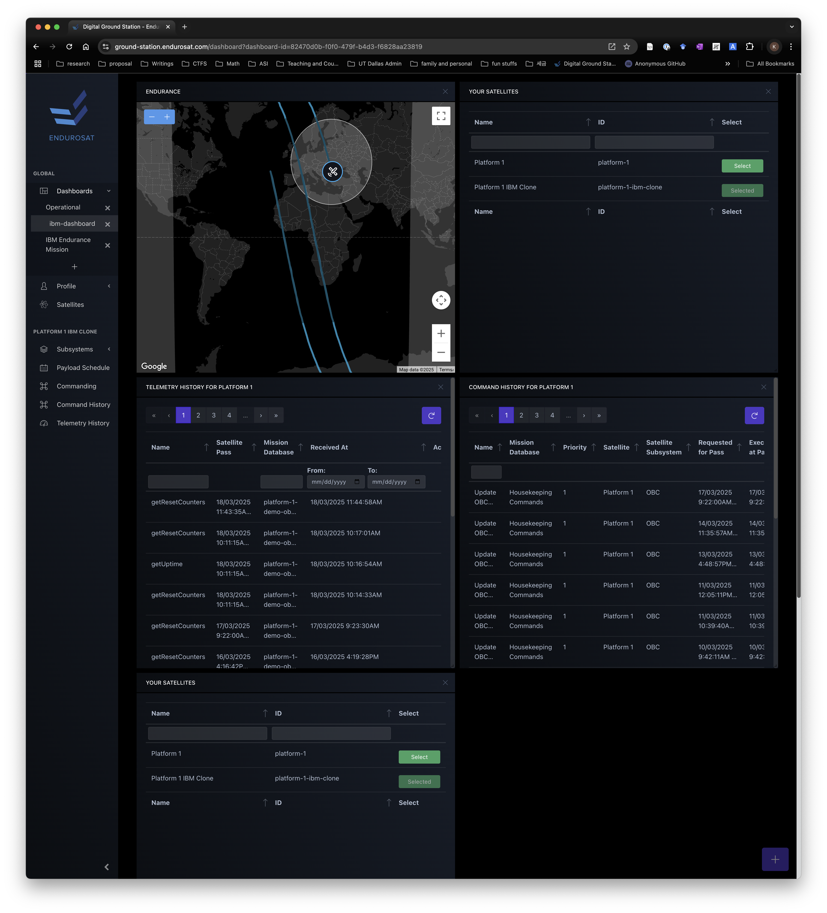
How My First Mission Crashed
Could not schedule and run the experiments
  Unstable communication, hard to schedule an experiment
  Time synchronization problem
No common bases for payload operations
  Ad-hoc implementation for per-mission basis
  Found many unreasonable design decisions
And many many more …

Slide 21
How My First Mission Crashed
Communication is very thin and unstable
  Return rate 10 % ~ 20 %
  High frequency band communication are sensitive and power greedy
    X-band communication not activated
Powers are very scarce
  Short charging time; insufficient battery capacity
  Need to budget wisely among: ADCS, communication, and payload operation
Difficult (almost impossible) maintenance operation
  OBC software mostly in-house and ecosystem is largely fragment
  Open-source solutions are too heavy-weighted or not well maintained
    E.g., NASA cFS

Slide 22
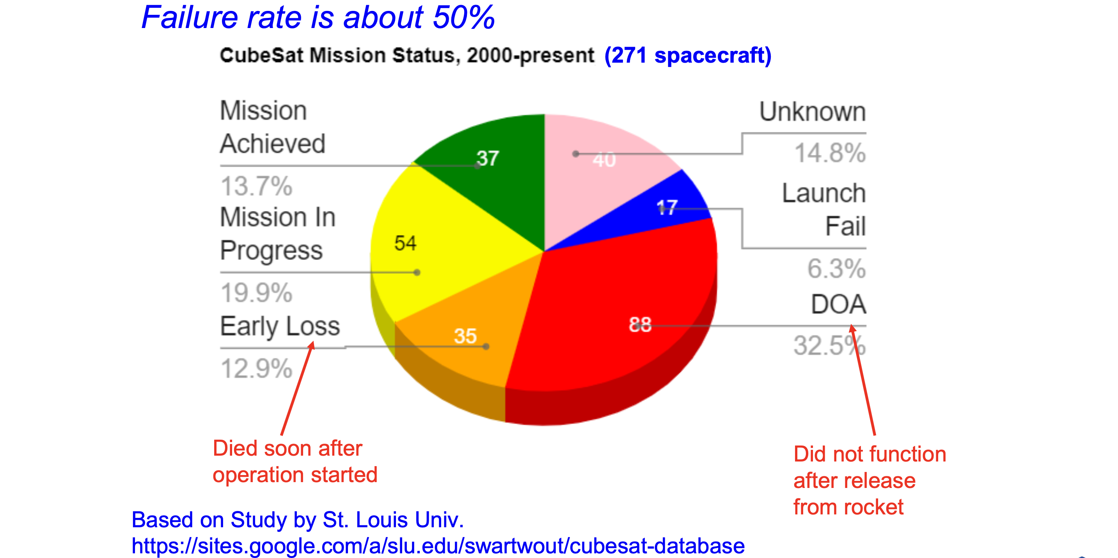
This is a Community Issue
Notes:
Kibo04-11

Slide 23
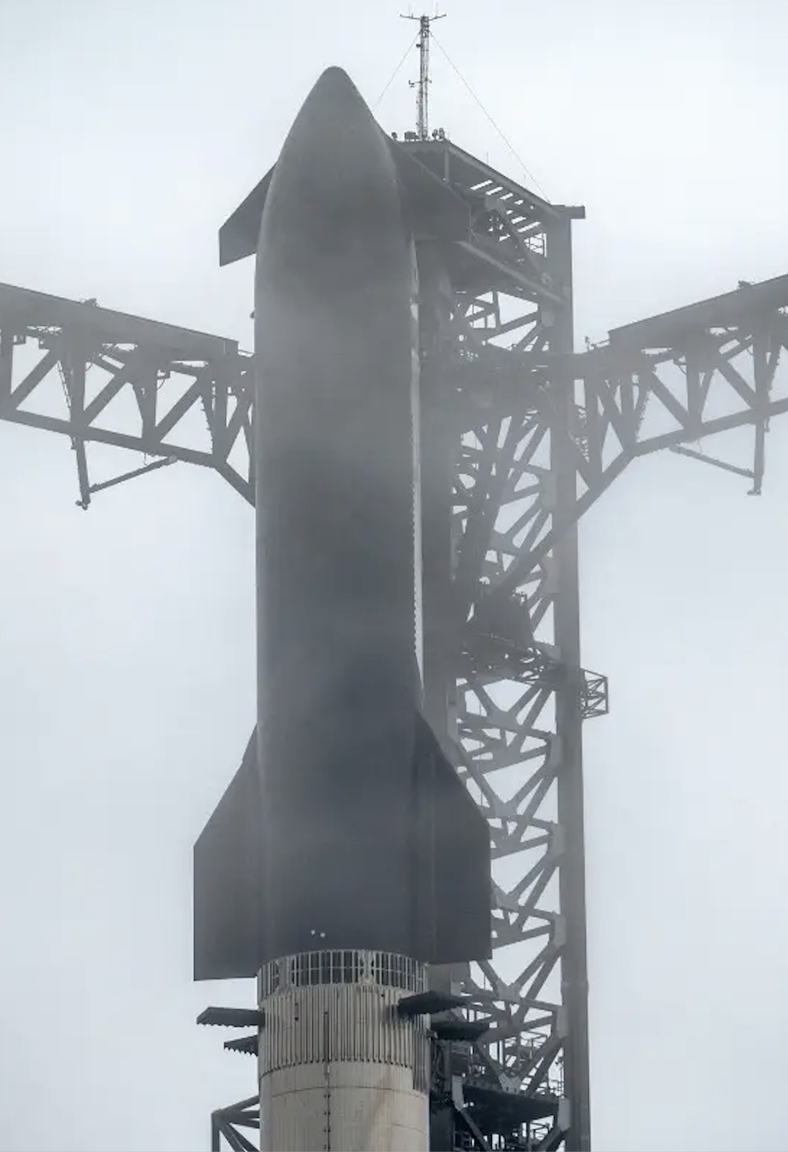
Space Research Opportunities
Launch cost dropped (and will drop) over time
COTS components and open-source software stacks
Unclear legal and regulatory guidelines
  Many recommendations but few enforcements
What will be the killer application for space
(or LEO)?

Slide 24
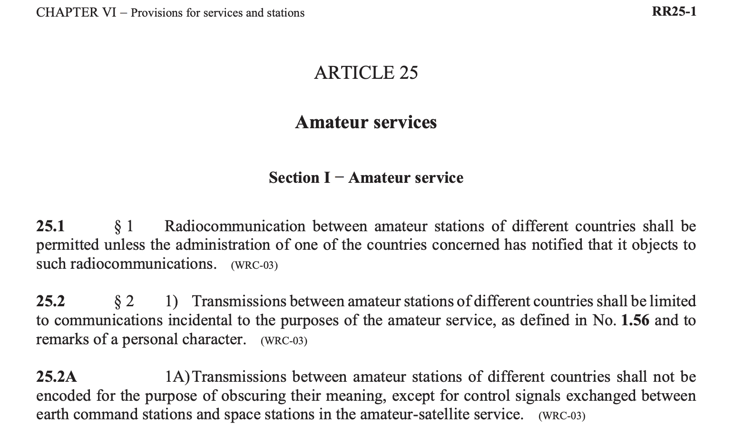
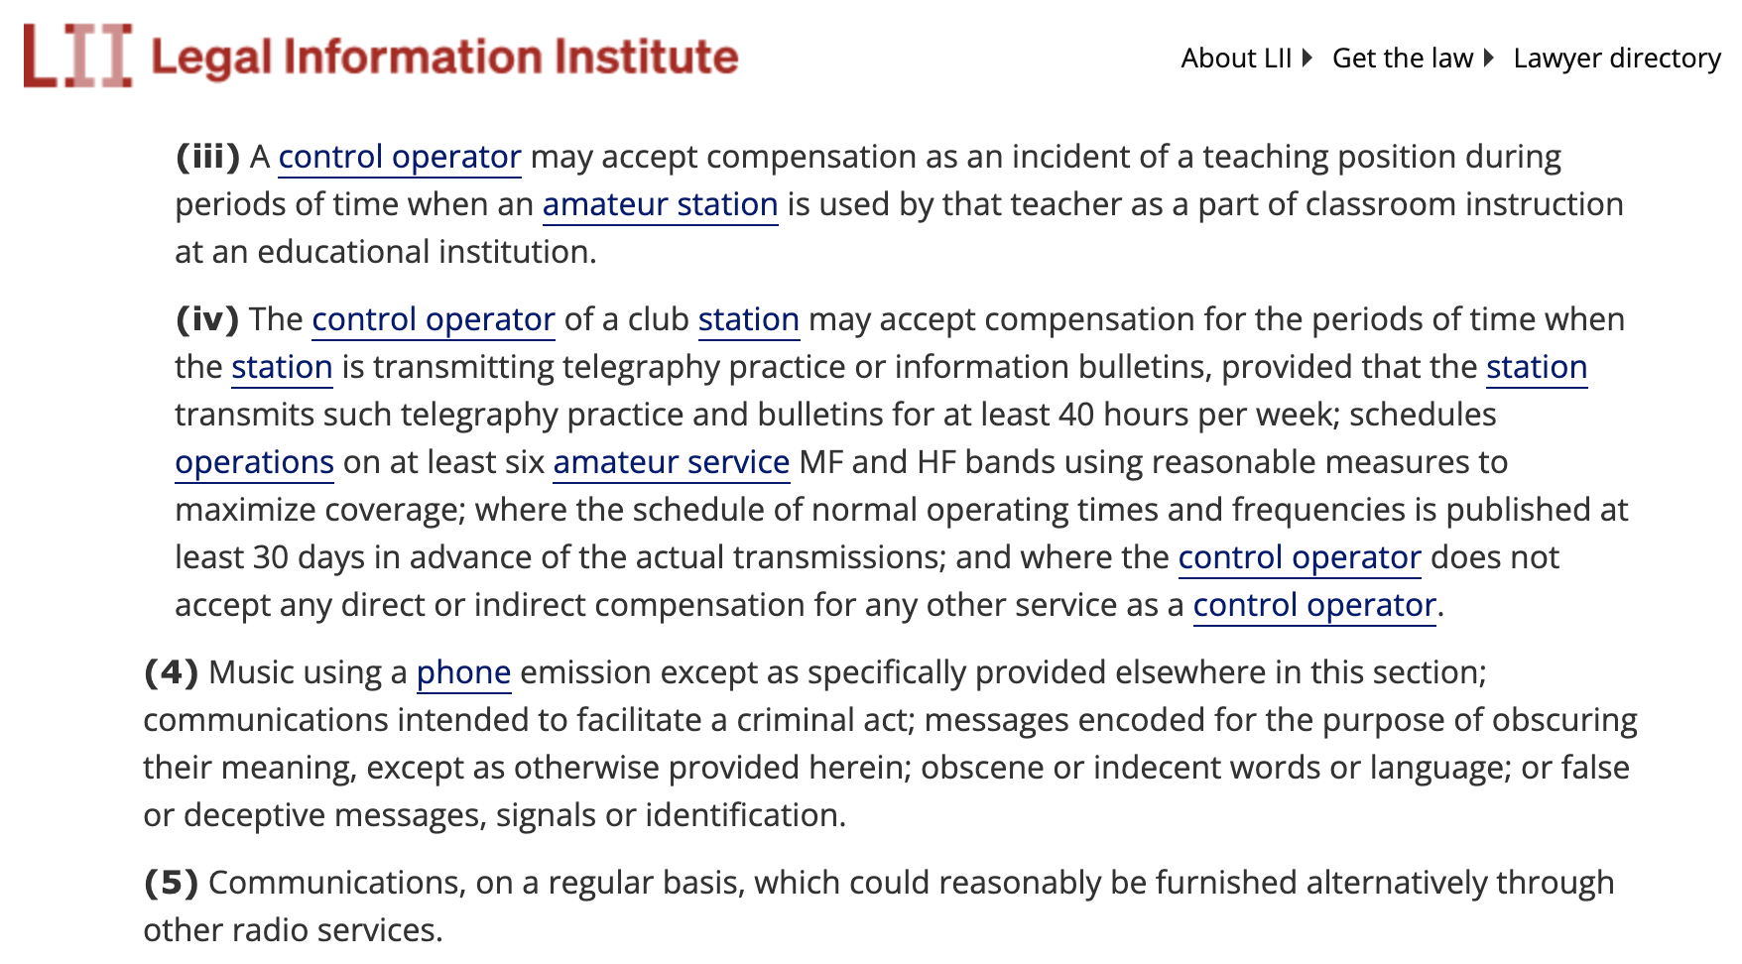
Two Research Ideas
Small Satellites Under Space Influence
  Small satellites built with COTS components + open-source software stacks
Security and privacy of RF communications for satellites using amateur bands
  Telemetry (downlink) and telecommands (uplink) communications cannot be obfuscated (or encrypted)
  Due to outdated assumptions on amateur band users
ITU-RR Article 25.2A (International Telecommunication Union Radio Regulations — binding worldwide)
FCC Part 97.113(a)(4) in the US

Slide 25
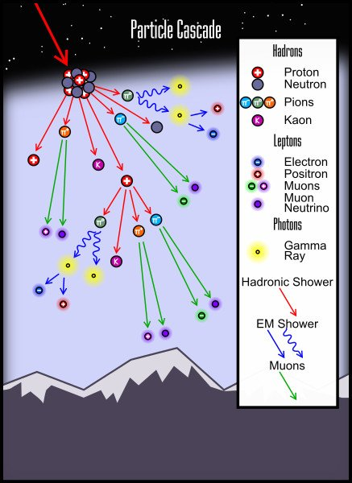
Small Satellites Under Space Influence
Confirm and verify our assumptions cyber/digital components
  DRAM?, SoC?, SD Cards?, HWRNG?
  Open-source software stacks
CubeSat model for cyber security research
  Running space software – e.g., NASA cFS framework
  Emulating space mission tasks
  End-to-end experiments and testing

Slide 26
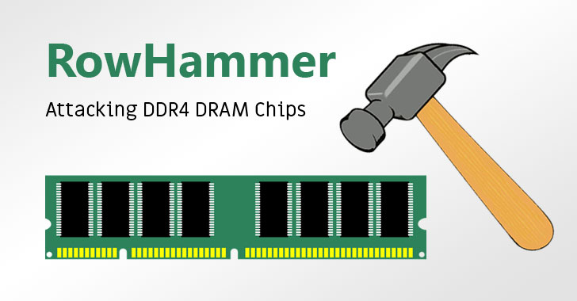
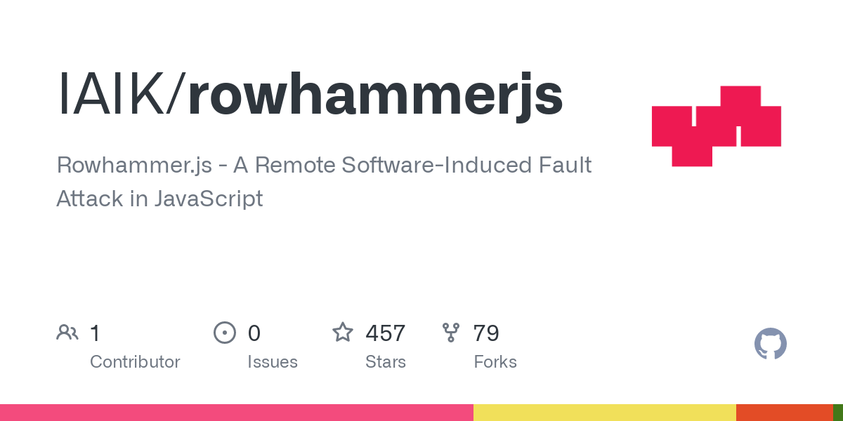
RowHammer Attack
First proposed by researchers in 2014
  Kim et al. ICSA 2014
One of prominent HW attack vectors
  Spectre, MeltDown and RowHammer
Google Project Zero actualized the attack 2015
  Gain kernel privileges
  Hypervisor escape
Created high-severity practical threats
  Javascript level attack from the browser
  Mobile phone take over
  ….

Slide 27
Robustness and Stability of COTS Components
Evolving space practice
  Based on heritage components + COTS components
  Based on COTS components + specially-designed/mission-specific devices
Security-sensitive CPU features need to e tested
  HWRNG: Hardware Random Number Generators
  Crypto co-processors
  CPU performance counters

Slide 28
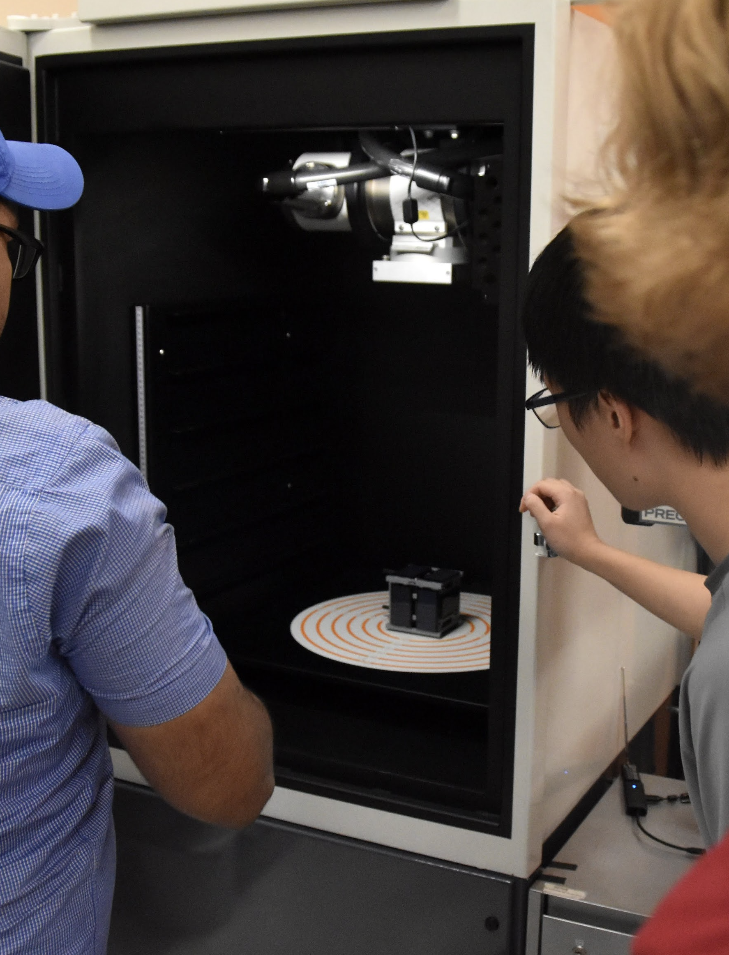
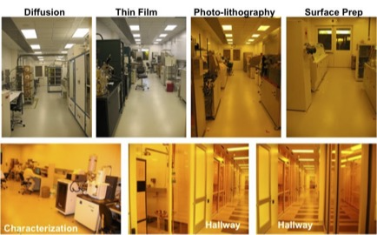
Small Satellites Under Space Influence
Space RQs
  Q1: How can we emulate space influences?
  Q2: What components would break first?
    What would be the recipe to impact certain components?
    What would be the recipe to trigger software errors (e.g., bitflips, SEU) while not taking permanent damages to the HW components
What would be distribution of the software errors?
  Are space software are designed and written to be resilient against such errors?

Slide 29
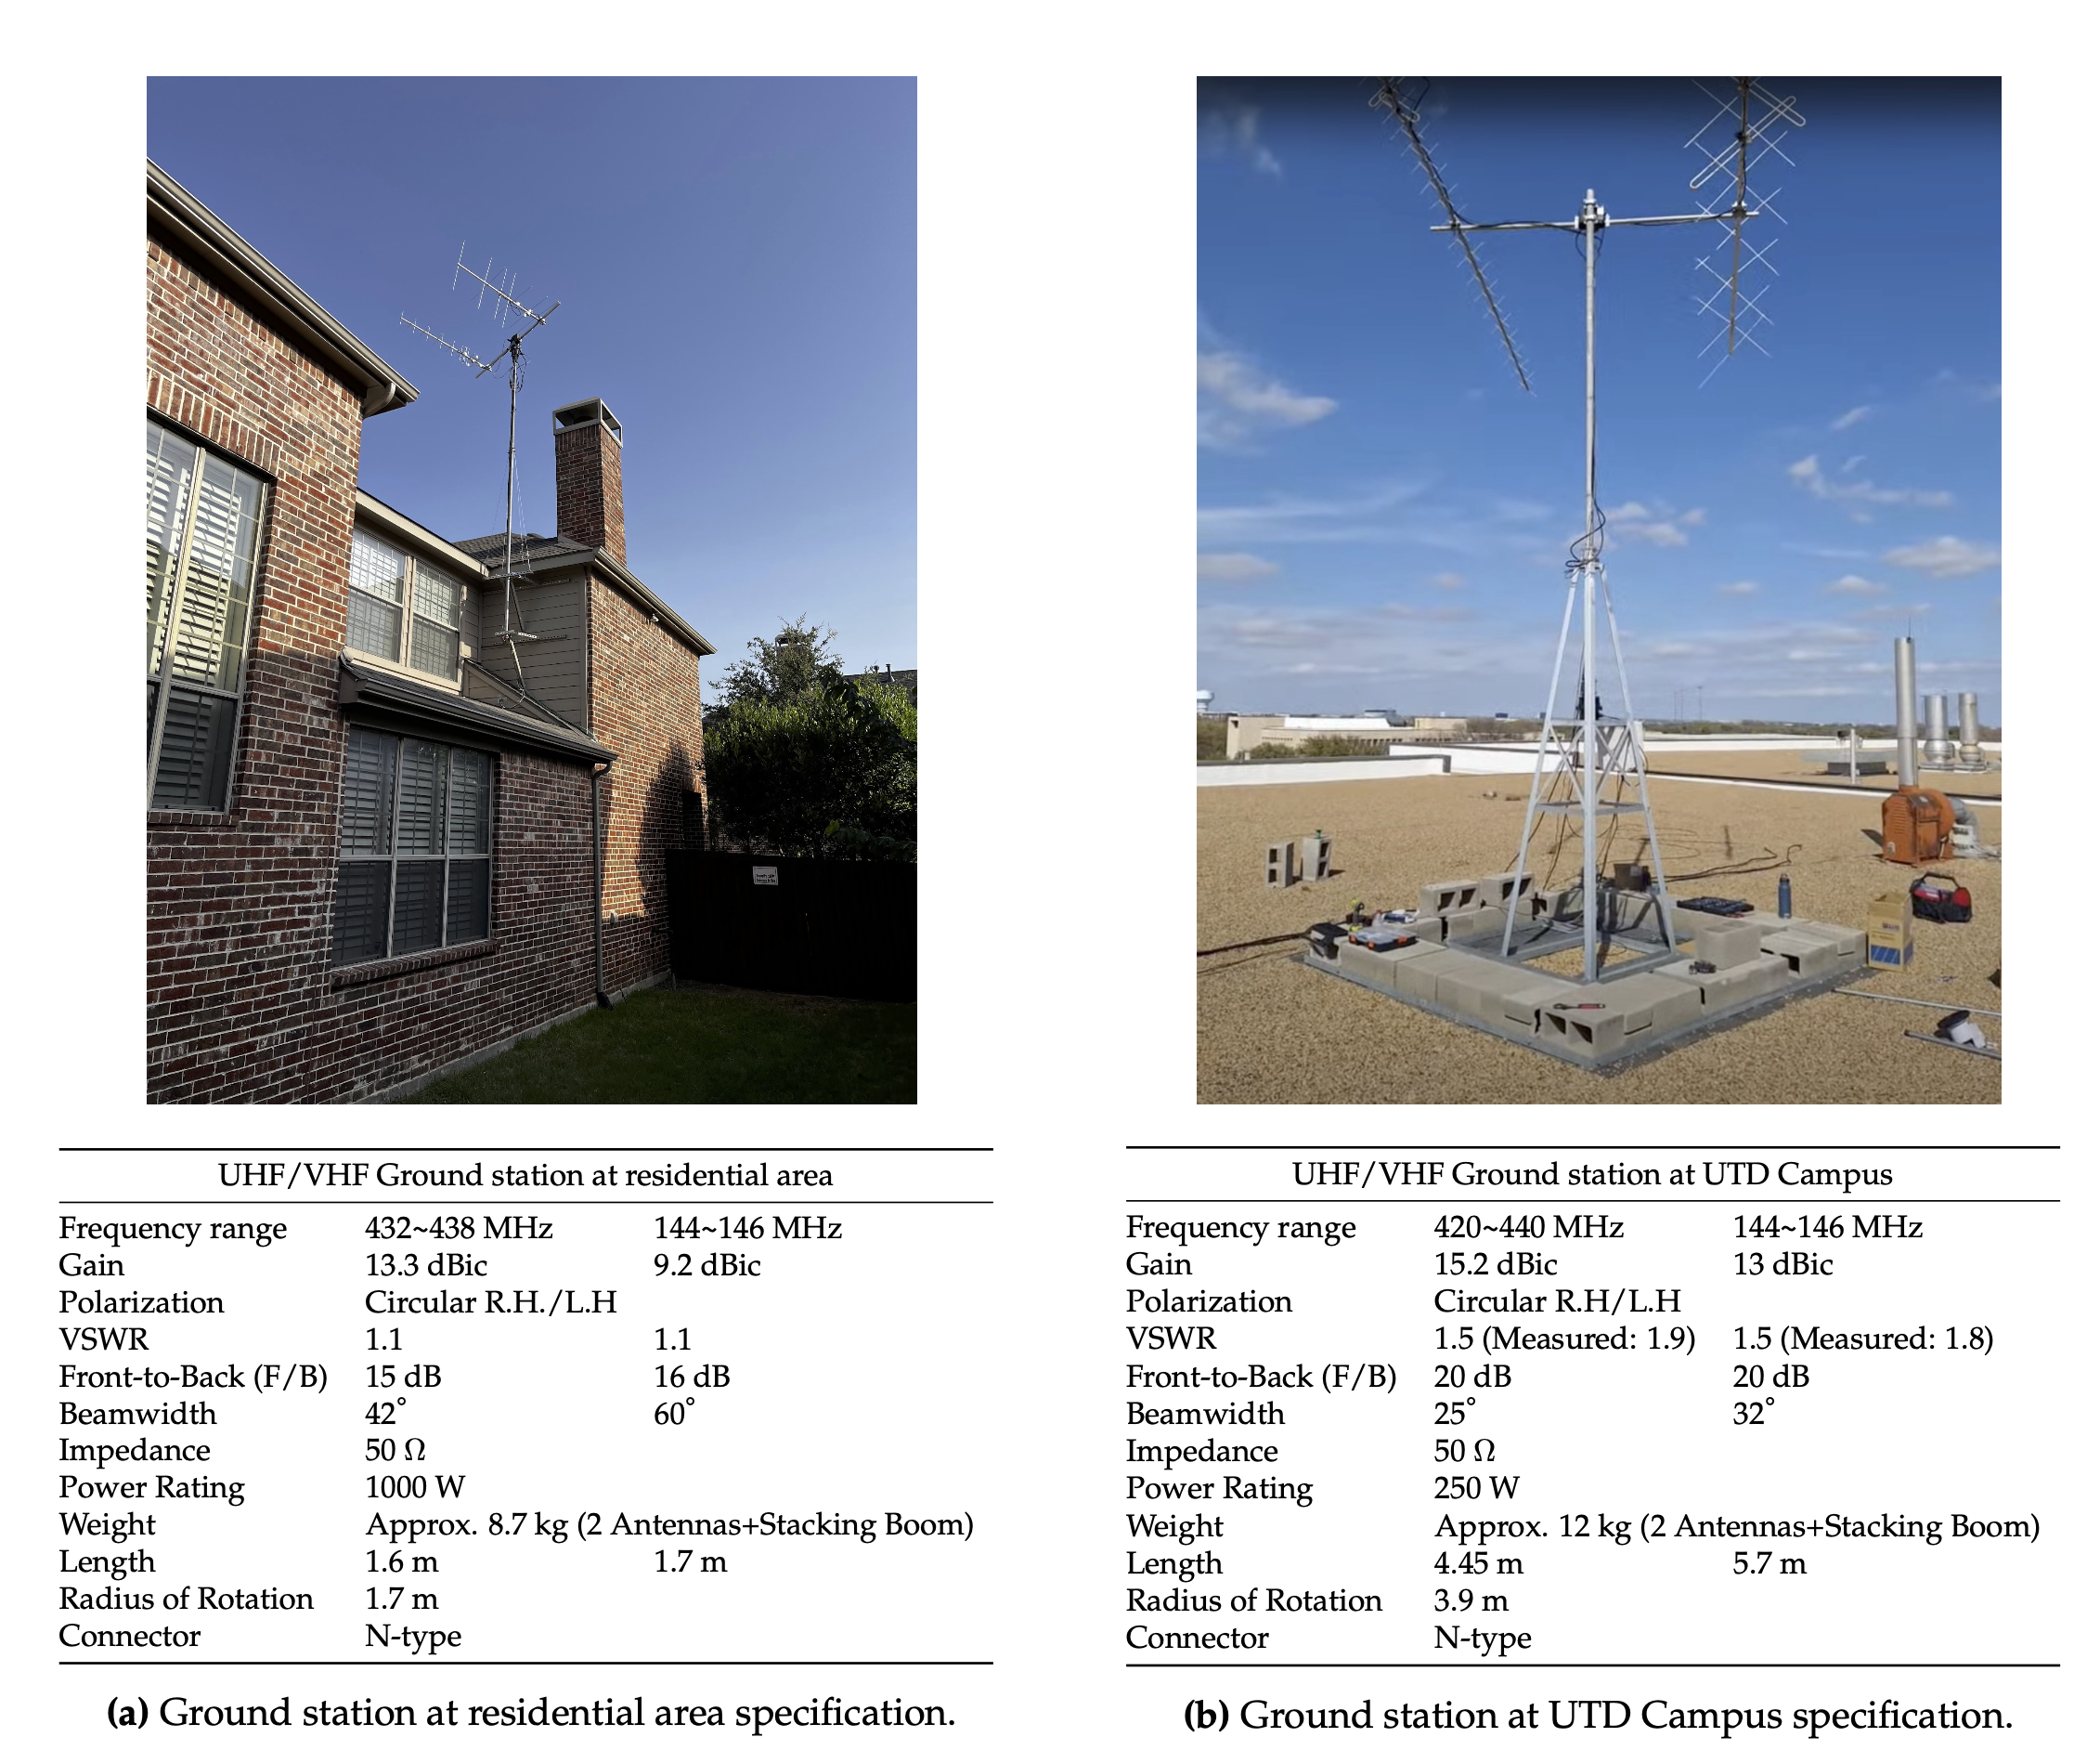
Satellite Communication
UTD Ground stations
  Operational and participating crowdsourcing ground station network
Collecting downlink RF signals in Amateur bands aiming to
  Improving demodulation performance
  Decode/understand satellite telemetry items
Notes:
https://network.satnogs.org/stations/3671/
https://network.satnogs.org/observations/9999114/

Slide 30
Satellite Communication
RF communications
  De facto route open to user and the attacker
  Channel between ground station and spacecraft
Private bands are expensive and limited
  Public frequencies reserved for amateurs and research groups
  Cannot obfuscate (or encrypt) the traffic by regulation
May contain information (telemetry) critical for satellite operations
Notes:
https://network.satnogs.org/stations/3671/
https://network.satnogs.org/observations/9999114/

Slide 31
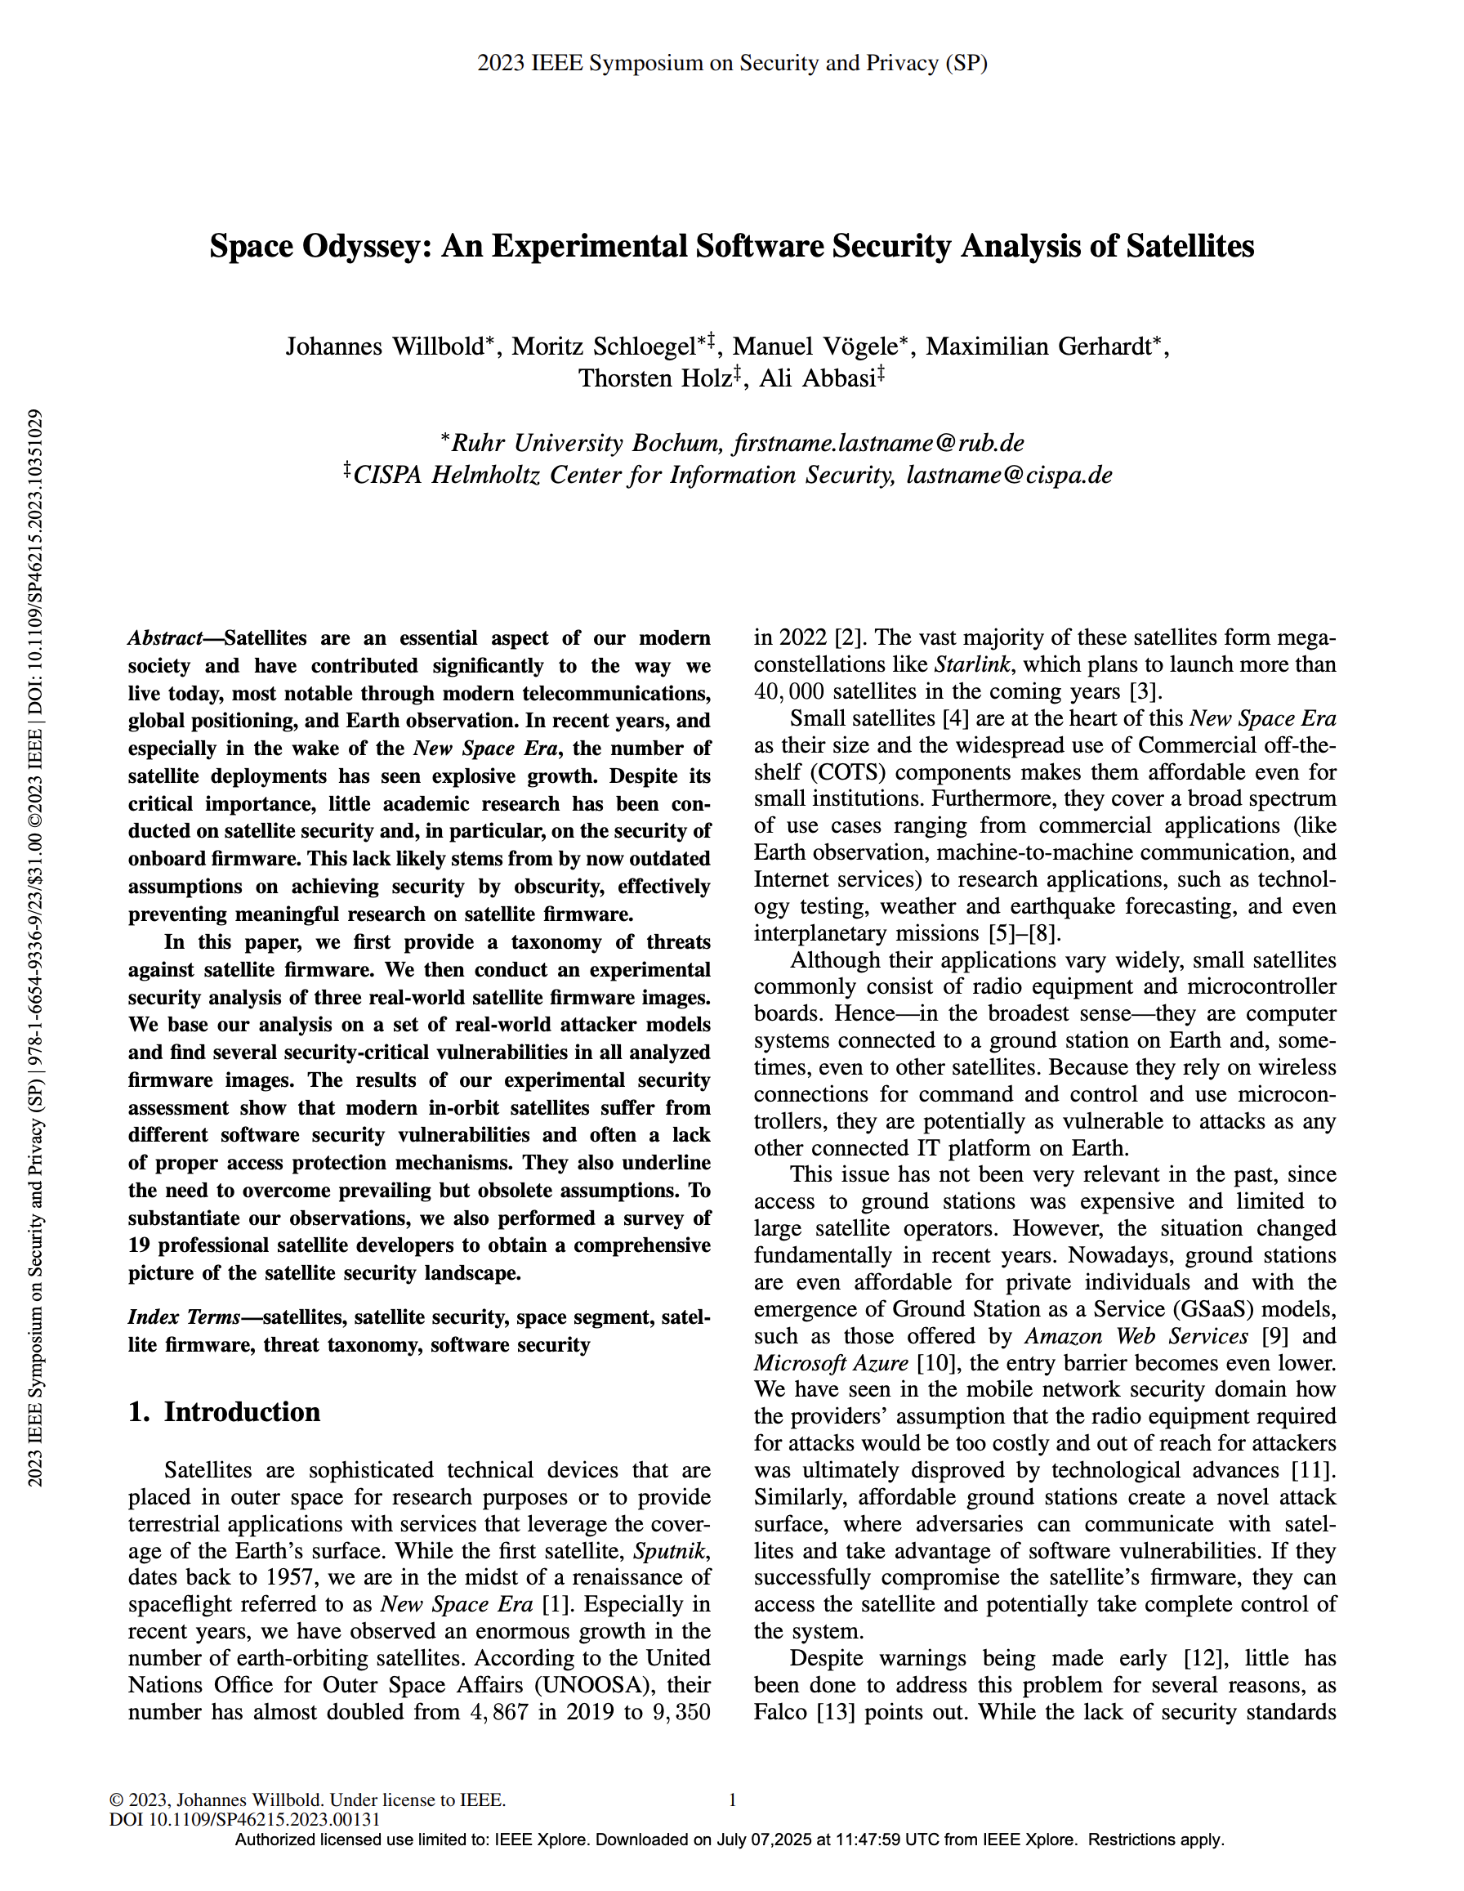
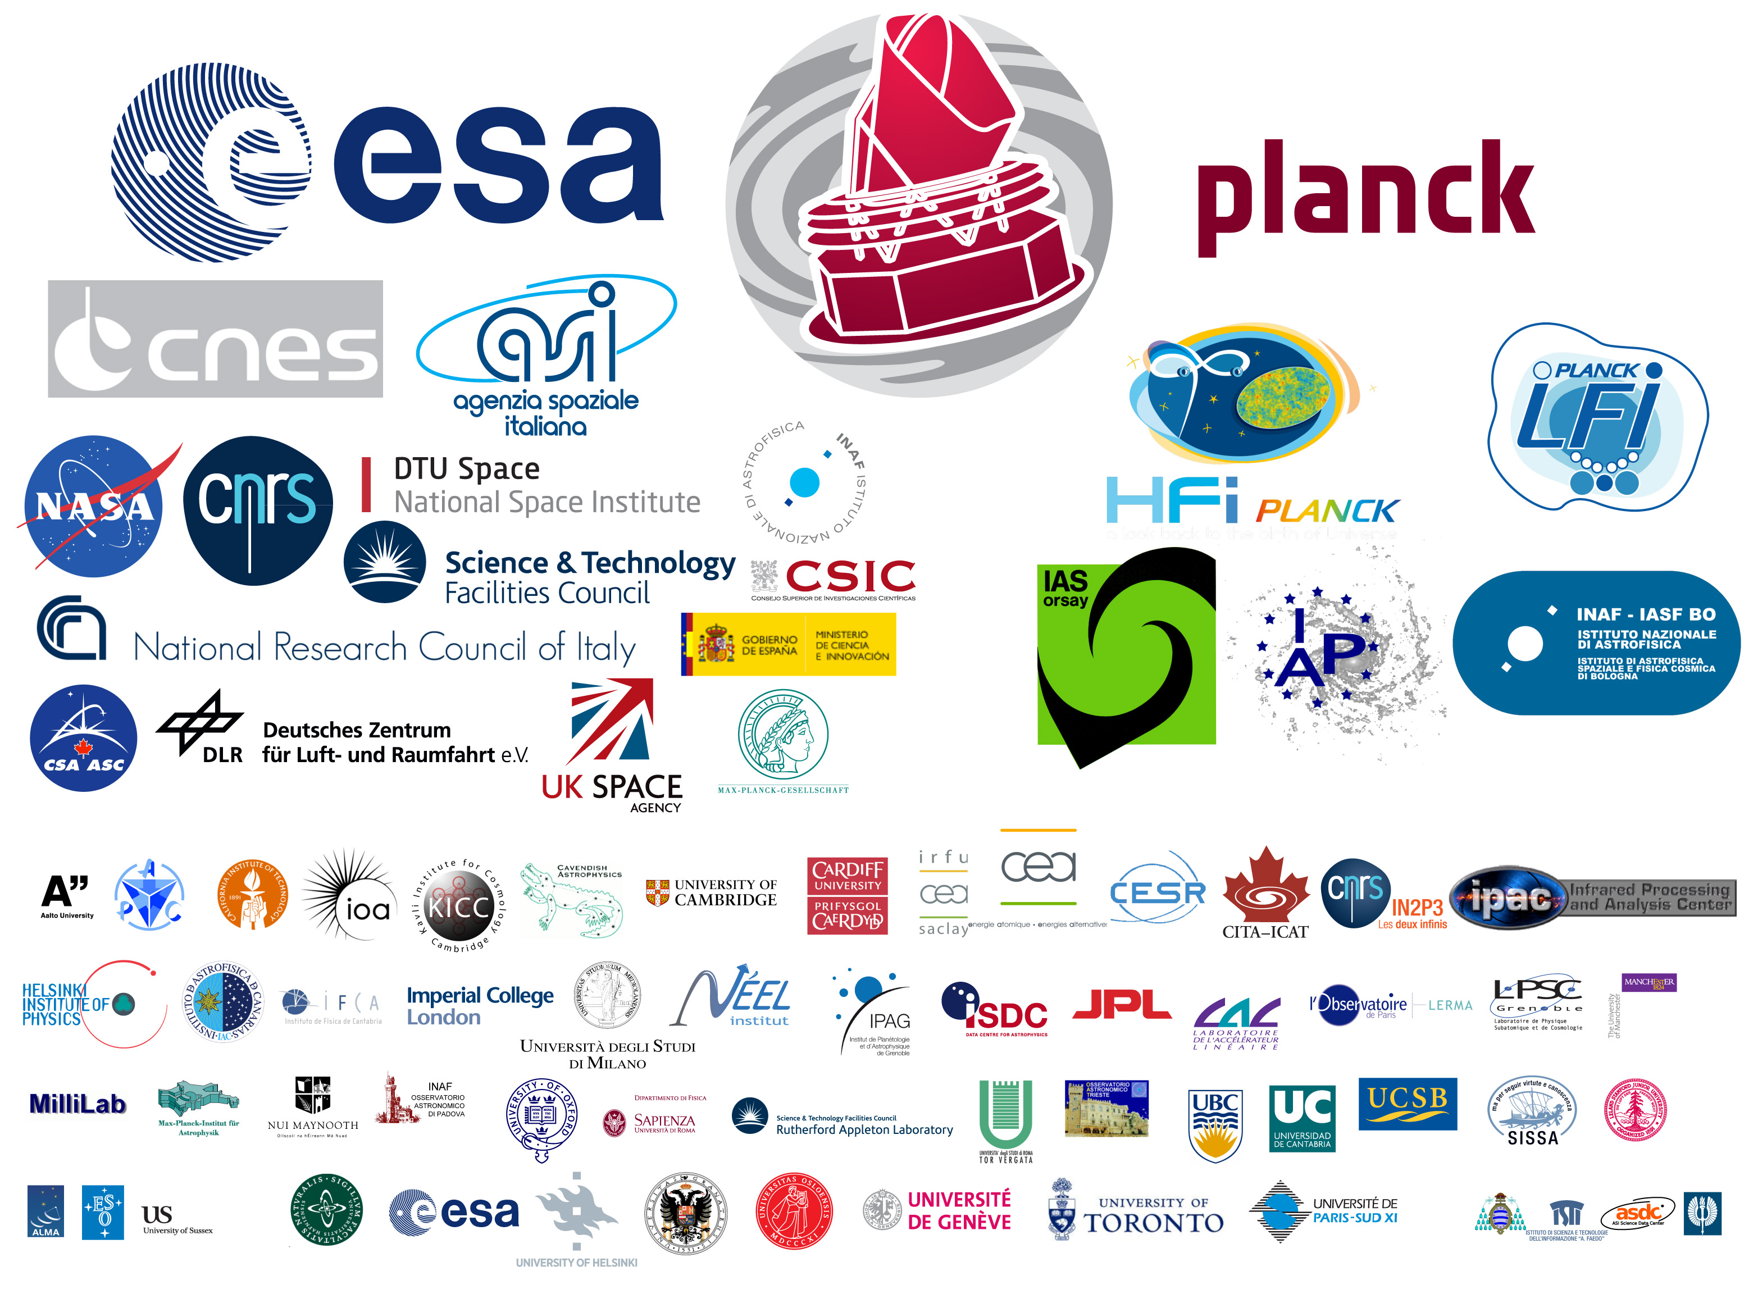
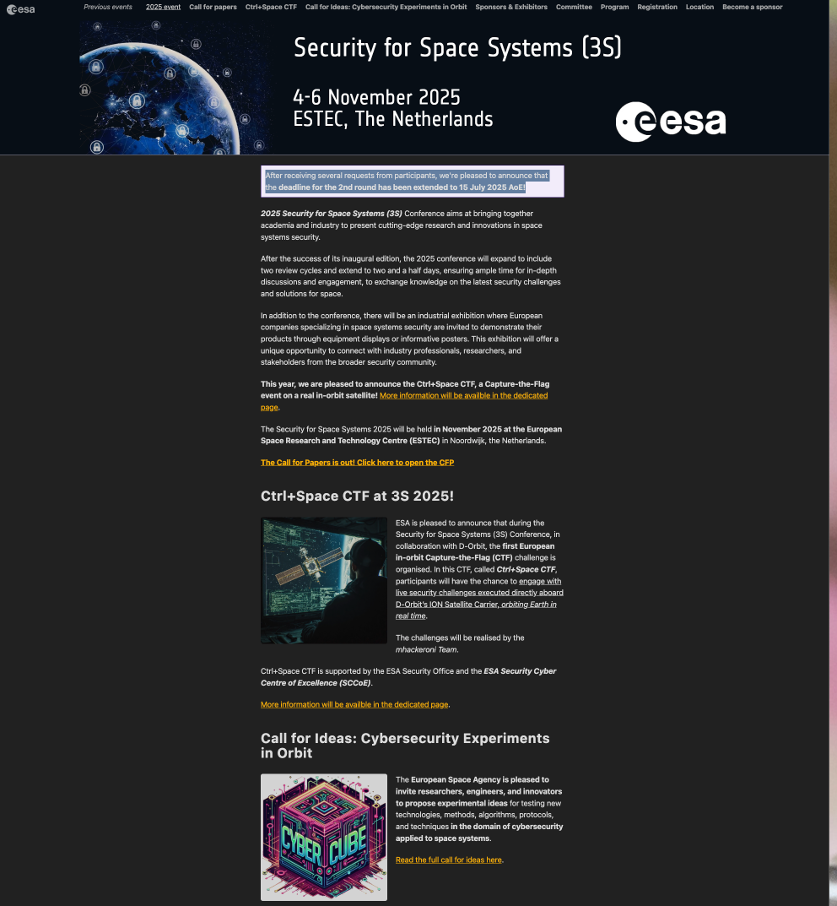
Small Satellite + Cybersecurity
European Space Agency (ESA) is actively engaging in cybersecurity
  Compared to NASA

Slide 32
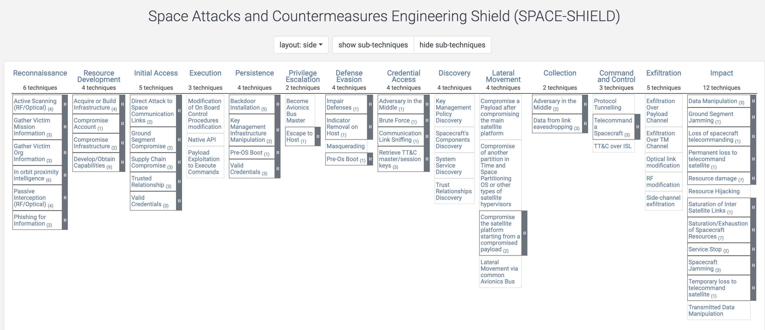
Space Attack Vectors (SPACE-SHIELD)
https://spaceshield.esa.int/
Notes:
https://sparta.aerospace.org/

Slide 33
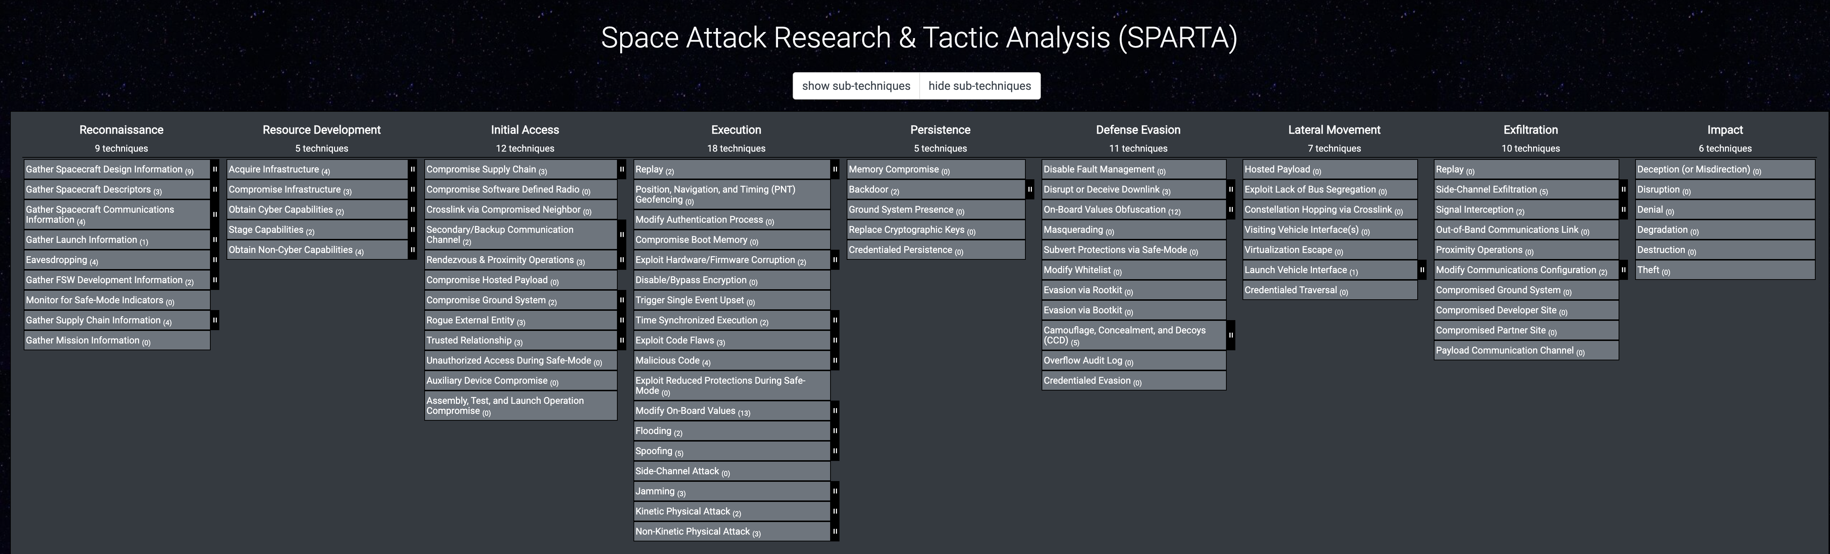
Space Attack Research and Tactic Analysis (SPARTA)
https://sparta.aerospace.org/

Slide 34


Space Security In Action

Slide 35
Research Objectives
New space era, new operational practices
  Widespread use of COTS components and open-source software stacks.
  Are these systems secure and resilient against space-related challenges?
RF communication as a critical attack surface
  RF communication is vital for spacecraft operations.
  However, its security and safety remain insufficiently verified.
Testbed environment for small satellite research
  UTD’s ongoing efforts focus on building expertise and establishing a comprehensive space testbed environment.

Slide 36
Thoughts on Space Threat Modeling
Bridging aerospace and cyber communities
  Difficult in U.S.: cultural reasons, security clearances
Highly inter-disciplinary research
  Collaborative effort is must
Different views to see the research problems
  Like old days of computing
    Micro computers vs. mainframe
    Early days of Internet
Can’t think of killer-applications

Slide 37
Conclusion
Space is expanding
  Rapidly dropping launch cost, shrinking technology
  Increasing privatization of space activities
Gap between aerospace and cyber security sectors
  Aerospace remains cautious in adopting new technologies
The UTD team’s commitment to space and security research
  Development of the IBM Endurance CubeSat.
  Establishment of UHF/VHF ground stations.
  NSF-supported small satellite workshop.

Slide 38
Backup

Slide 39
Small Satellite Workshop
Three-day program with 19 participants
  17 UTD students from diverse backgrounds
  2 graduate students from KAIST
  University press release
  Workshop website
Supported by NSF (#2321117)
  “CyberTraining:Pilot:CyberTraining for Space CI in Low Earth Orbit (LEO)”
Interdisciplinary effort
  Cybersecurity, material science, computational algorithm

Slide 40


Day 1 Schedule
Student group
  6 groups 3 ~ 4 students per group
Basic concept intro
Start hands-on building

Slide 41



Day 2 Schedule
Guest lecture: Jessica Thompson, US Space Force
Finish building CubeSatSim
  Conduct lab challenges
Session on
  Satellite software systems
  RF communication

Slide 42



Day 3 Schedule
Different location NSERL @ ROW building
Physical and structural considerations
Session environmental influences on spacecraft
  E.g., temperature variation, excessive radio exposures
Session on space debris and de-orbiting mechanisms

Slide 43
Participants
Student demographics
Two International participants!
Program | Female | Male | Sum
Biomedical engineering | 1 |  | 1
BS Mechanical Engineering, MS Systems Engineering & Management | 1 |  | 1
Computer Engineering | 1 |  | 1
Computer Science | 1 | 9 | 10
Electrical Engineering |  | 1 | 1
Materials Science and Engineering |  | 2 | 2
Physics |  | 1 | 1
Software Engineering |  | 1 | 1
Telecommunication Engineering | 1 |  | 1
Total | 5 | 12 | 19
Program | Bachelor | Master | Ph.D. | Sum
Biomedical engineering | 1 |  |  | 1
BS Mechanical Engineering, MS Systems Engineering & Management |  | 1 |  | 1
Computer Engineering | 1 |  |  | 1
Computer Science | 5 | 4 | 1 | 8
Electrical Engineering |  |  | 1 | 1
Materials Science and Engineering |  | 1 | 1 | 2
Physics |  |  | 1 | 1
Software Engineering | 1 |  |  | 1
Telecommunication Engineering |  |  | 1 | 1
Grand Total | 8 | 6 | 5 | 19

Slide 44



Small Satellite Workshop
Notes:
https://photos.app.goo.gl/oMKwqfvbT2cD2wtf7

Slide 45
Workshop Outcomes and Plan
Resources and infrastructures
  CubeSat Model
    Extending AMSAT’s CubeSatSim
  Research and education/training infrastructure
    UHF/VHF Ground stations
    X-ray radiation chamber
  Education/Training materials
Future plan
  Annual space security workshop
  Course design
  Community outreaches

Slide 46
Research Problems
Proper testbed environment*
  In-orbit (preferred) or terrestrial
  Small satellites/CubeSats are toys
Conferences/Workshop support
  Between cyber and aerospace communities
  Strict requirements for citizenship and security clearance
Access to space computing devices and testing environment
  Legacy software and hardware components
  Radiation testing environment

