Slide 1
Small Satellite and LEO Introduction
Small Satellite Workshop 2026

Slide 2
Resources and Disclaimer
The workshop material we be heavily based on external resources of the followings
State of the Art Small Satellite by NASA
CubeSat 1-0-1 by NASA
KiboCUBE Academy
Resource page
  https://satworkshop26.syssec.org/resources
Notes:
https://codimd.syssec.org/s/3B6Ef3-Wf
TODO: we may want to move this to the earlier part of the slide.

Slide 3
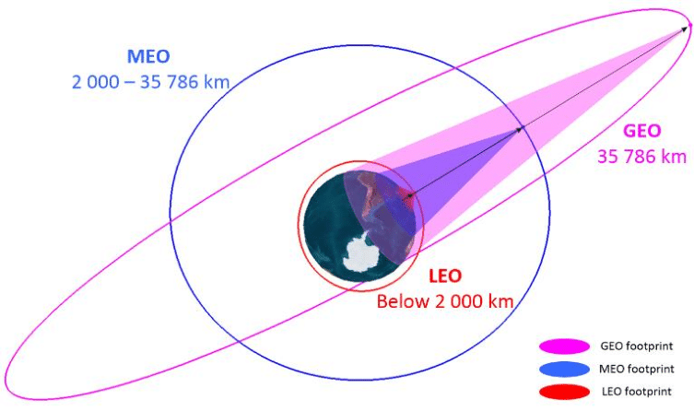
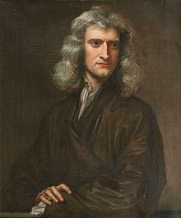
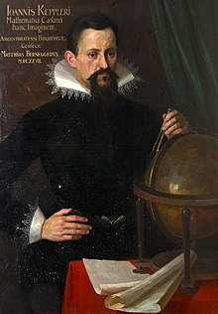
What is Satellite?
How can it circle around the Earth?
  Basic Physics
  Balance between gravity and velocity
    The closer to earth, faster the velocity
    Vice versa
GEO satellites
  Geo-stationary Earth Orbit
  A circle per day
LEO satellites
  Low Earth Orbit
  A circle per 90 ~ 120 min
    Eclipses every 45 mins ~ 1 hour
Isaac Newton, image: Wikipedia
Johannes Kepler, image: Wikipedia
Notes:
https://www.researchgate.net/figure/GEO-MEO-and-LEO-orbits_fig5_363595939

Slide 4
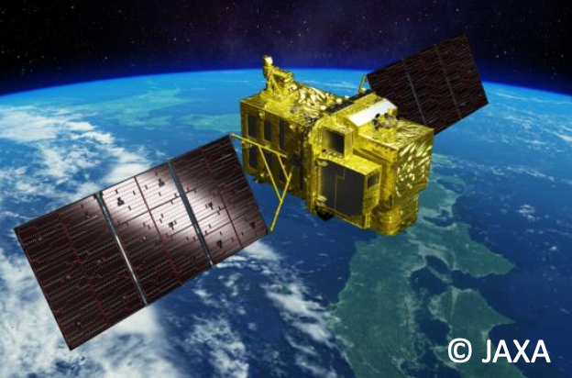
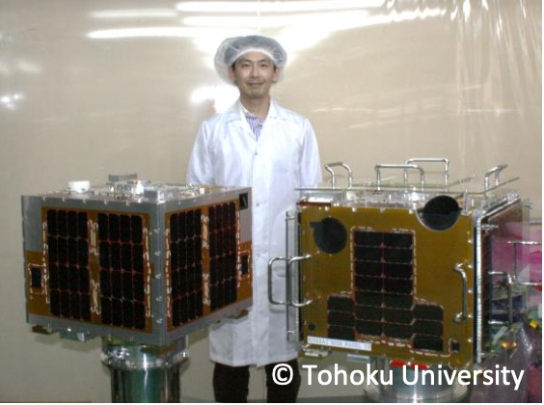
Spacecrafts
Large satellite
Small satellite
Large mass
High cost
Long development time
Dedicated launch
Need high-reliability, low-risk
High-performance, low observation frequency
Small mass
Low cost
Short development time
Small mass = Frequent launch opportunities
Low cost
  Can try challenging missions, realize large
Constellations/networks
  Frequent Observations
Rapid Development
  Can utilize brand new technologies
Suitable platform for space education and rapid technology demonstration
Notes:
KIBO01_

Slide 5
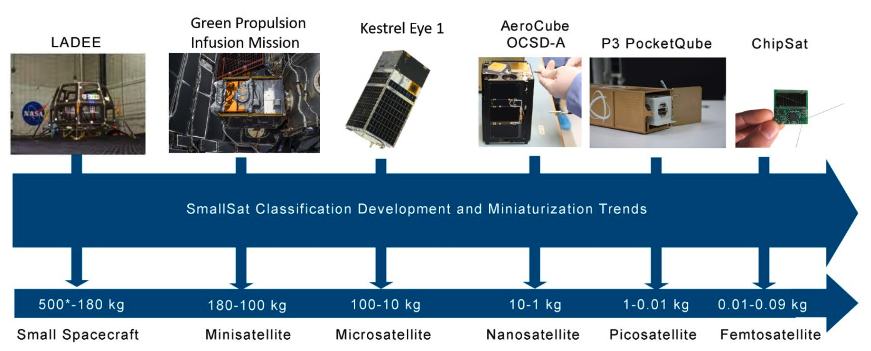
Small satellites
CubeSat
Image: State-of-the-Art small satellite technology @ NASA
Notes:
TODO: elaborate more no this slide

Slide 6
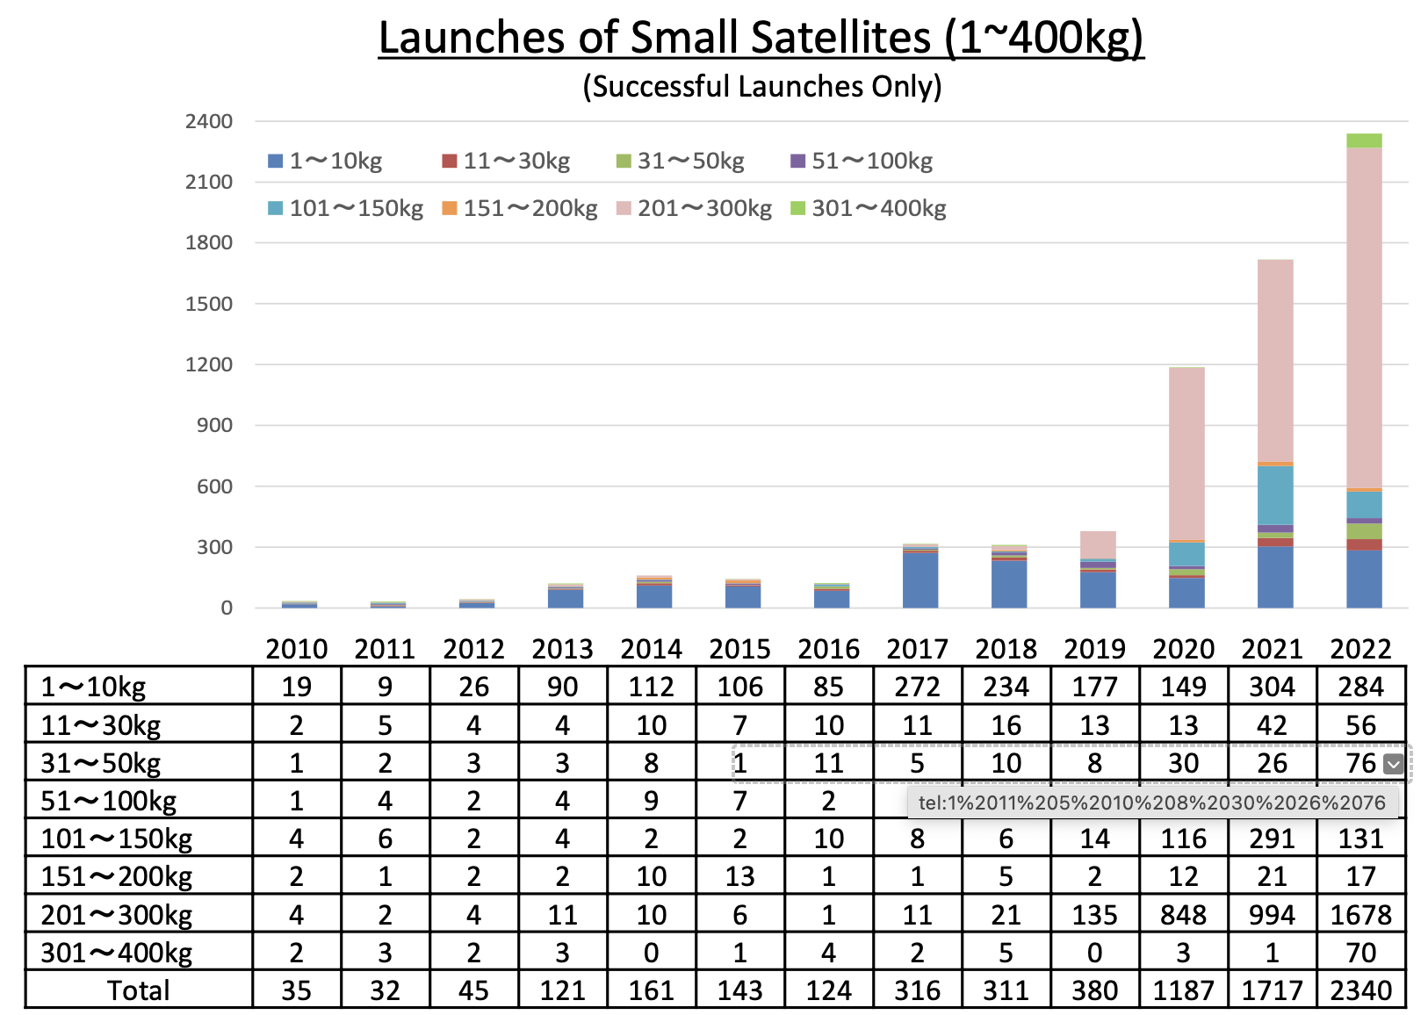
Small Satellites on the Rise
The number of small satellites smaller than 400kg, including mega-constellations, is rapidly increasing.
Large portion of them are mega-constellation of communication satellites
Substantial increase in research, small/medium business engagements

Slide 7
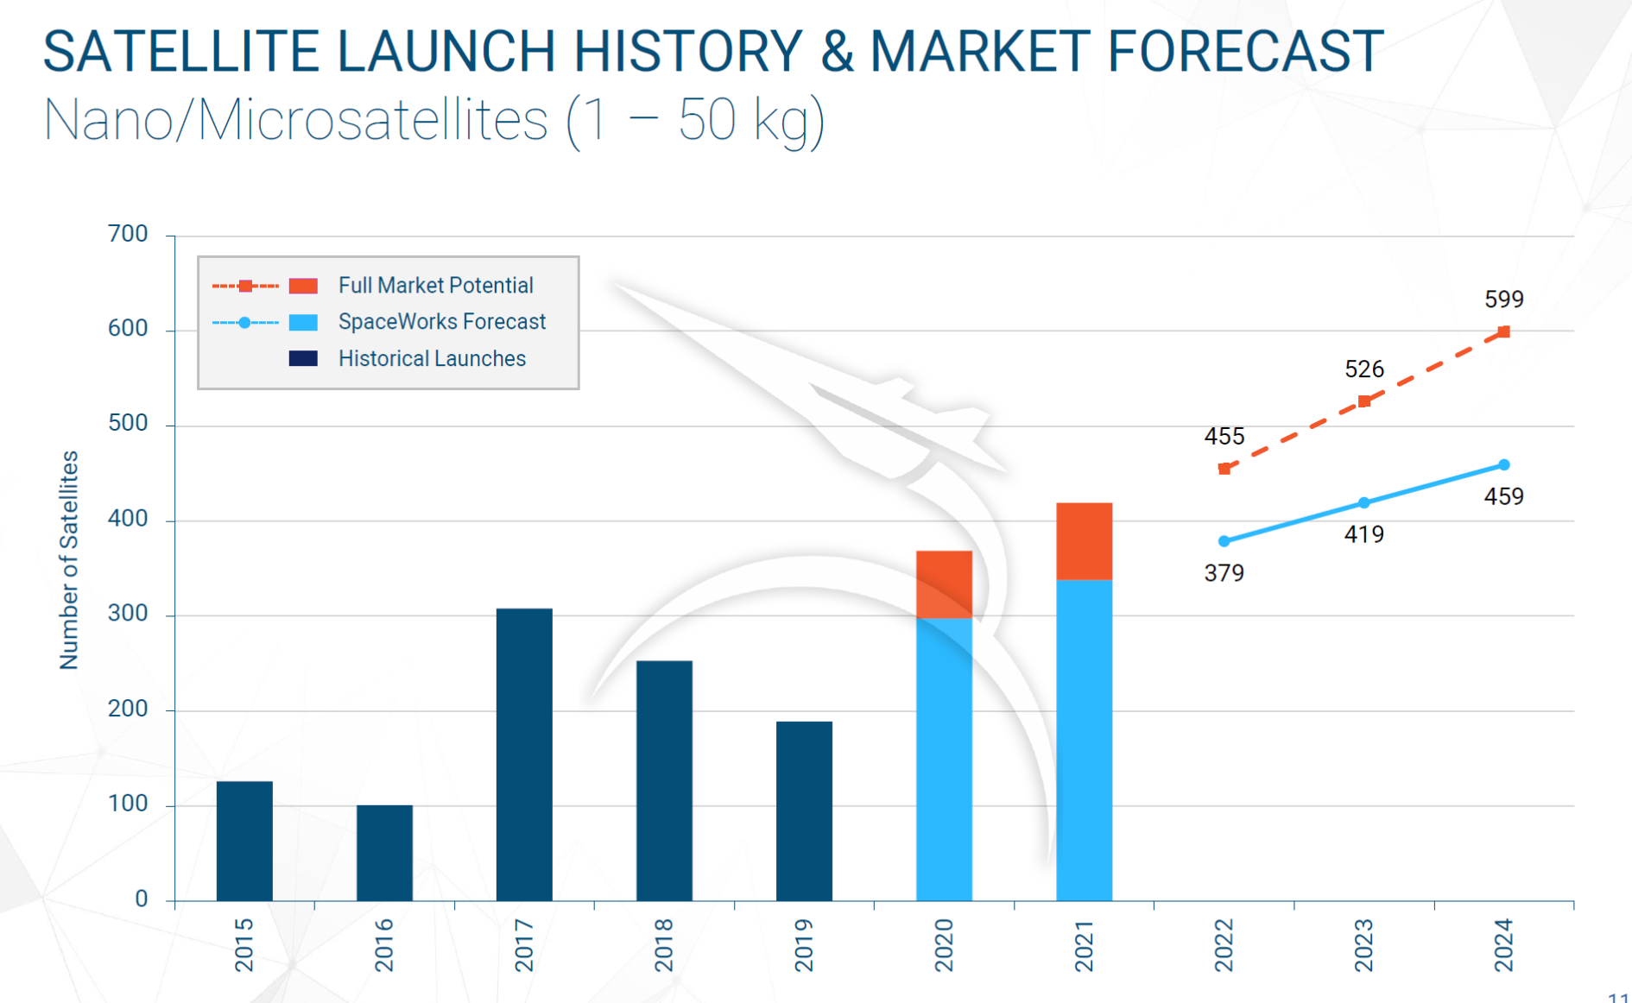
Small satellite Launches
Image: SpaceWorks

Slide 8
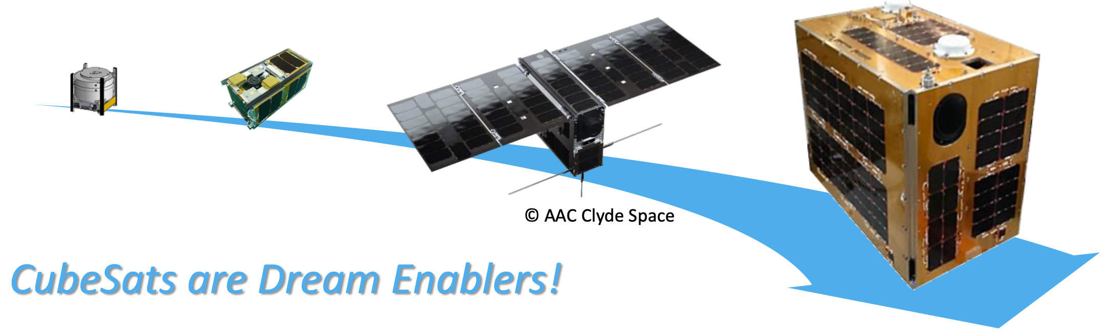
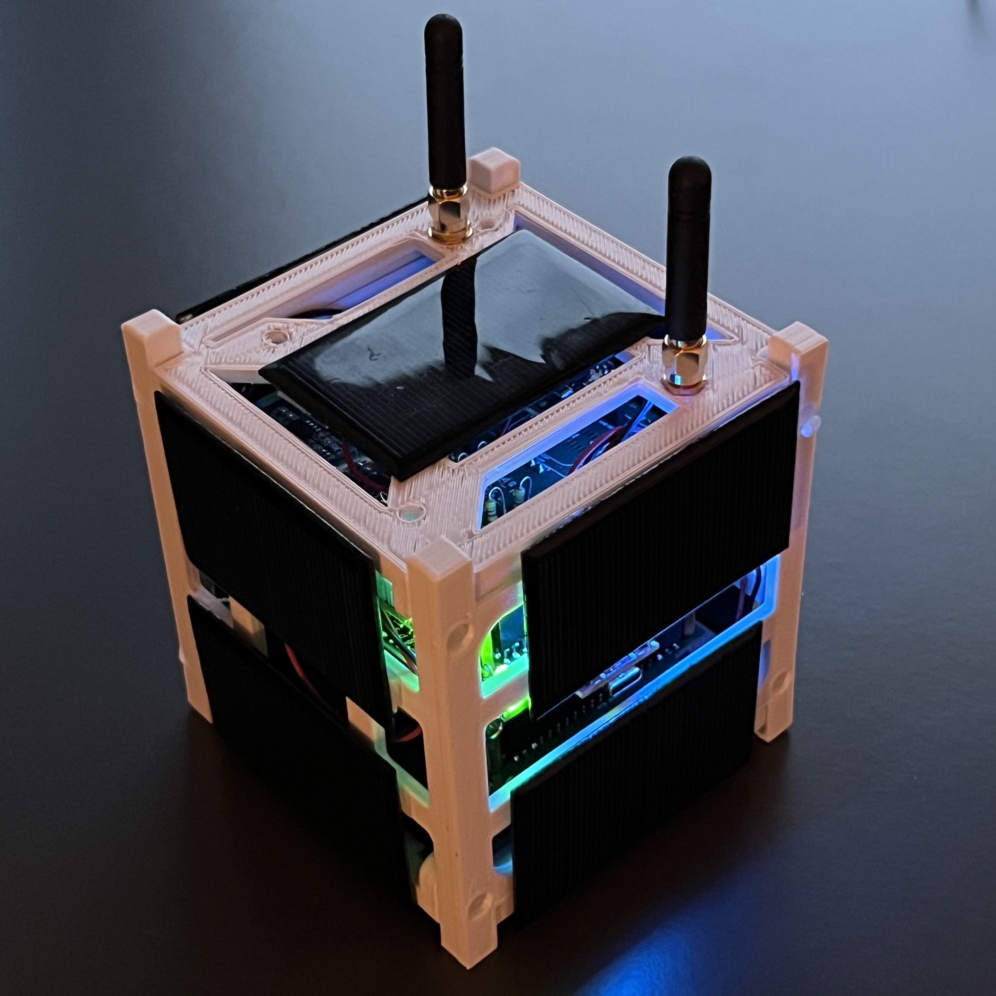
Small Satellite Opportunities
“Start small, go big!”
CubeSats have become a major game-changer
  No longer for education only, but for actual space exploration
  Achievements obtained from CubeSats can be applied to advanced missions.
Even 1U CubeSats bring everything within your reach!

Slide 9
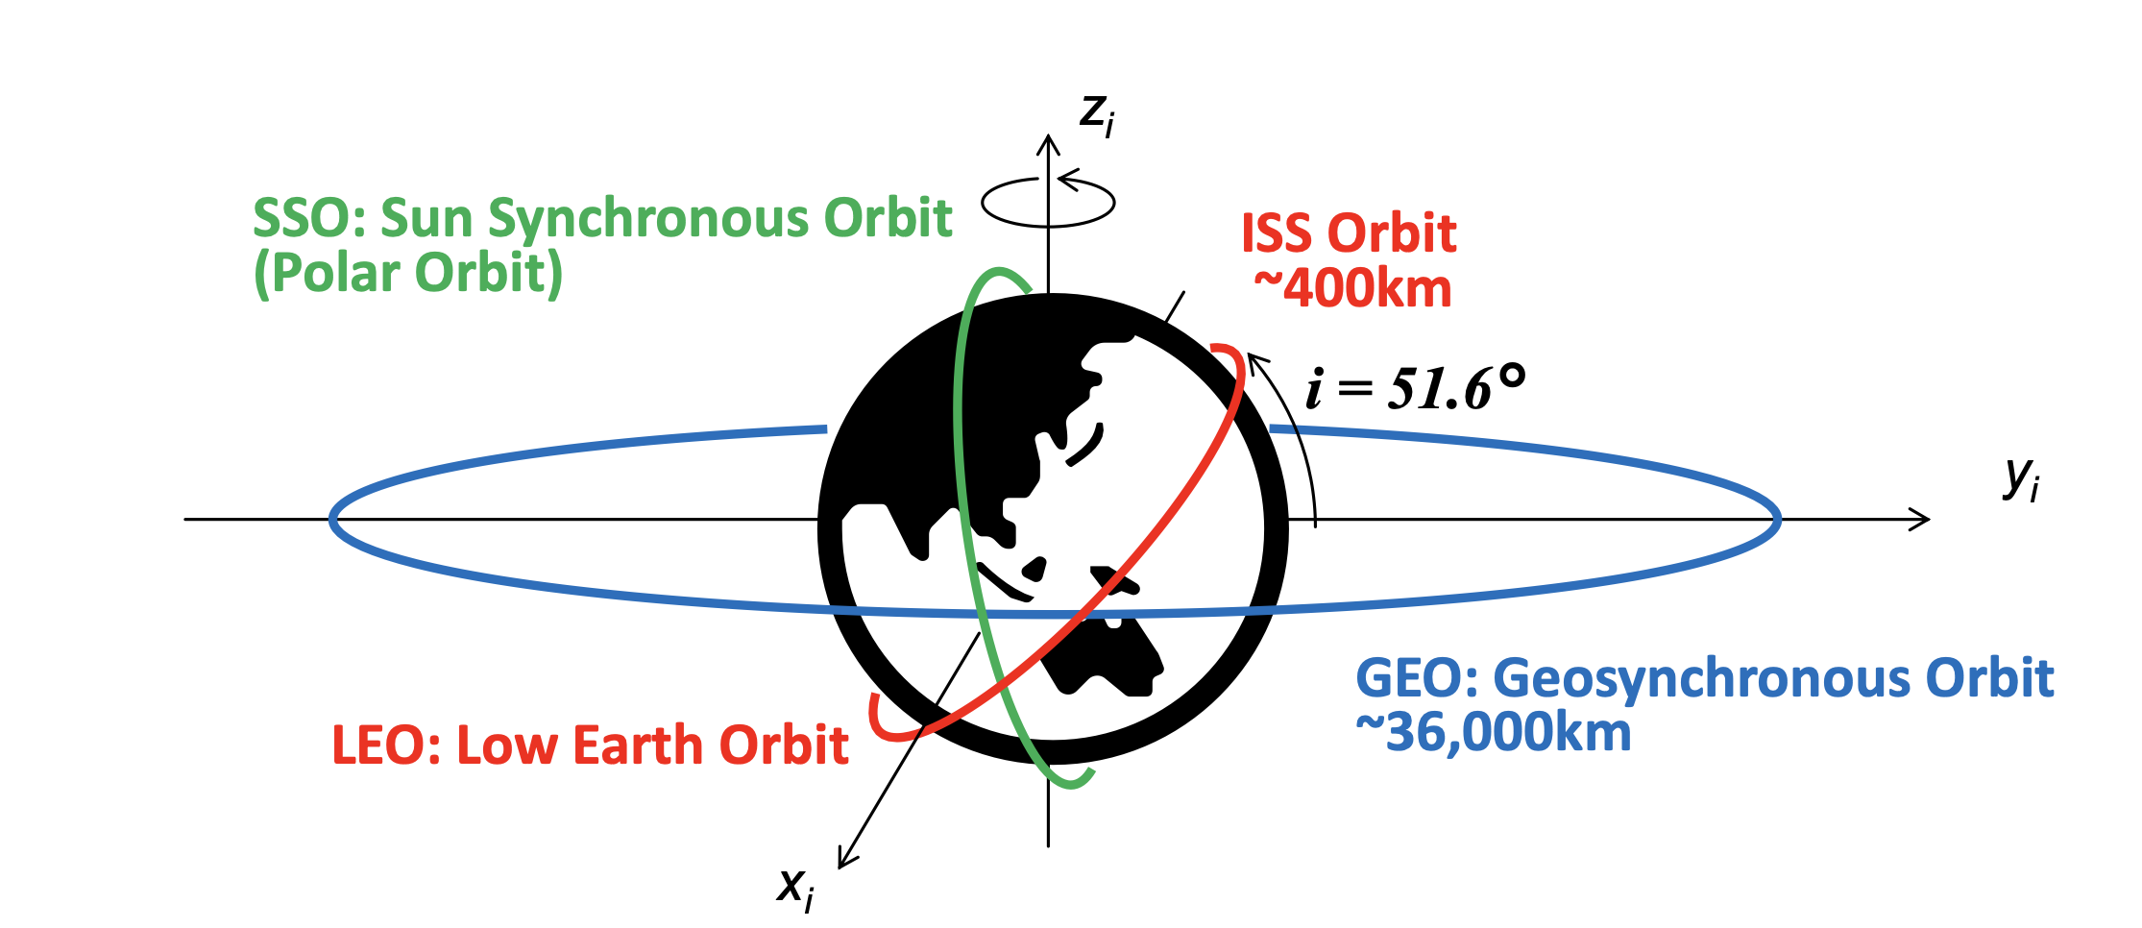
Different kinds of of Earth Orbit
GEO, ISS orbit, SSO, LEO
Notes:
Kibo07_5

Slide 10
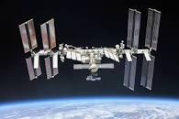
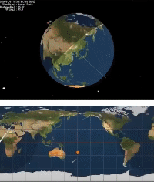
Example: ISS Orbit
ISS Orbit:
  Altitude: ≃ 400km*
  Inclination: ≃ 51.6 deg
  Orbital period: ≃ 91 min
  Orbit altitude changes for about ±20km
CubeSats deployed from the ISS stay in almost the same orbit as the ISS.
Slight differences in initial relative velocity and different mechanical characteristics, such as mass and shape (and hence, ballistic coefficient), make the CubeSats separate from each other into different orbits.
ISS orbit covers the ground surface of regions with lower latitude (between ± 51.6 deg).
ISS rotates around the Earth about 16 times a day, while the Earth rotates about 22.5 deg during the 1 orbital period of the ISS.
Spheresoft
Notes:
Kibo07_5

Slide 11
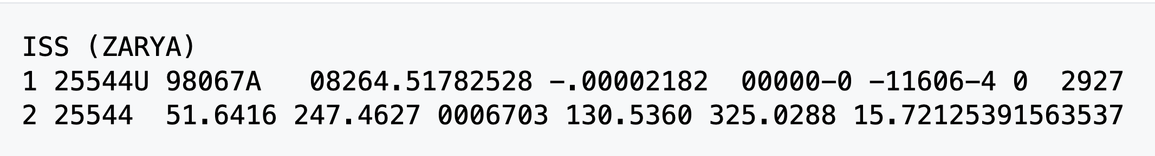
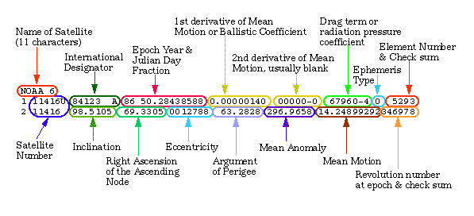
TLE (Two Line Element)
TLE: Data format encoding orbital element
  Two-line text containing information about the movement of an object in orbit around the Earth at a given time (“epoch”)
https://www.space-track.org/documentation#/tle
Notes:
Tracking IBM satellite https://www.n2yo.com/satellite/?s=52770#results
https://celestrak.org/NORAD/elements/
https://www.space-track.org/documentation#/tle

Slide 12
NORAD ID
The Satellite Catalog Number (SATCAT)
A.K.A NORAD (North American Aerospace Defense) ID is a sequential nine-digit number
  Assigned by the USSPACECOM in the order of launch or discovery to all artificial objects in the Earth orbit
  NORAD ID 1: Sputnik
https://www.space-track.org/

Slide 13







Satellite Operational Components
Ground Station
Command and Control
Satellite structure
Payload component
WEB-based User
Interface
Ground
Stations
CubeSat
Payload
Operations

Slide 14
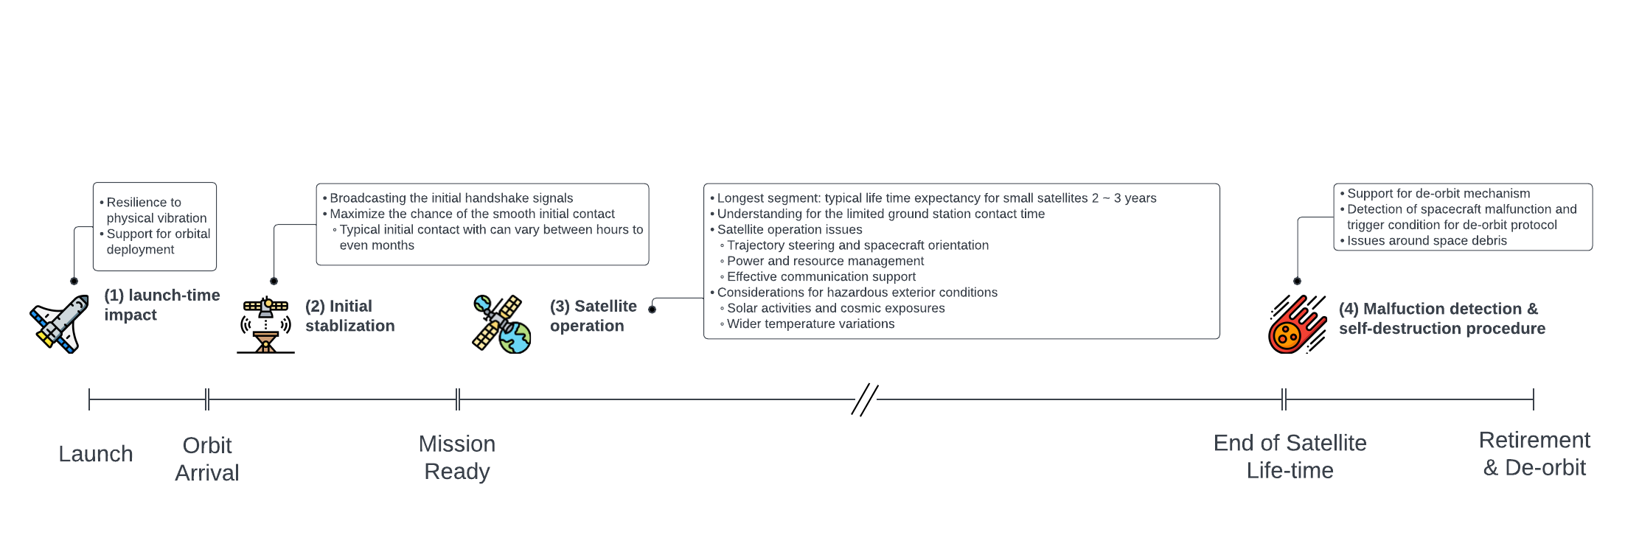
Operational Processes
Temporal perspective
Depicts post-launch operations only
Comparable or even more time are required for
  Planning, development, and testing

Slide 15
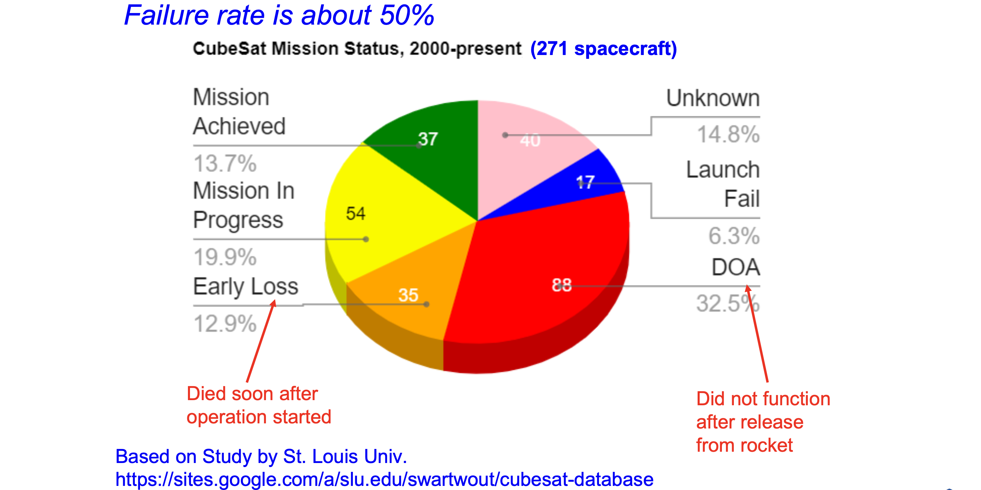
CubeSat Failures
Notes:
Kibo04-11

Slide 16
Frequent Causes of Failure and Countermeasures
Radiation causes electronics failures
  Use space-proven parts or conduct radiation tests during early development phases
Electric power subsystem fails to provide power, or battery voltage gets very low and cannot be recovered
  Design satellite behaviors under low battery voltage
  Make solar power generation possible in any situation
Communication subsystem fails to communicate with the ground station because of component failures, insufficient RF power or EMI (Electromagnetic Interference)…
  Implement backup systems (redundant receivers, etc.)
  Calculate the link equation correctly and add enough link margin
  Conduct ground tests using EM or FM in a realistic situation
  Find and consult with communication technology experts
Notes:
Kibo04-12

Slide 17
Why Space System is Difficult?
Harsh Space Environment
Vacuum | Vaporization, cold welding, friction, electric discharge, change of material, heat spot…
Radiation | Electronics parts malfunction and breakdown, degradation of solar cells and materials…..
Thermal | Large temperature differences/cycles, heat shock, heat spot…..
Launch | Vibration, shock, acceleration, sound vibration…..
Distance | Long range communication over 500-2000 km…..
Others: Atomic Oxygen, Plasma, Debris/Meteoroids, Ultraviolet rays
Notes:
Kibo04-14

Slide 18
Non-Maintainable System
A satellite cannot be touched after launch
Sometimes a satellite must survive 10+ years without any human interactions
Be imaginative
  Consider all the possible events and anomalies which may happen to your satellite and prepare countermeasures
Be rigorous
  Conduct ground tests in various settings in the space environment, in various operation modes
Notes:
Kibo04-15

Slide 19
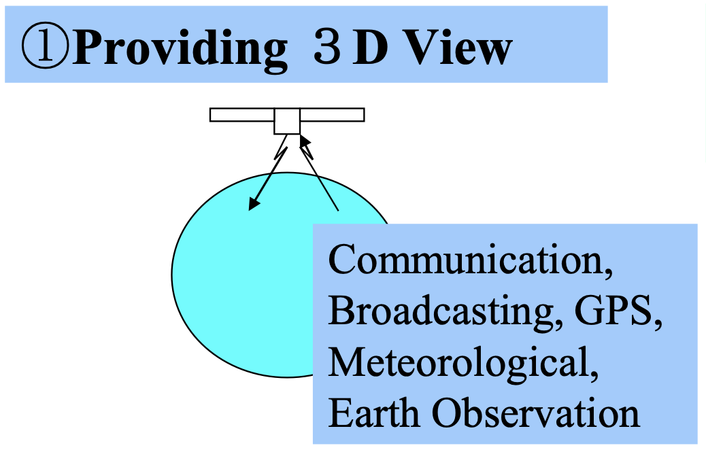
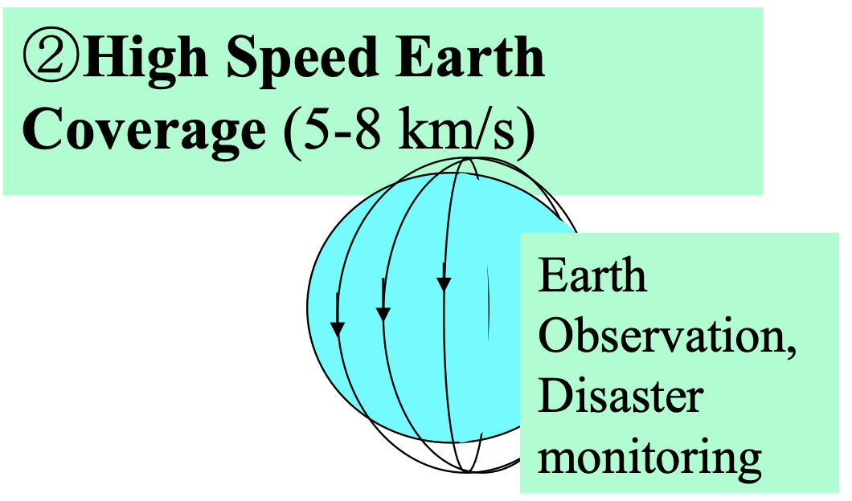
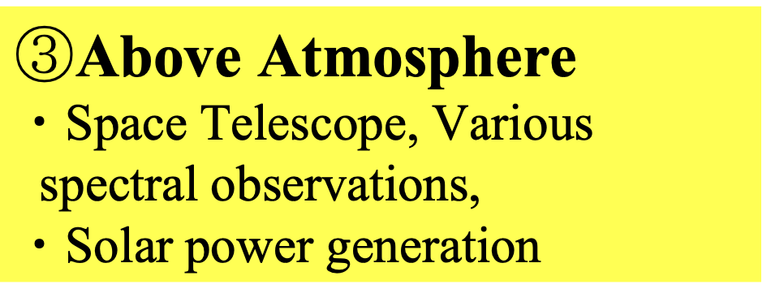
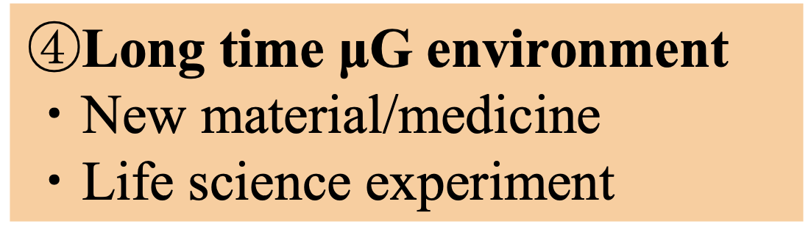
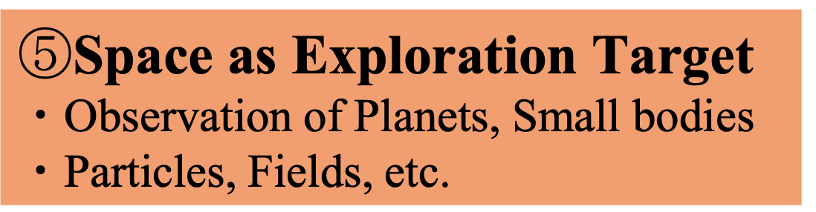

Space Features
Notes:
Kibo03_10

Slide 20
Space Features
Providing 3D view
High speed coverage of the Earth
Staying above the atmosphere
Obtaining long time micro-G environment
Space as an exploration target
Human existence in space
Other

Slide 21
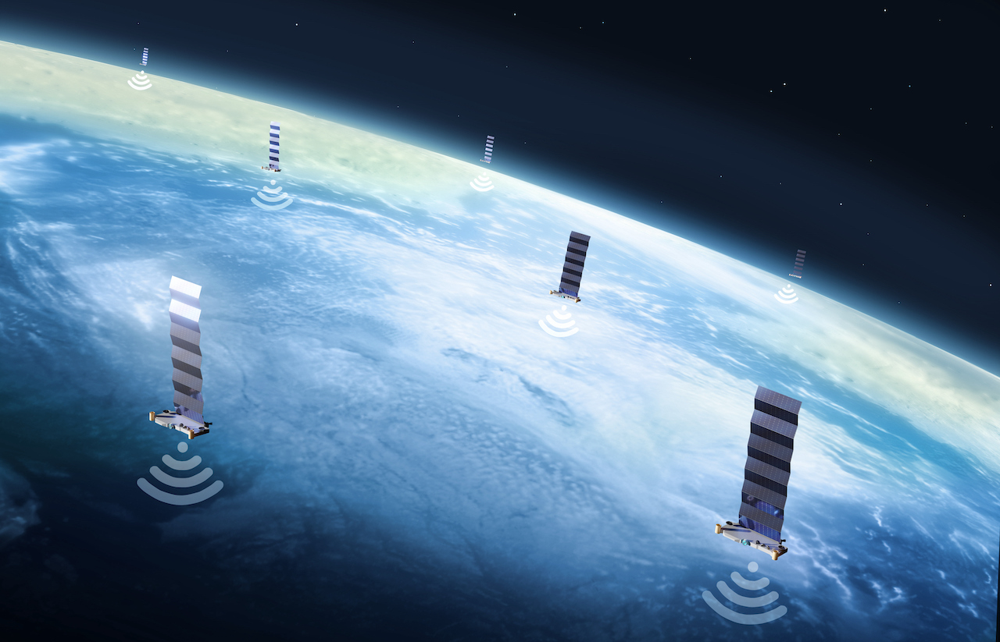
Communication/broadcasting satellite
Starlink Broadband
  Mega constellation
  1. Providing 3D view

Slide 22
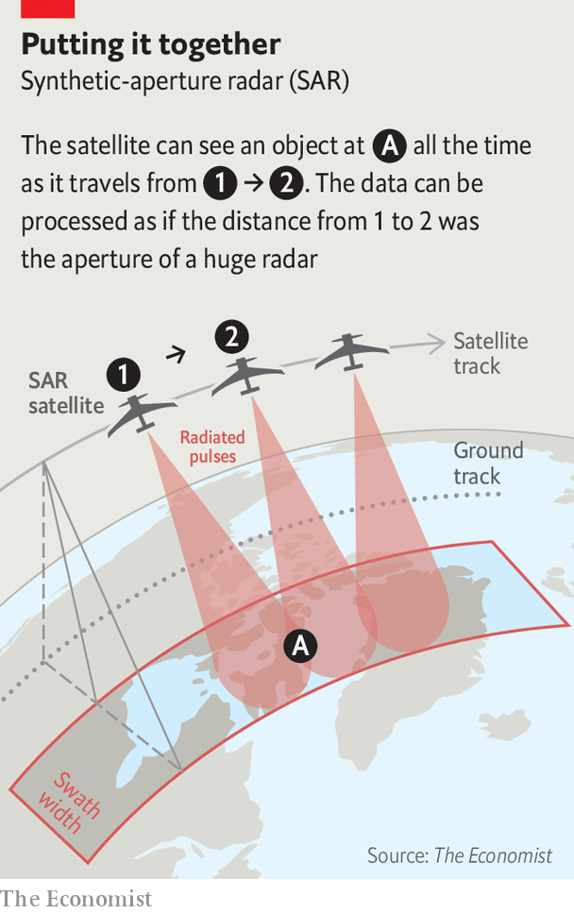
Synthetic Aperture Radar (SAR)
A technique for producing fine-resolution images from a resolution-limited radar system
  Providing 3D view
  High speed coverage of the Earth

Slide 23
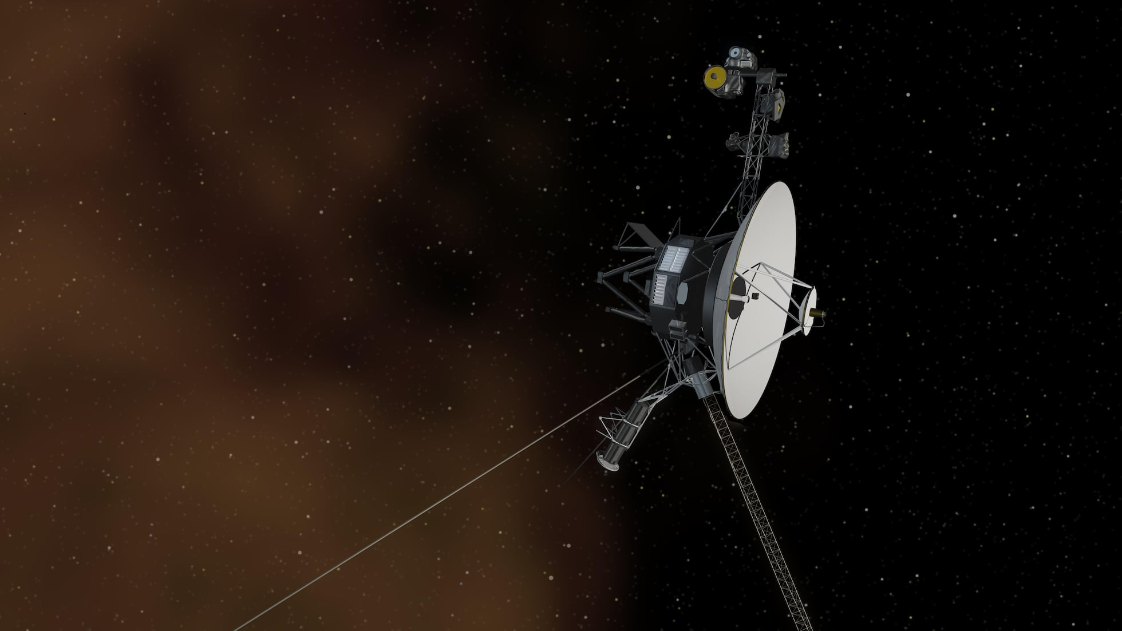
Deep Space Exploration Probe
5. Space as an exploration target
'Voyager 2' probe in interstellar space.
NASA/JPL-CALTECH

Slide 24
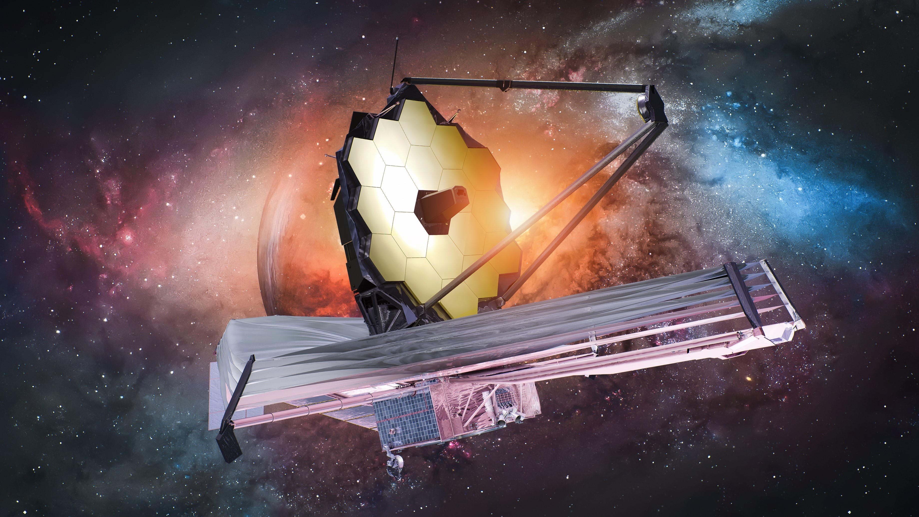
James Webb : Space Telescope
3. Staying above the atmosphere

Slide 25
What is Your Space Mission?
How future will look like for you?
  Will space be important for you?
What applications can we think of?
  Considering special features of the space
  What would be interesting applications relevant to your research?
    It is an open question to you!
Notes:
Brainstorming

Slide 26
Backup

Slide 27
Space Governance
Who own the space?
Still practical regulation and procedures to follow
Many recommendations, but only a few enforceable regulations
Open problem!

