Slide 1
CubeSat Components and Subsystems
Small Satellite Workshop 2026
Kangkook Jee

Slide 2
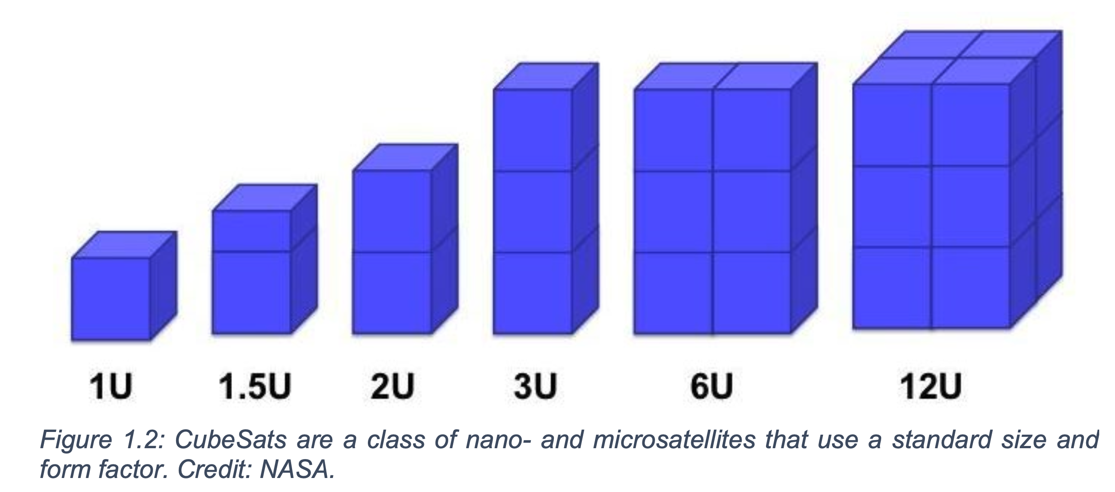
CubeSat Overview
What is CubeSat?
  1U, 2U, 4U, 6U, 6UW

Slide 3
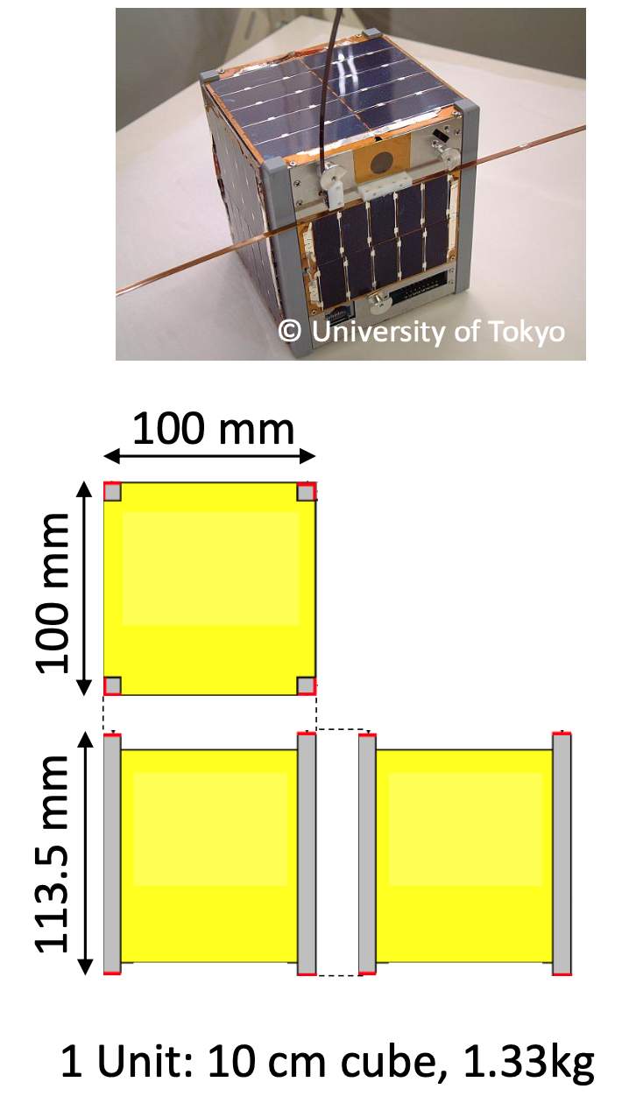
CubeSat Standardization History
Some standards are available:
CubeSat Design Specification rev.13 (2014/2/20)
  6U CubeSat Design Specification rev. 1.0 (2018/6/7)
  California Polytechnic State University (https://www.cubesat.org/)
CubeSat Subsystem Interface Definition version 1.0
  UNISEC Europe (2017/8/24)
  http://unisec-europe.eu/wordpress/wp-content/uploads/CubeSat-Subsystem-Interface-Standard-V2.0.pdf
ISO Space systems – Cube satellites (CubeSats) (2017/6) (https://www.iso.org/standard/60496.html )
JEM* Payload Accommodation Handbook Vol.8 D
  (https://humans-in-space.jaxa.jp/kibouser/library/item/jx-espc_8d-d1_en.pdf )
Notes:
Kibo07_11

Slide 4
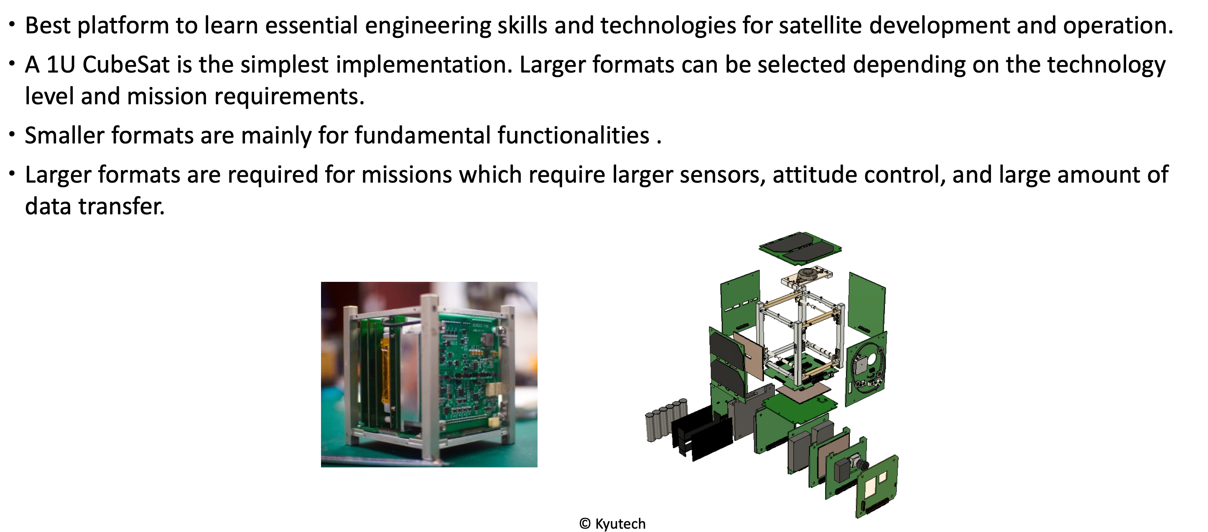
Example: 1U CubeSat

Slide 5
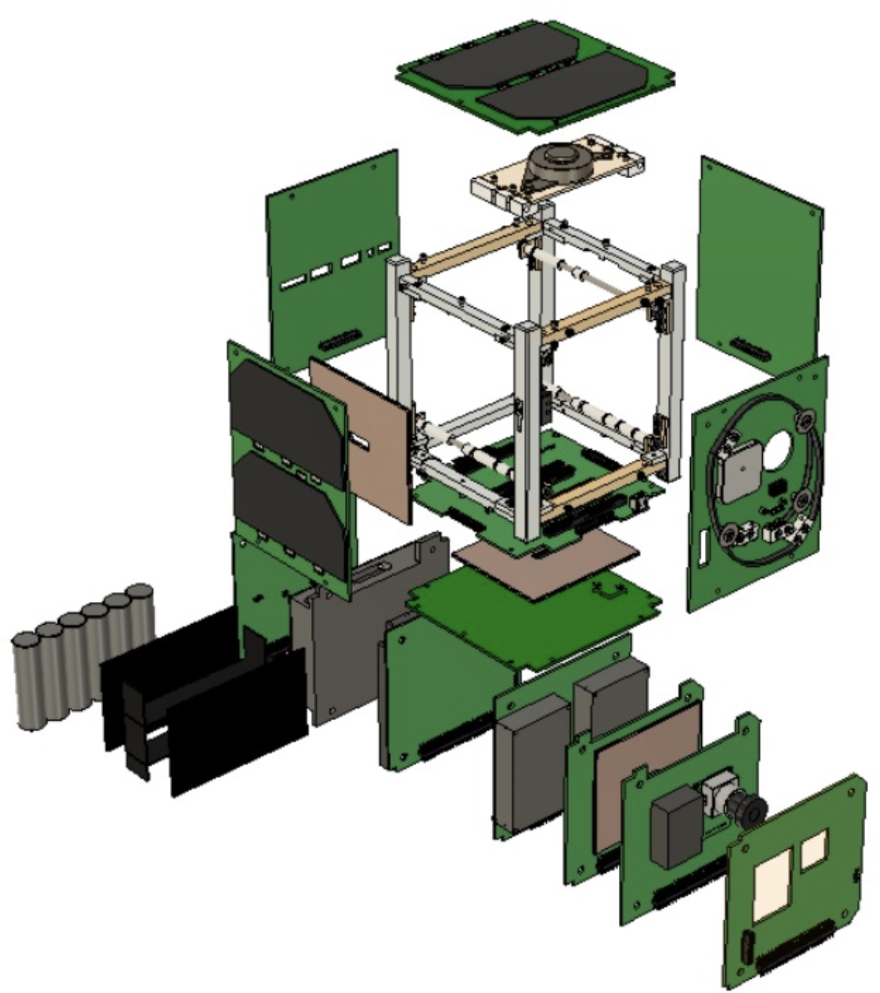
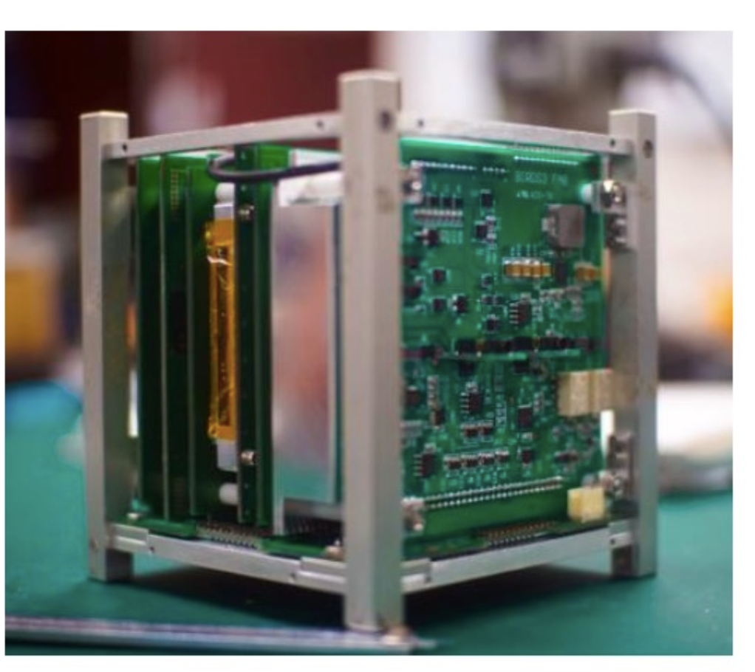
Case Study: 1U CubeSat
Best platform to learn essential engineering skills and technologies for satellite development and operation.
An 1U CubeSat is the simplest implementation; Larger formats can be selected depending on the the technology level and mission requirements.
  Small CubeSats mainly focuse on life-sustaining functionalities
  Larger CubeSats are for missions with larger (or various) sensors, attitude control, high-throughput data transfers

Slide 6
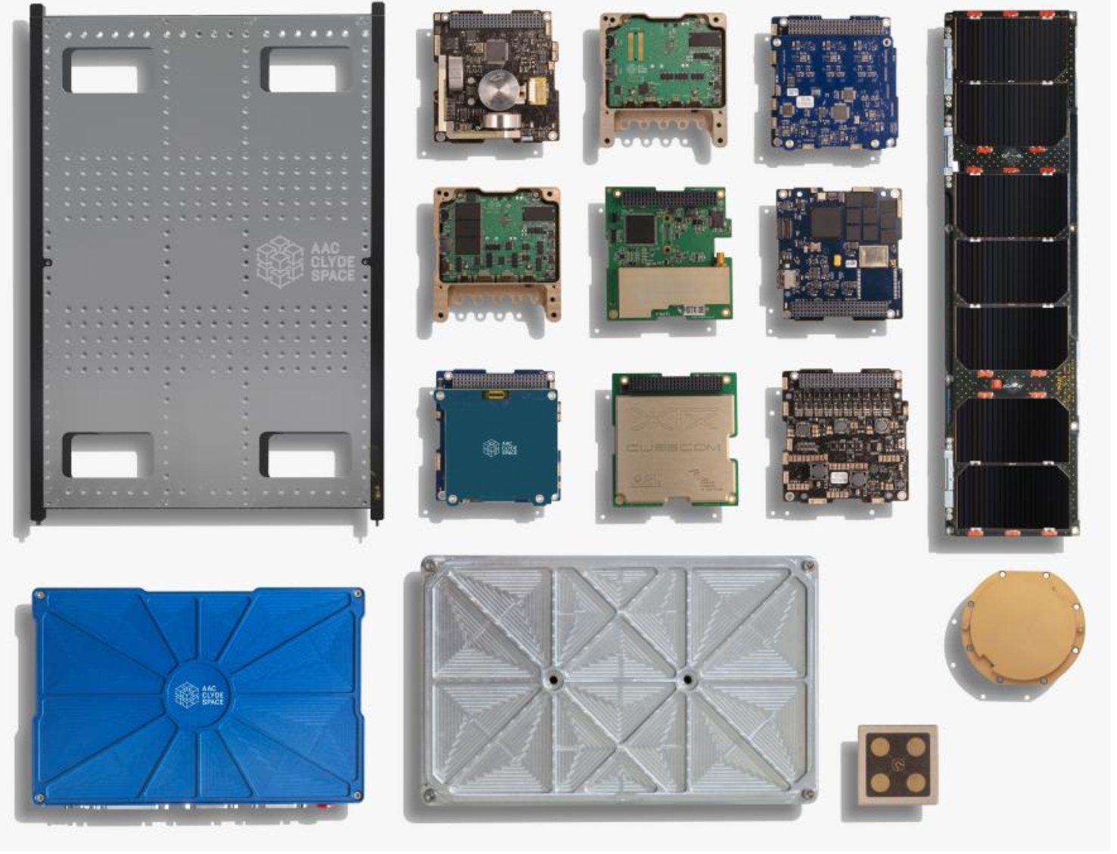
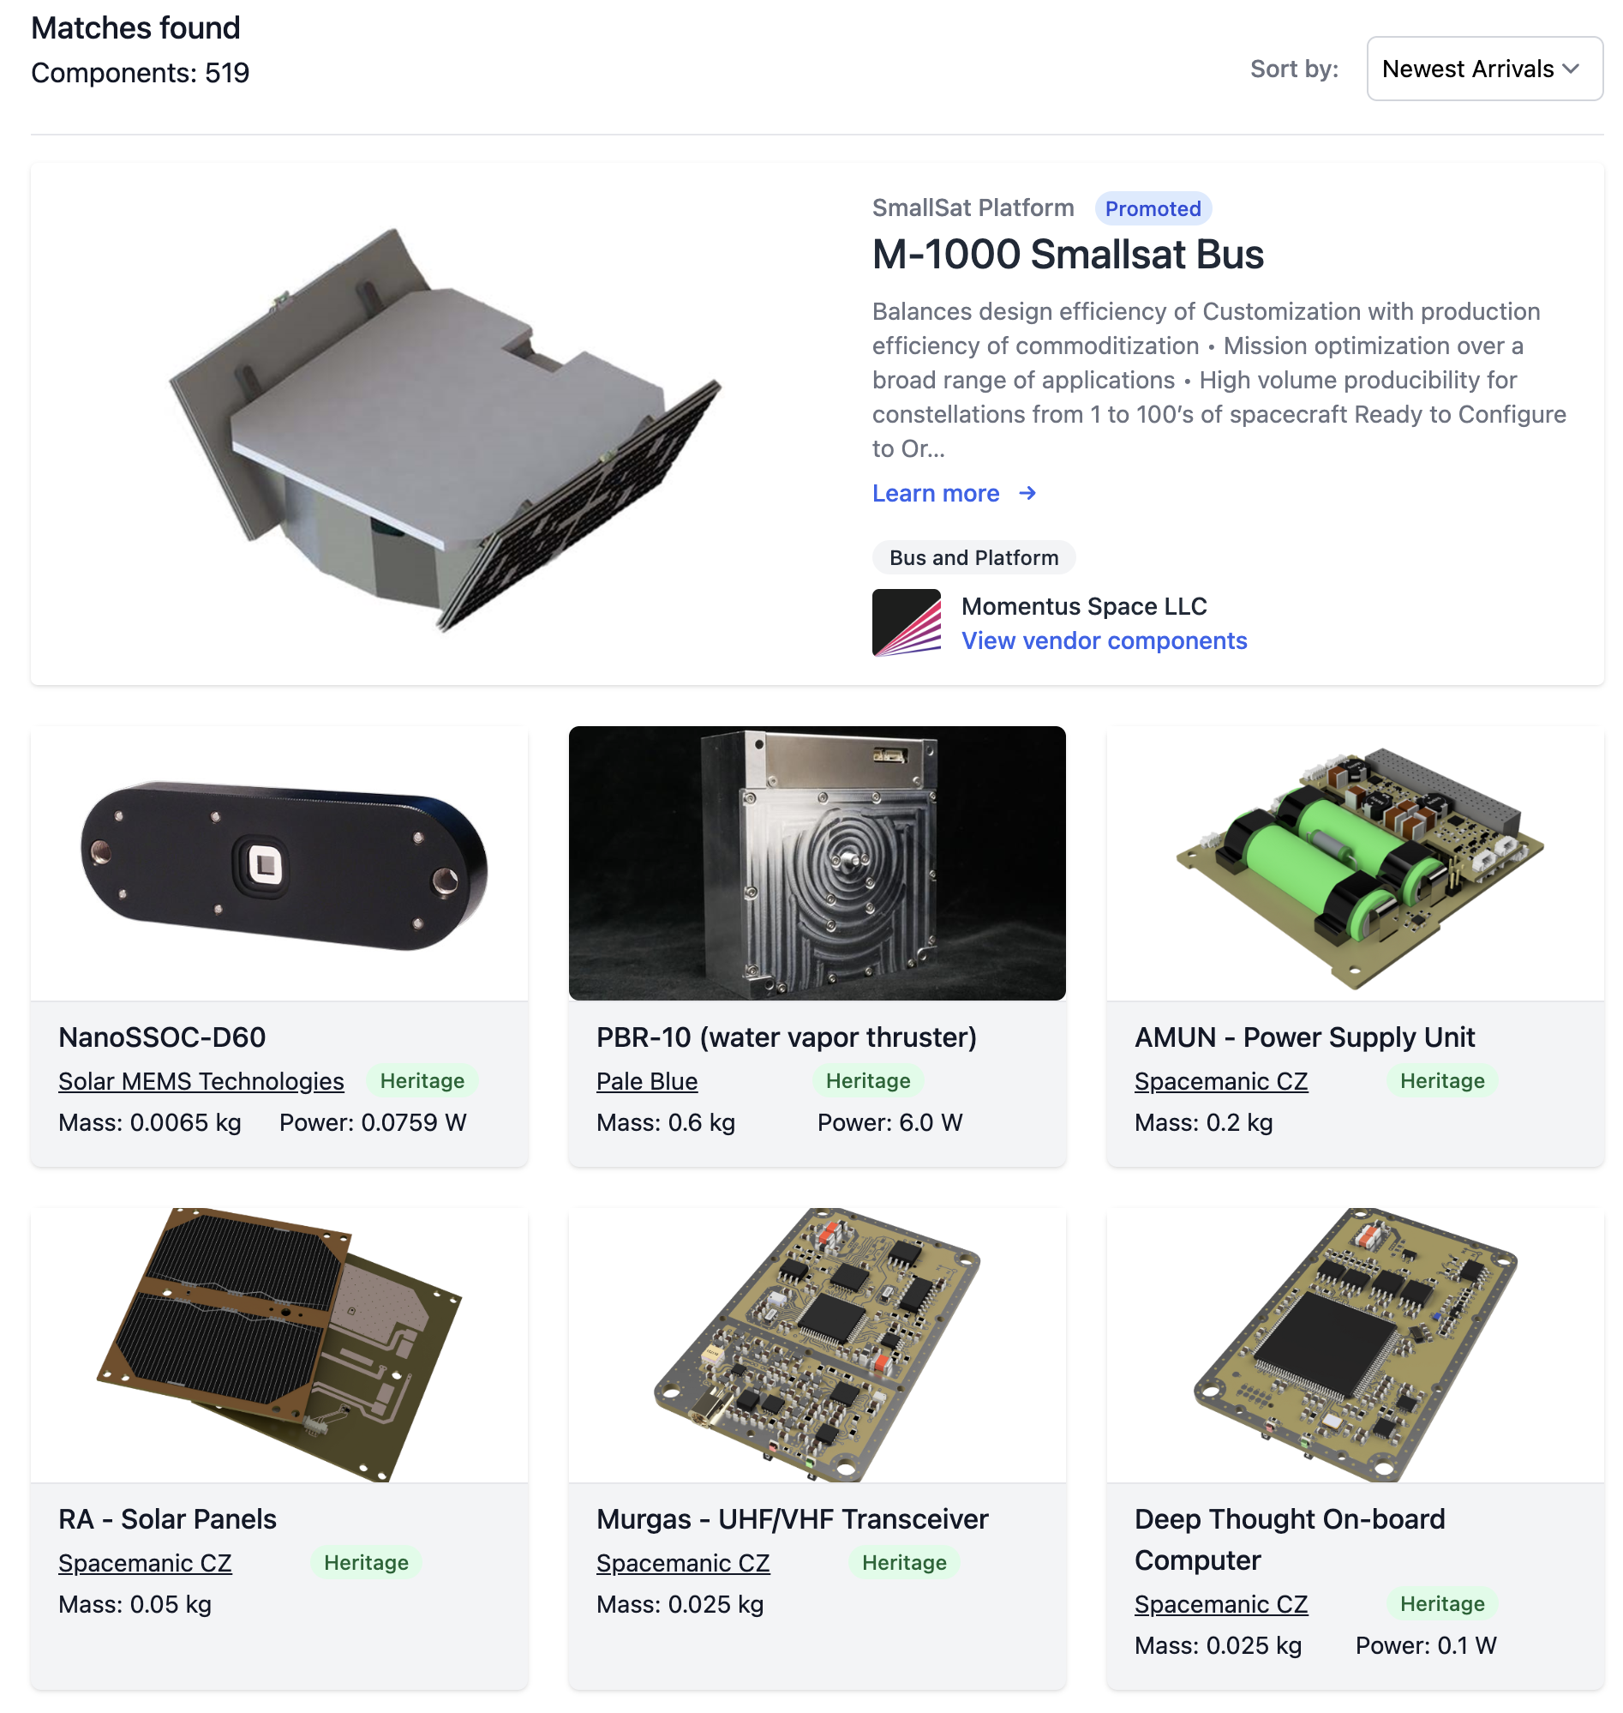
CubeSat Components
More CubeSat components are commercially available
AAC Clyde Space
https://www.satcatalog.com/

Slide 7
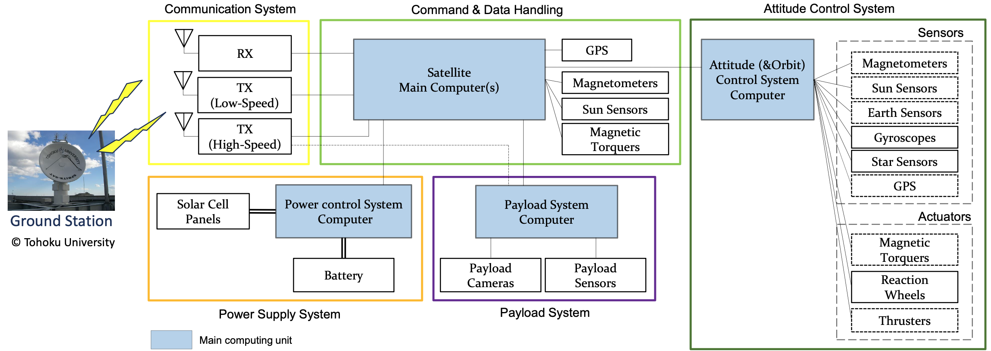
Satellite Subsystem Block Diagram
Satellite components can be generally categorized into subsystems according to their functionalities.
  Each interface needs to be specified, controlled, integrated, and tested for the system integration.
Notes:
Kibo10_12

Slide 8
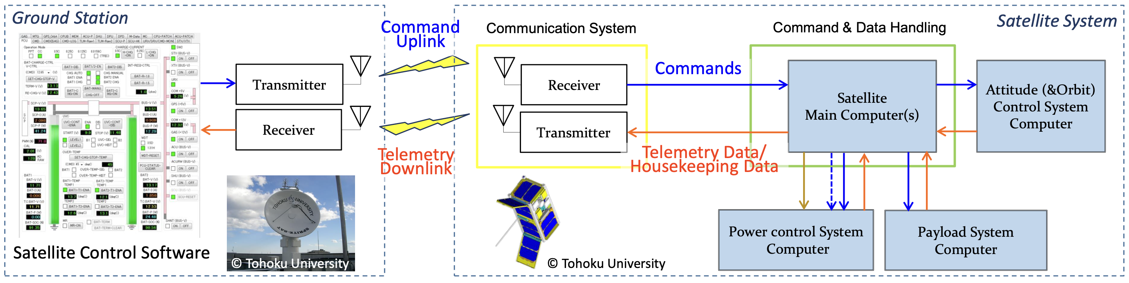
Satellite Commanding and Status Monitoring
The C&DH subsystem conducts command processing, on-board data handling, and autonomous functions.
Command Processing:
Command decoding and validation
Command processing and distribution
  Command data packet
  Discrete pulses
Decryption
Data Handling:
Housekeeping (HK) data collection
HK data processing and formatting
Mission data (payload) acquisition and formatting
Downlink data formatting and coding
Encryption
Autonomous Functions:
Contingency situation detection
(e.g., UVC: Under voltage control)
Transition to safe mode
(Automatic power-off of component)
Notes:
Kibo10_6
Satellite Commanding and Status Monitoring

Slide 9
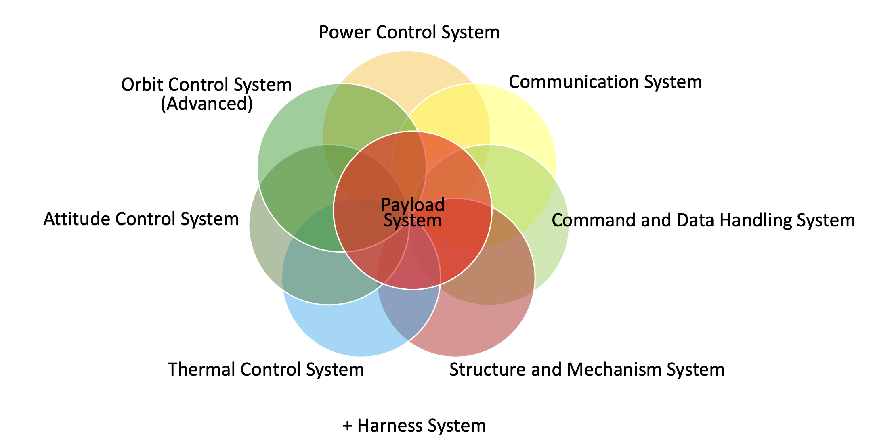
CubeSat Subsystems
Typical subcomponents for a satellite system

Slide 10
CubeSat Subsystems
Electric Power System (EPS) / Power Control System
Command and Data Handling (C&DH)
Attitude Determination and Control System (ADCS)
Communication Modules
Thermal Control

Slide 11
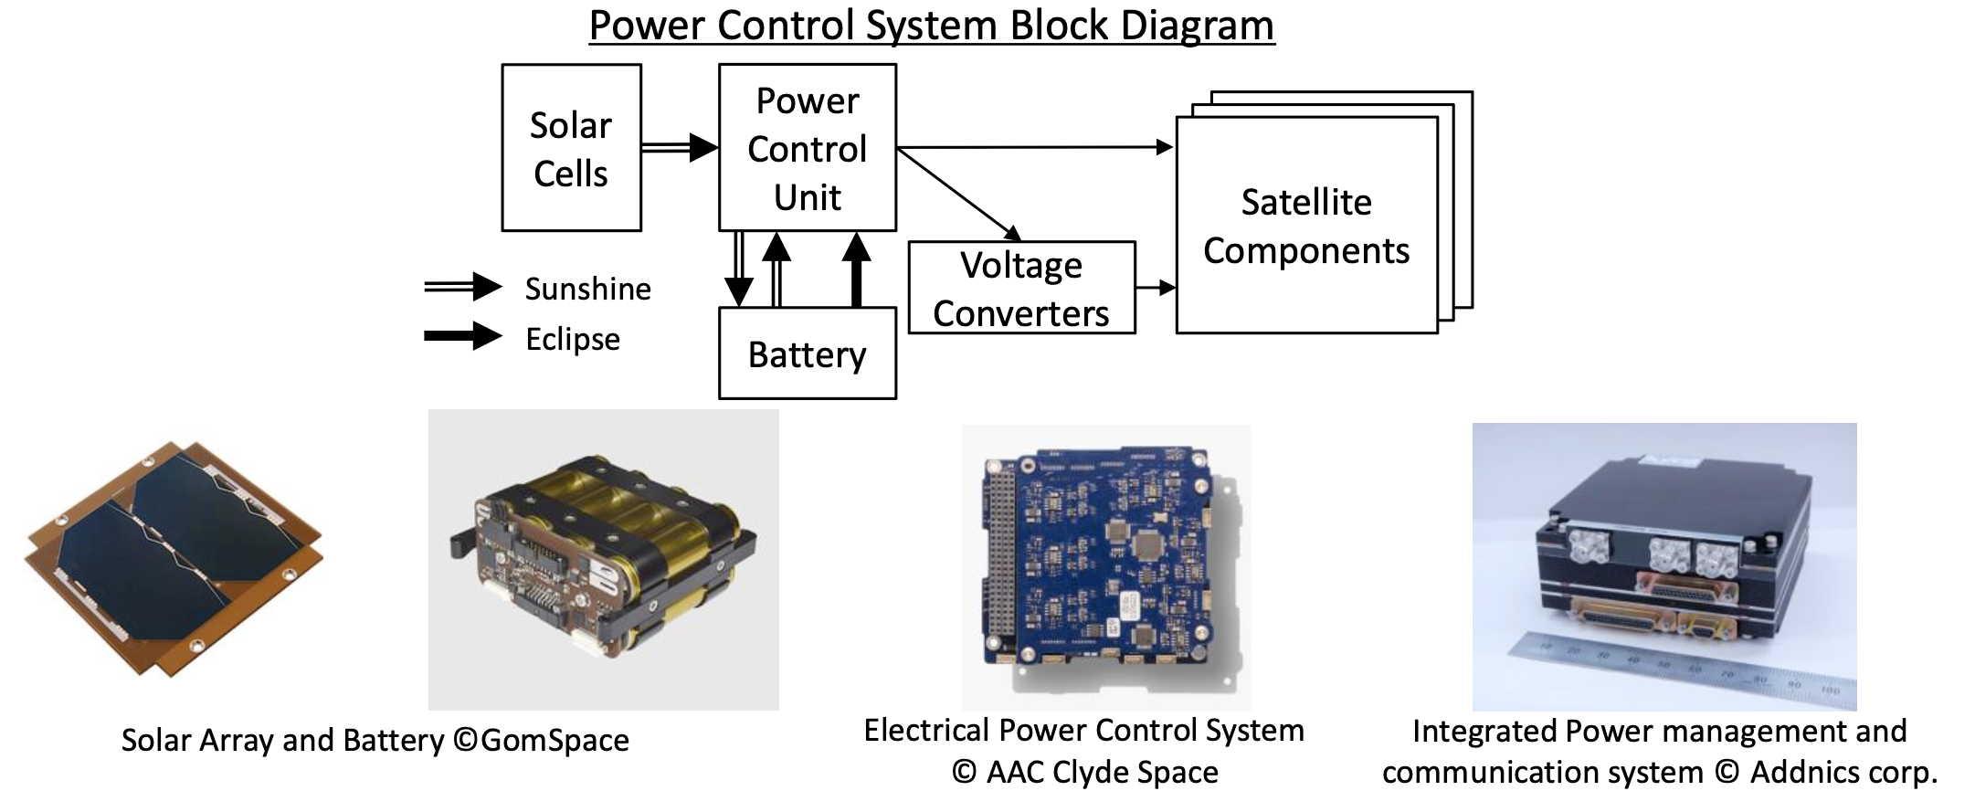
Electric Power System (EPS)/Power Control Systems
Power control systems manage (1)power generation by solar panels; (2) storage into secondary batteries; (3) distribution to the satellite components
Power control systems shall be highly reliable, as compared to other on-board components.
The size of solar cells and capacity of the battery shall be determined based on the power consumption requirements of the satellite mission.
Notes:
Kibo07_17

Slide 12
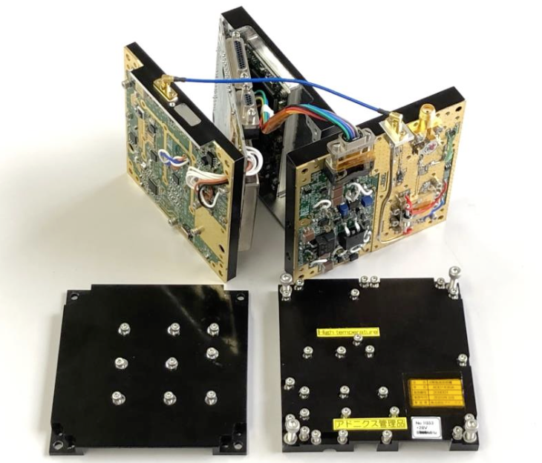
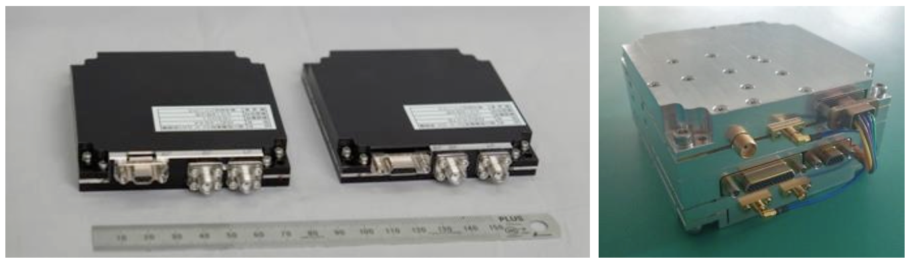
Communication System: Transmitter/Receiver
As the satellite operates remotely in space, information exchange through communication is top priority.
The communication throughput, especially for the down-link, determines/limits the entire performance of the satellite system itself.
For high-speed communication, higher electrical power is required, and the temperature of the transmitter increases. (Typically, a ground contact lasts about 10 minutes or less.)
Rx shall be ideally powered always, not to miss any commands sent from the ground station.
  Tx can be turned on and off according to the ground contact schedule.
The amount of mission data down-link can be increased by using more than one ground station if available.
  Consider Collaborative/Crowd-sourcing satellite operation
CubeSat S-band RF Transmitter and Receiver, X-band Transmitter, and inside of the X-band Transmitter (from left to right) © Addnics corp.
Notes:
Kibo07_18

Slide 13
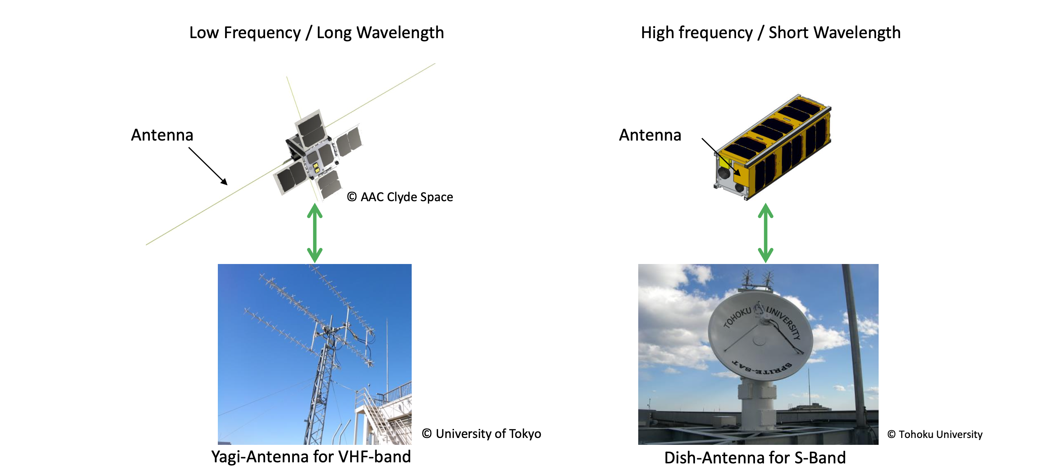
Communication System: Antenna

Slide 14
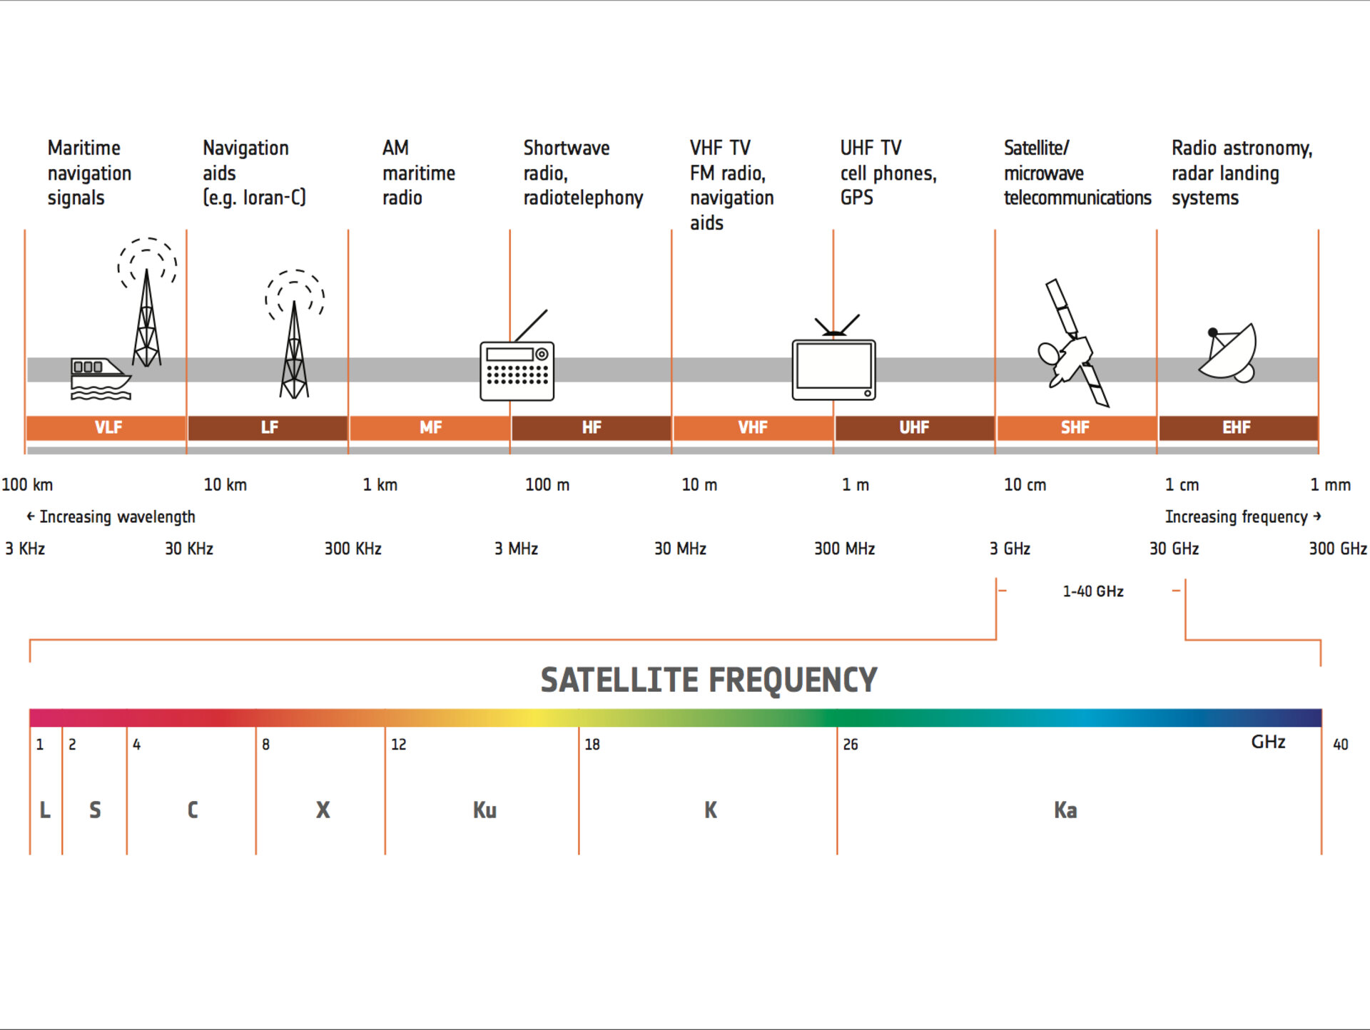
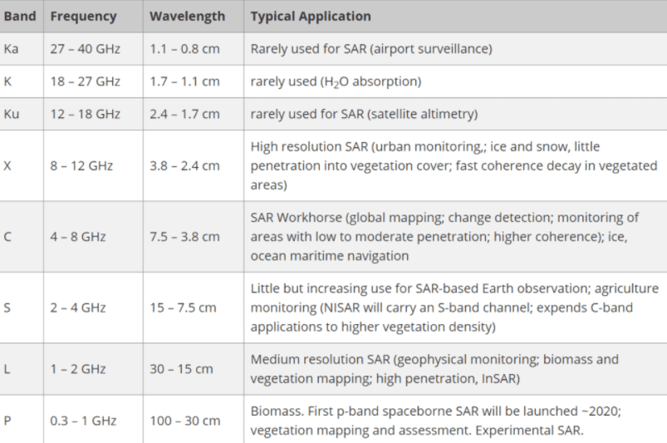
Satellite RF Frequency Band
Notes:
https://www.esa.int/Applications/Connectivity_and_Secure_Communications/Satellite_frequency_bands
https://www.satnow.com/community/what-are-satellite-frequency-bands

Slide 15
Notes:
https://upload.wikimedia.org/wikipedia/commons/c/c7/United_States_Frequency_Allocations_Chart_2016_-_The_Radio_Spectrum.pdf

Slide 16
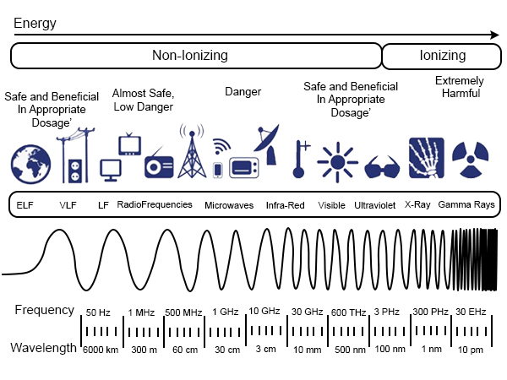
Satellite RF Frequency Band
Notes:
https://www.esa.int/Applications/Connectivity_and_Secure_Communications/Satellite_frequency_bands
https://www.satnow.com/community/what-are-satellite-frequency-bands

Slide 17
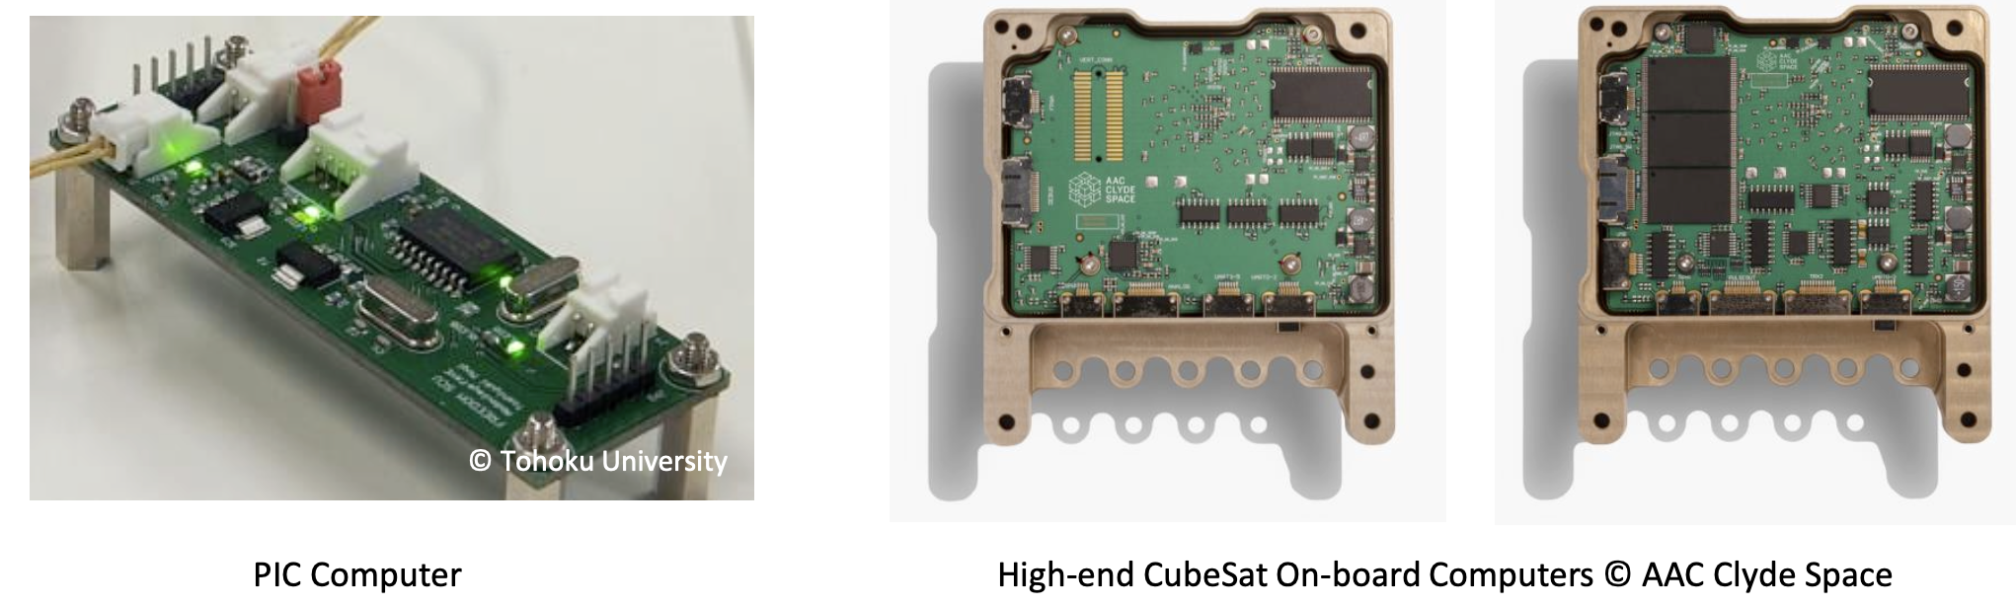
Command and Data Handling System
Command and Data Handling System (C&DH) manages (1) data handling, (2) components commanding/monitoring, (3) data storage, (3) signal processing (for communication), and (4) error handling inside the satellite.
Certain levels of autonomous functions need to be implemented in C&DH so that satellites can survive in the space environment.
A high level of reliability is required for the C&DH computers. When errors occur, due to e.g., radiation effects, the power control system shall power cycle (power off /on) the computer either autonomously or by telecommand from the ground station
Notes:
Kibo07_21

Slide 18
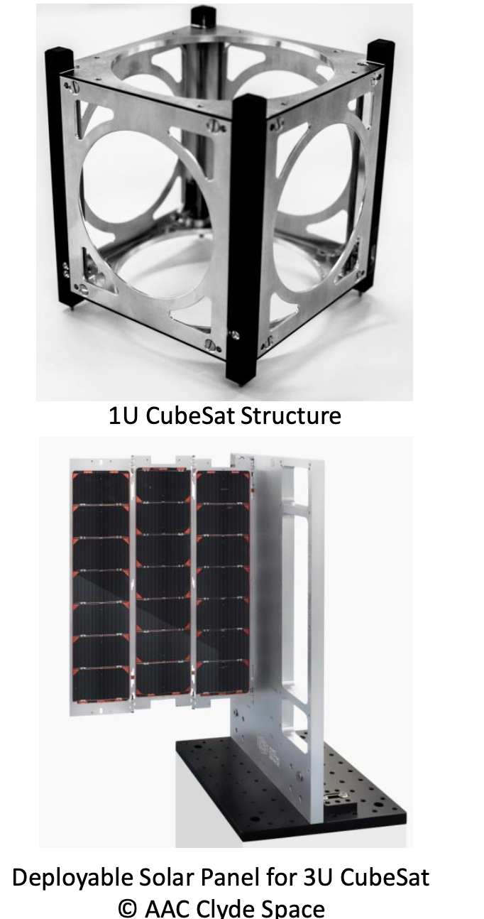
Structure and Mechanical System
Structure System
  Is the main interface with the launch vehicle. CubeSats have the rails that connects between the satellite and the deployer pod.
  CubeSat specification dictates the entire form-factors
    the outer dimensions, surface area, and surface treatment of the rails and outer envelope of the entire satellite.
  The structure system shall withstand a launch environment, such as vibration, static acceleration, shock, (acoustic, air venting), etc.
Mechanical System
  Separation switches, deployable antennas, deployable solar panels, shutters, booms, and any other mechanically moving elements on the satellite.
  The mechanical system shall be safely stowed during the launch to ensure the secure deployment of the CubeSat from the pod.
Notes:
Kibo07_22

Slide 19
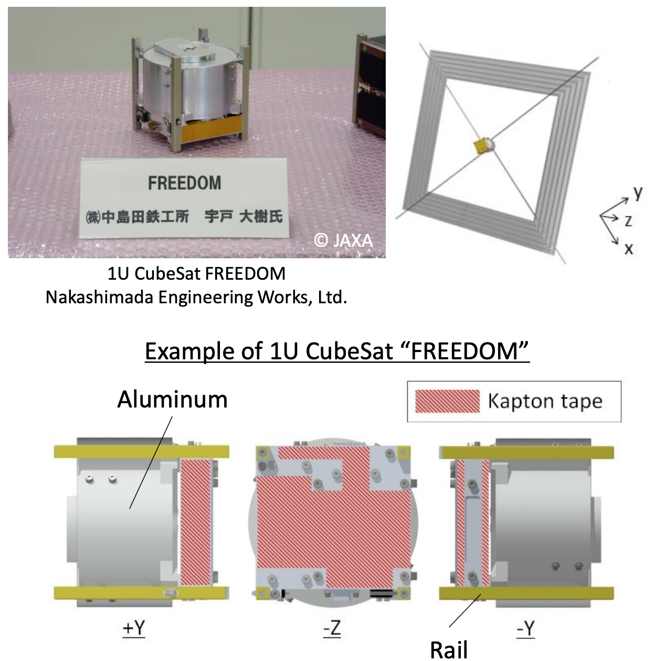
Thermal Control System
Thermal control of a satellite can be achieved in two different ways:
  Passive control and active control
As active control needs electrical power (heaters/coolers) in general, passive control is common in CubeSats.
Passive thermal control utilizes different surface materials with different thermo-optical characteristics, for instance:
  Aluminum surface warms up the temperature,
  Kapton surface cools down the thermal condition.
Notes:
Kibo07_23

Slide 20
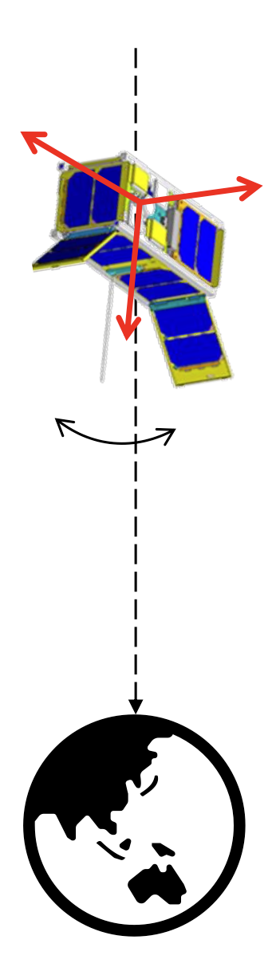
Attitude Determination and Control System (ADCS)
Attitude control capability is required depending on the mission operation of the satellite, such as:
  Pointing observation instruments toward the target
  Pointing high-gain antenna toward the ground station for high-speed communication
  Orienting solar panels toward the sun for larger power generation
For the attitude control, attitude determination is also necessary beforehand, therefore attitude determination sensors and attitude control actuators are required.
Type of attitude control
  Passive control
  Active control
Attitude control modes
  Detumbling control
  (after the separation from the launch vehicle or release from the ISS).
  Pointing control: inertial, nadir, target, velocity direction, etc.
Notes:
Kibo07_24

Slide 21
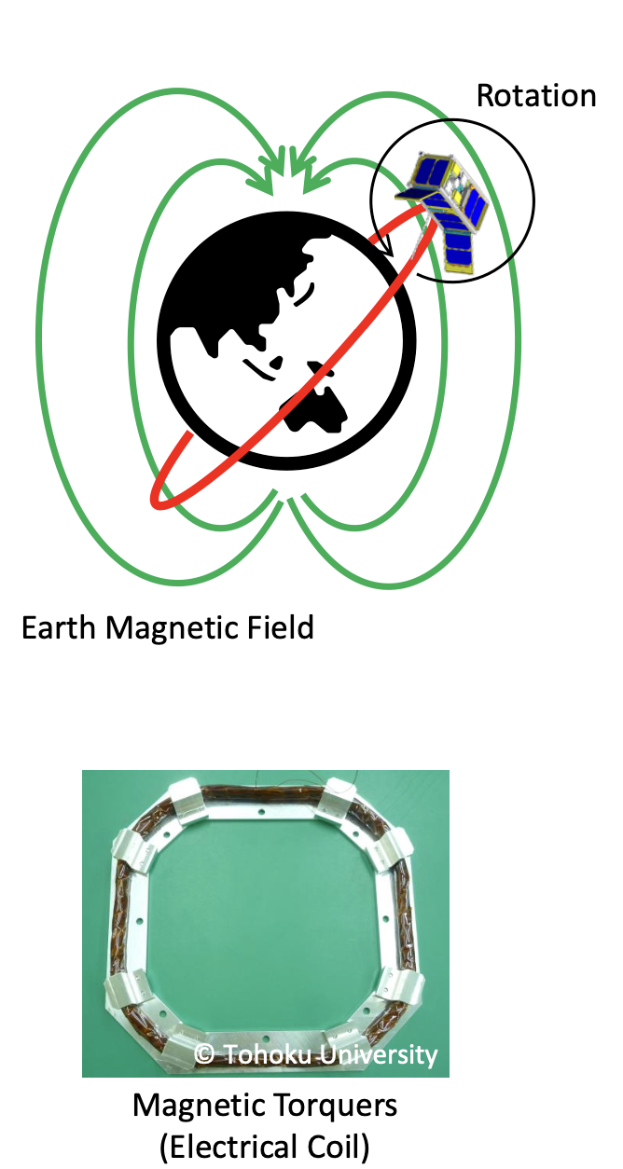
ADCS: Detumbling Control
Detumbling Control
  Satellites can experience high rotational rates after the separation from the launch vehicle, or deployment from the ISS.
  In general, satellites in a high-speed rotation cannot communicate with the ground station properly.
  Satellites shall be able to detumble and reduce the rotational speed down to about several degrees per second.
Type of detumbling control
  Active control: Generate magnetic moment by means of magnetic torquers to interact with the Earth’s magnetic field to actively slow down the rotational rate.
  Passive control: Utilize permanent magnets and magnetic hysteresis dumpers to passively slow down the rotational rate.
Notes:
Kibo07_25

Slide 22
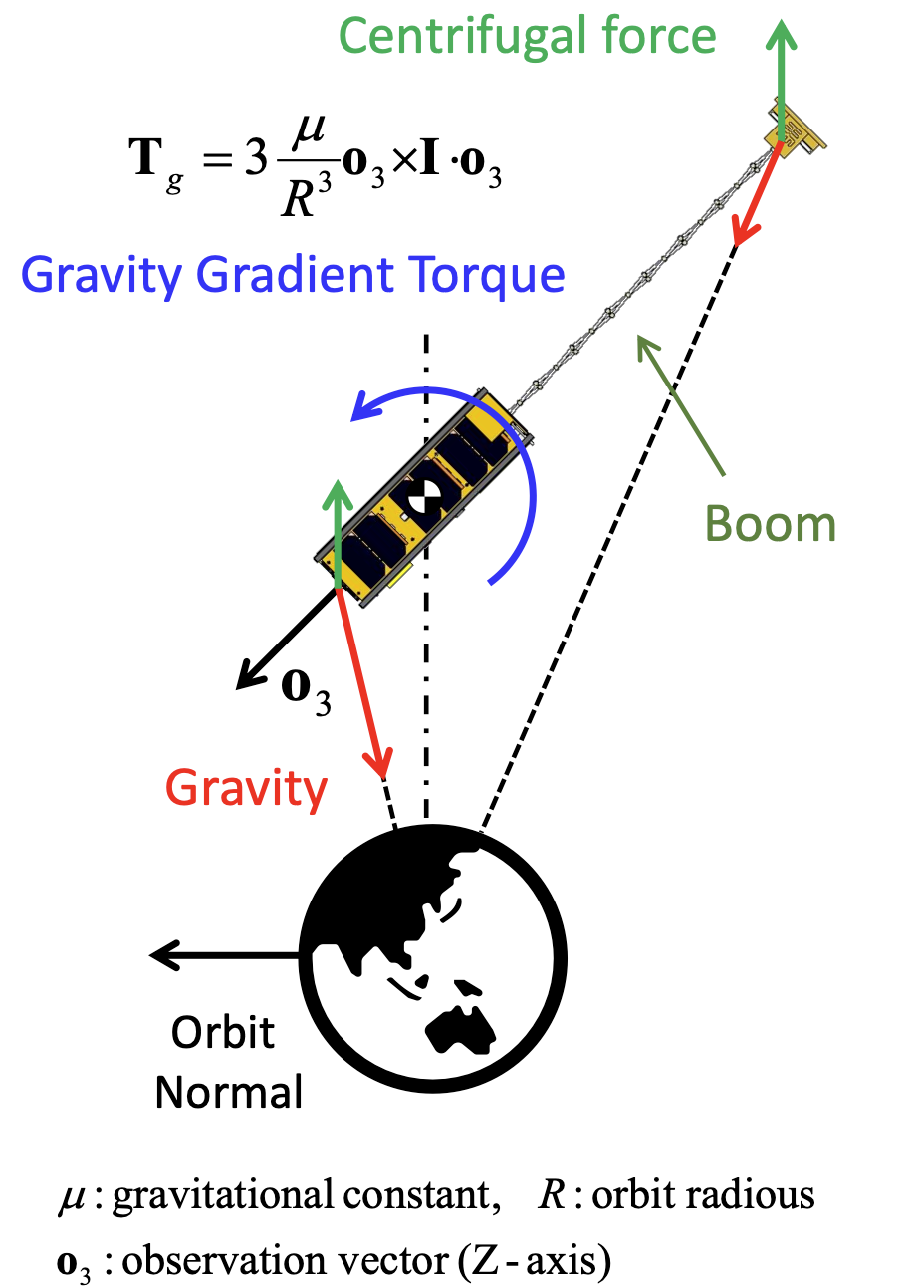
ADCS: Gravity Gradient Control (Passive)
Satellites with long shapes and spread mass distribution experience a gravity gradient torque such that the longitudinal direction points toward the Earth.
Cameras, antennas, and sensors can be pointed toward the Earth without additional electrical power for the attitude control.
Pointing accuracy is relatively low.
Can be combined with active attitude control with some attitude control actuators, such as magnetic torquers and reaction wheels.
Notes:
Kibo07_26

Slide 23
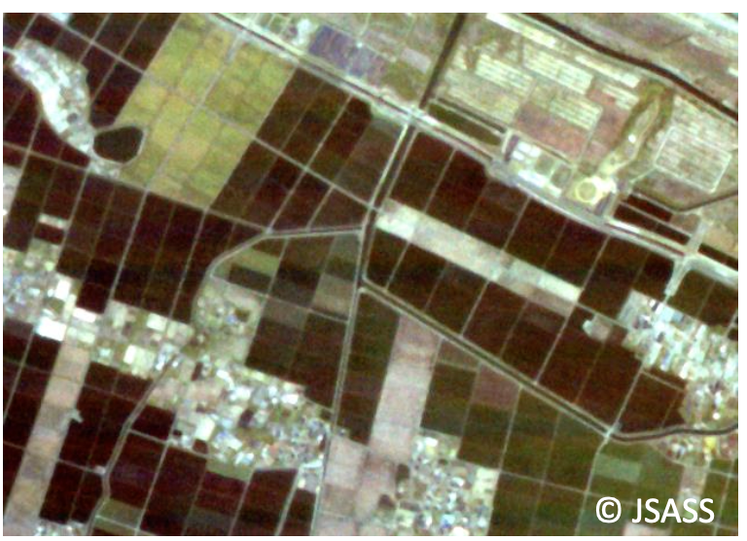
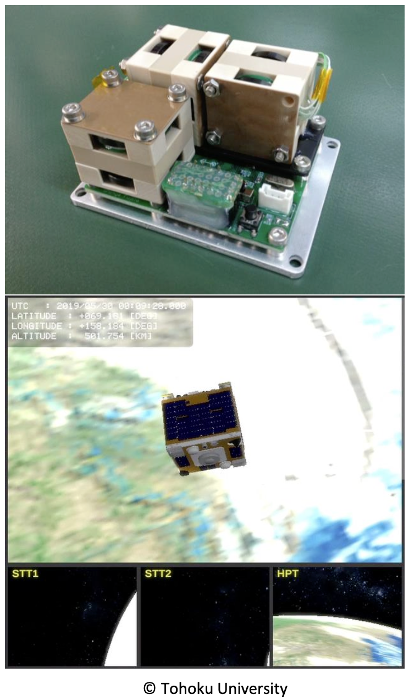
ADCS: 3-Axis Control
Attitude control actuators such as magnetic torquers and reaction wheels are used for active 3-axis control.
Reaction wheels can realize agile and stable attitude control.
Disturbance torques acting on the satellite gradually accumulate as angular momentum stored in the reaction wheels.
  Reaction wheels cannot be operated for a long time without desaturation using magnetic torquers.
Satellite attitude shall be determined precisely by means of a combination of attitude determination sensors.
Notes:
Kibo07_27

Slide 24
ADCS Systems
TODO

Slide 25
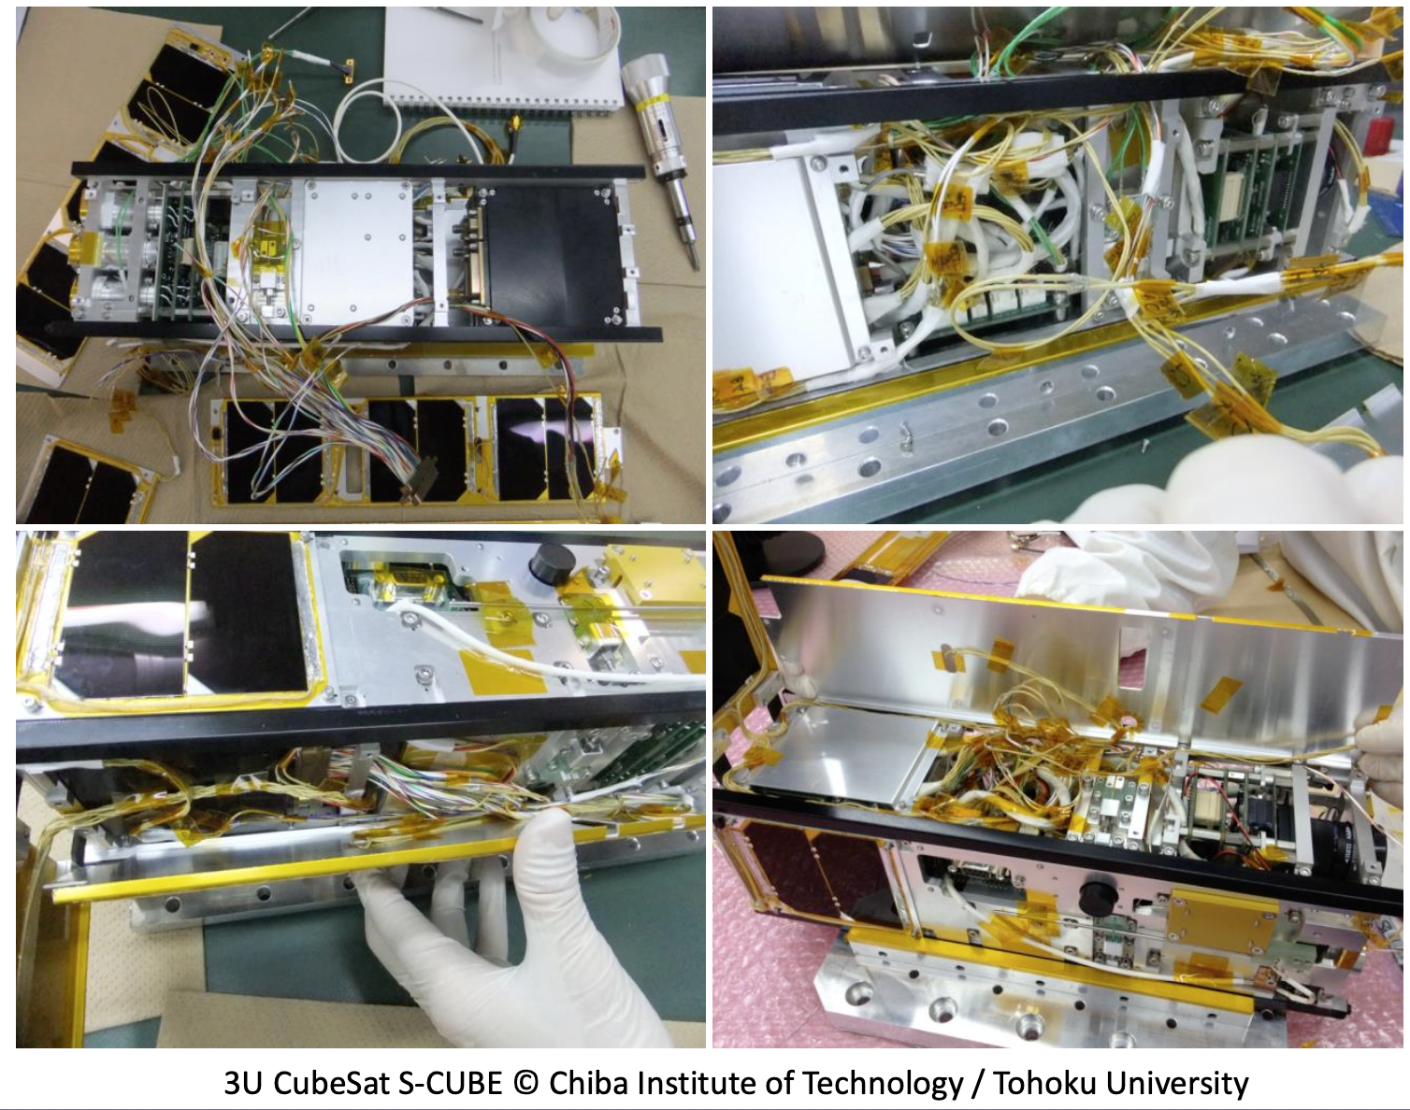
Harness System
The harness system is not negligible! It affects the handling ability during satellite system integration.
Notes:
Kibo07_28

Slide 26
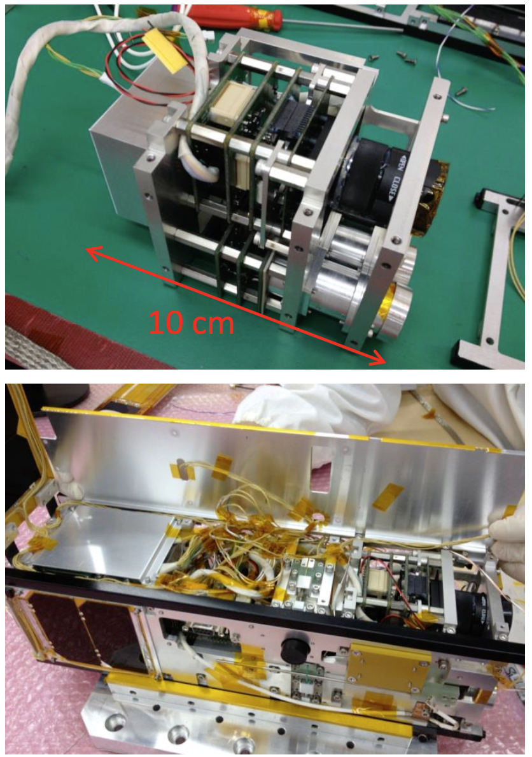
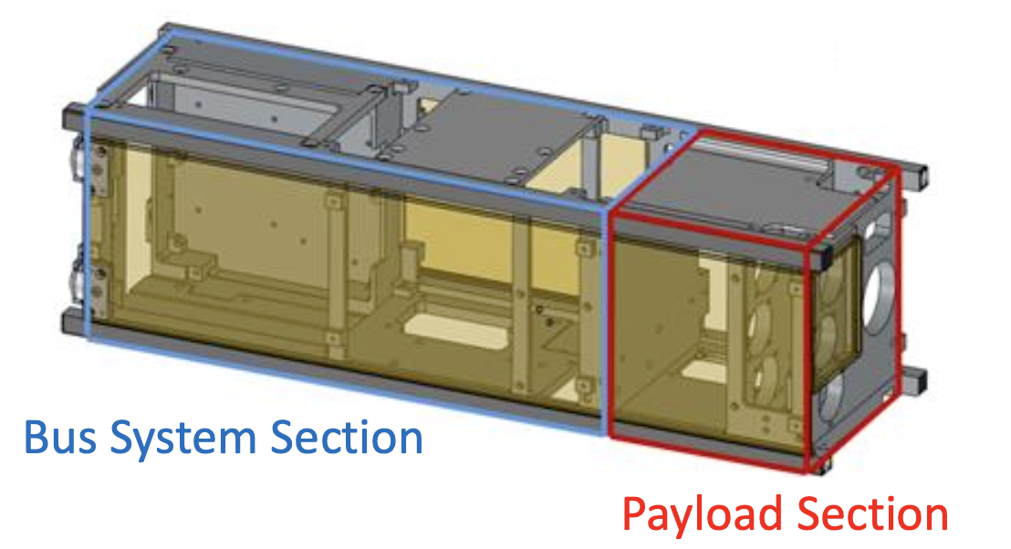
Payload Systems
The on-board components dedicated to the satellite’s missions.
Good practice is to define clear interfaces (mechanical and electrical) with the bus system.
Example of 3U CubeSat “S-CUBE”
  1U is assigned for the payload instruments
  2U is assigned for satellite bus system
3U CubeSat S-CUBE © Chiba Institute of Technology / Tohoku University
Notes:
Kibo07_28

Slide 27
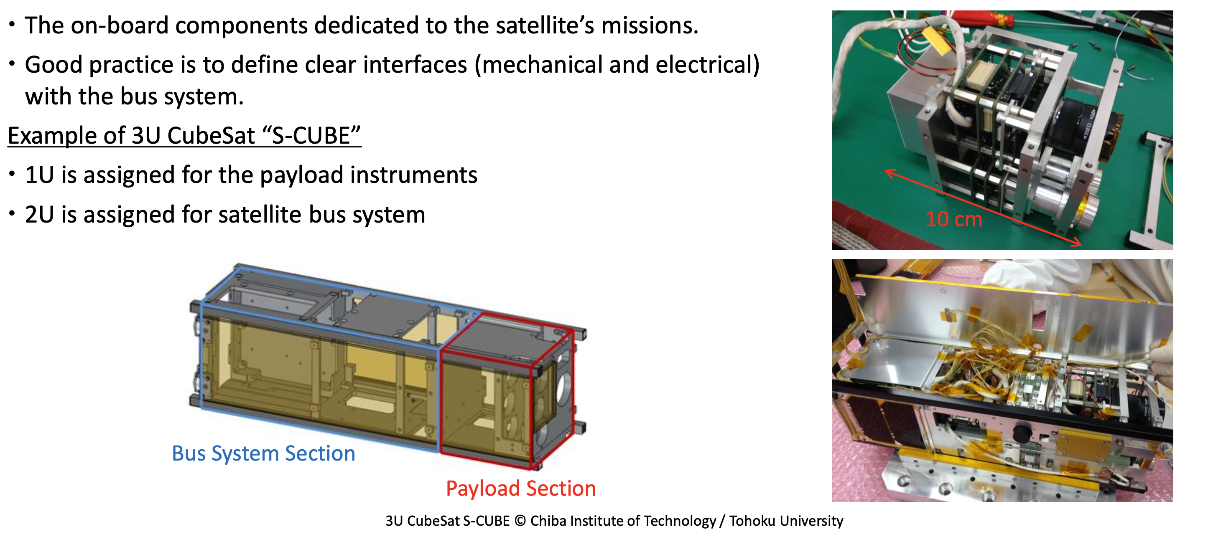
Payload Systems

Slide 28
Types of Payload Systems
Each CubeSat has its own mission.
  The larger the CubeSat is, the more payload instruments can be carried and the more advanced the missions are that can be conducted.
Examples of CubeSat payload instruments.
  Observation cameras (Earth, Planetary, Astronomy, etc.)
  In-situ space environment measurement sensors
  Meteor measurement sensors
  Communication instruments
  Engineering demonstrations
  Deployment mechanisms
  Advanced technologies (new sensors, electrodynamic tether, etc.)

Slide 29
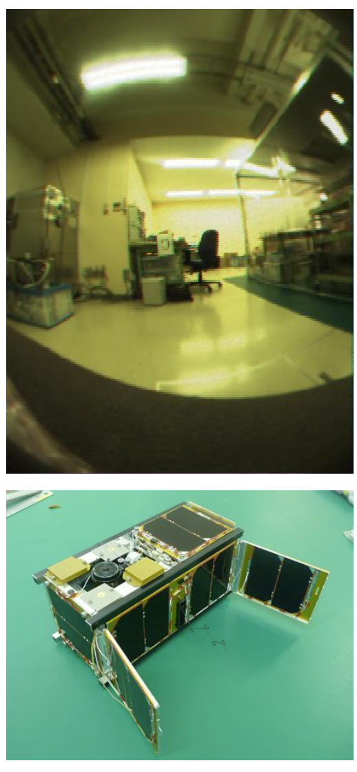
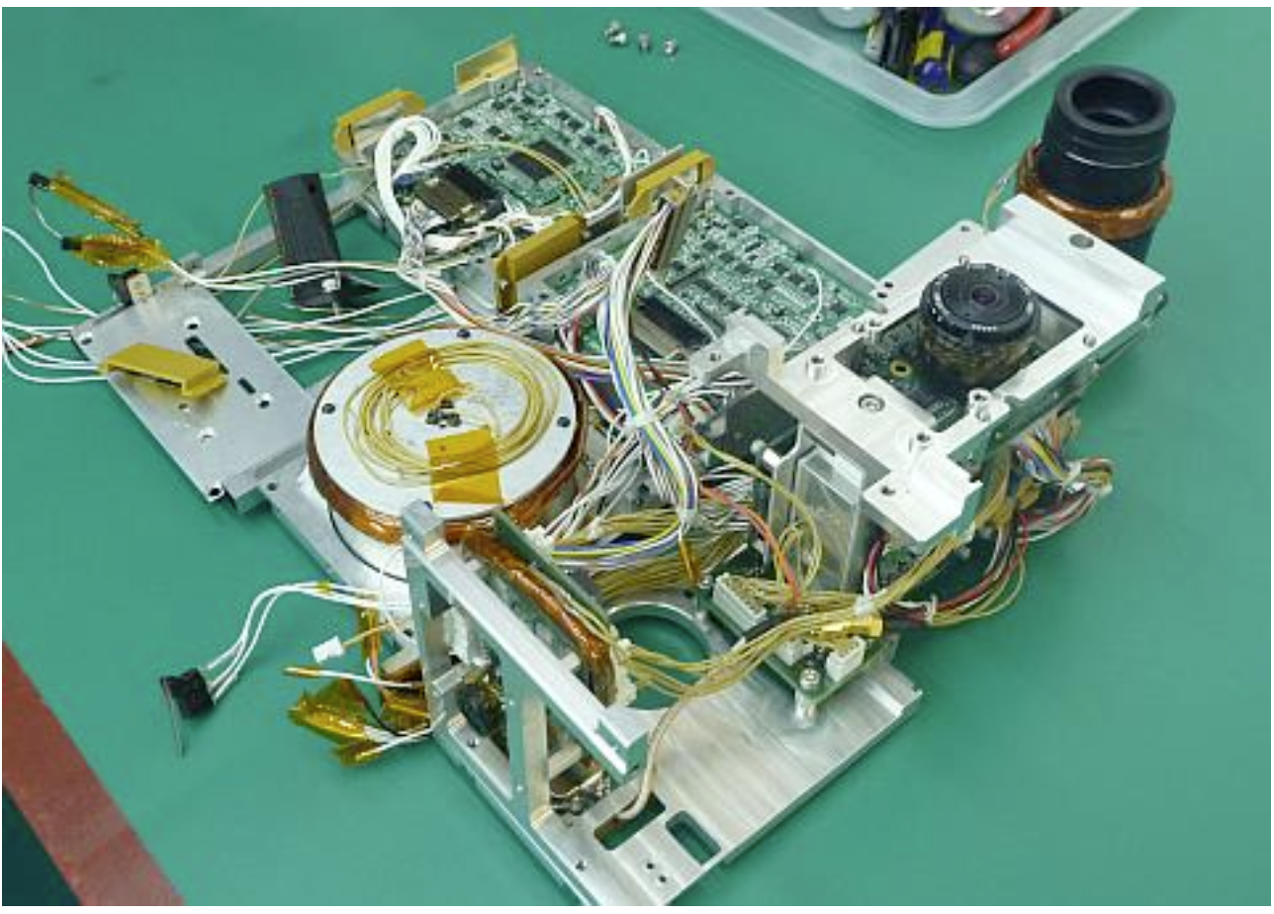
Payload: Earth Observation Camera System
Example of 2U CubeSat “RAIKO”
  Earth Observation Camera System
  New sensor: Star Tracker
2U CubeSat RAIKO © Tohoku University
Notes:
Earth Observation Camera System
Kibo07_32

Slide 30
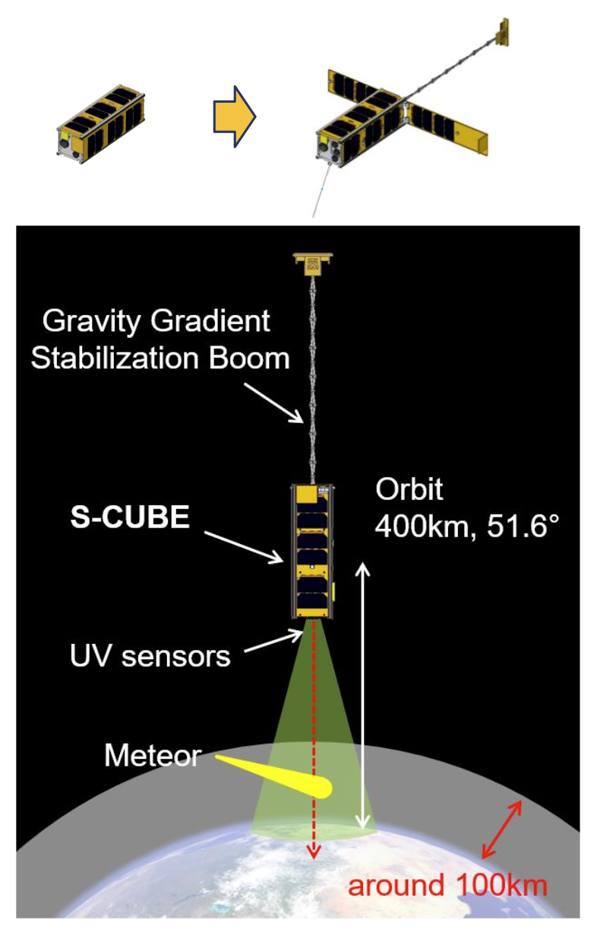
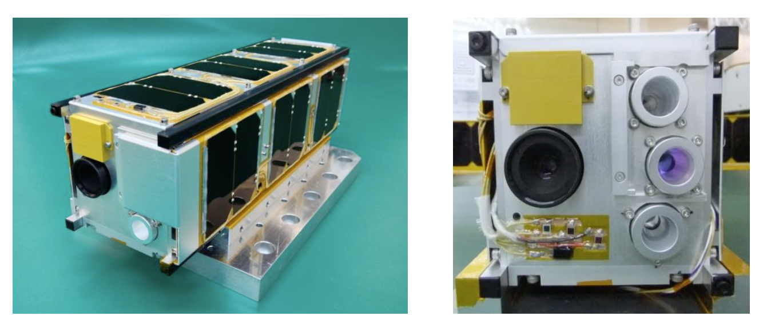
Payload: Meteor Observation
Example of 3U CubeSat “S-CUBE”
  Meteor Observation Camera System
  Gravity Gradient Boom
  Deployable Solar Panels
A gravity gradient boom was used to point the meteor observation camera toward the Earth’s atmosphere for detection of incandescent meteors as they enter the atmosphere.
3U CubeSat S-CUBE © Chiba Institute of Technology / Tohoku University
Notes:
Earth Observation Camera System
Kibo07_32

Slide 31
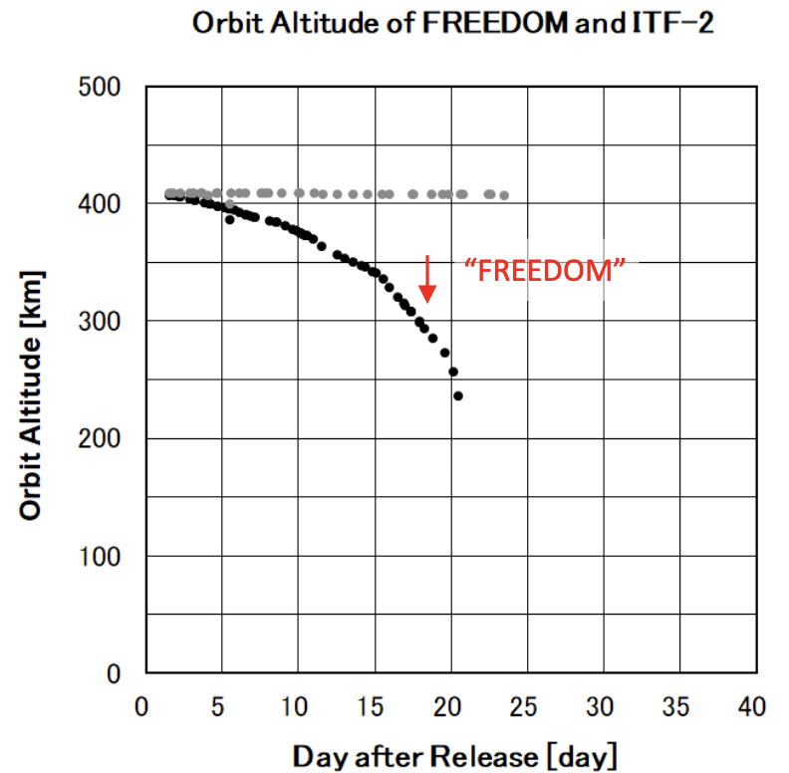
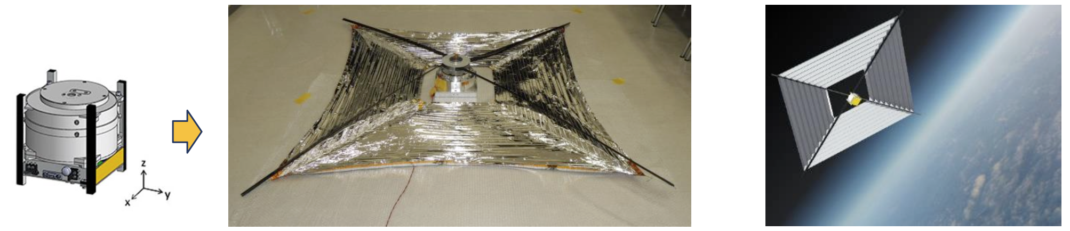
Payload: De-orbit Sail
Example of 1U CubeSat “FREEDOM”
  De-orbit sail for fast de-orbiting and re-entry into Earth atmosphere from ISS orbit.
No communication system, no solar cells.
FREEDOM demonstrated on-orbit deployment of the thin-film based de-orbit sail, which can be utilized for space debris mitigation and prevention using atmospheric drag.
1U CubeSat FREEDOM © Nakashimada Engineering Works, Ltd. / Tohoku University

Slide 32
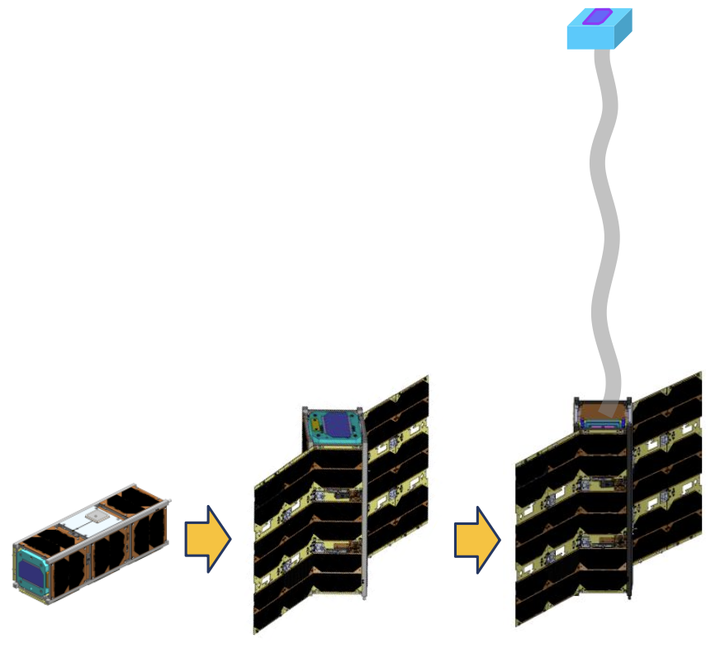
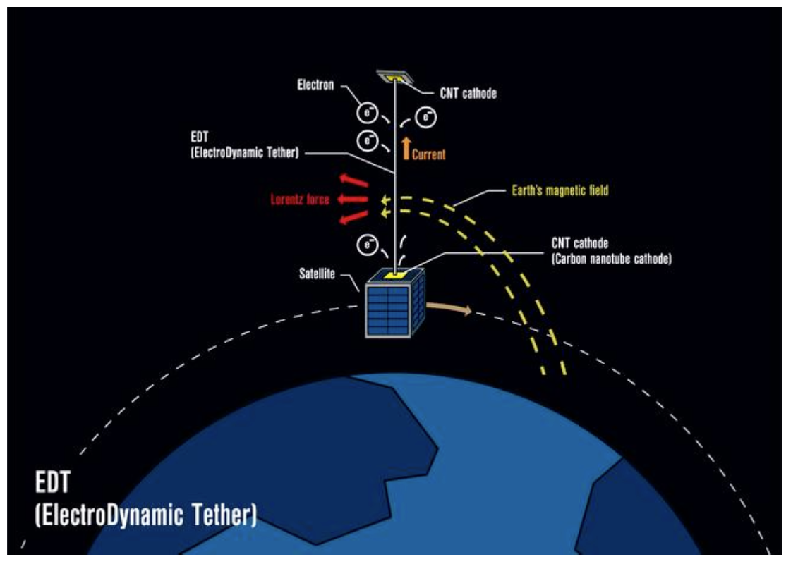
Payload: Electrodynamic Tether
Example of 3U CubeSat “ALE-EDT”
Electro-dynamic tether for de-orbiting and re-entry into Earth atmosphere.
3-axis attitude control is used to control the satellite attitude during the extension of the electrodynamic tether. The device will be useful for space debris mitigation and prevention in higher altitude orbits, as it can operate independent of atmospheric drag.
© ALE Co., Ltd.

Slide 33
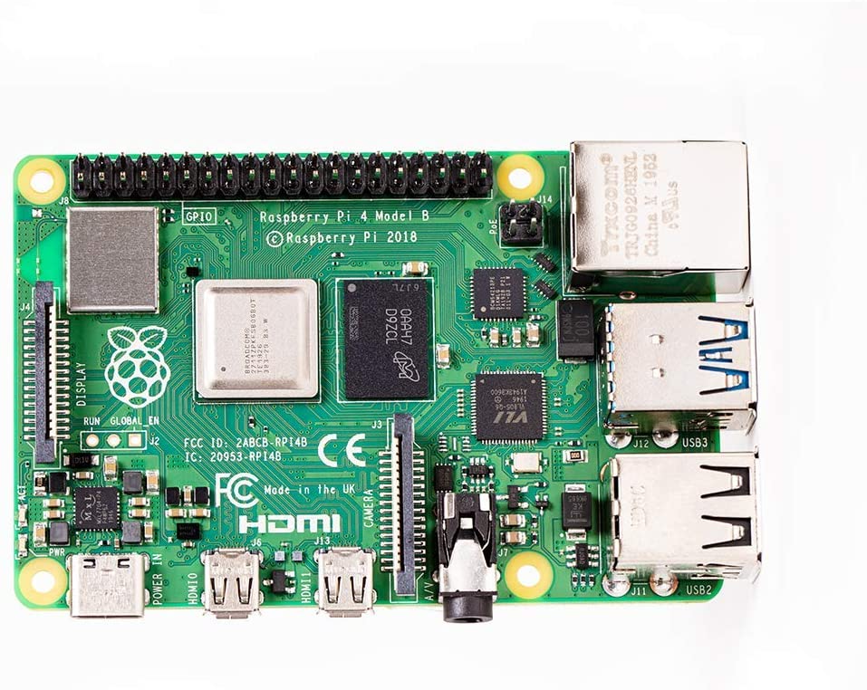
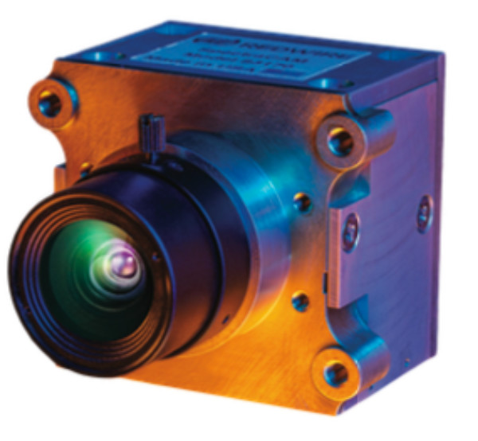
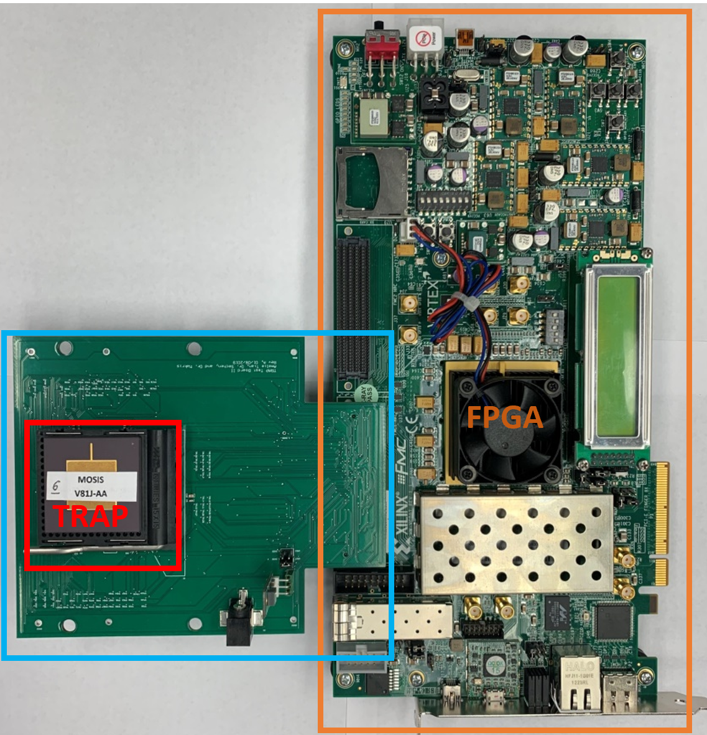
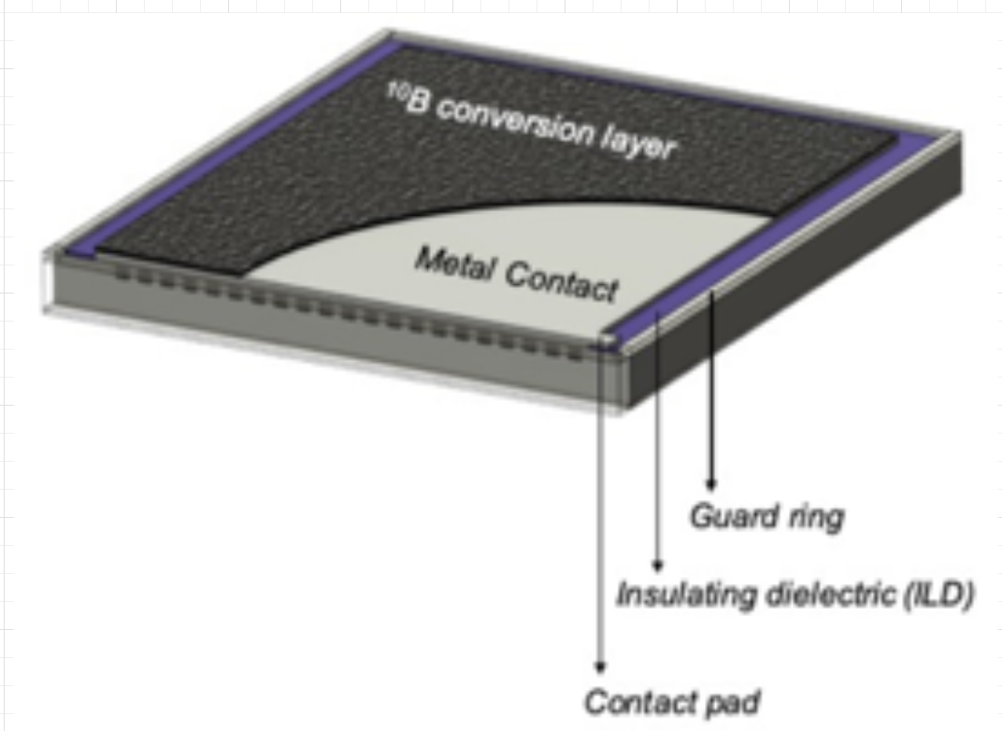
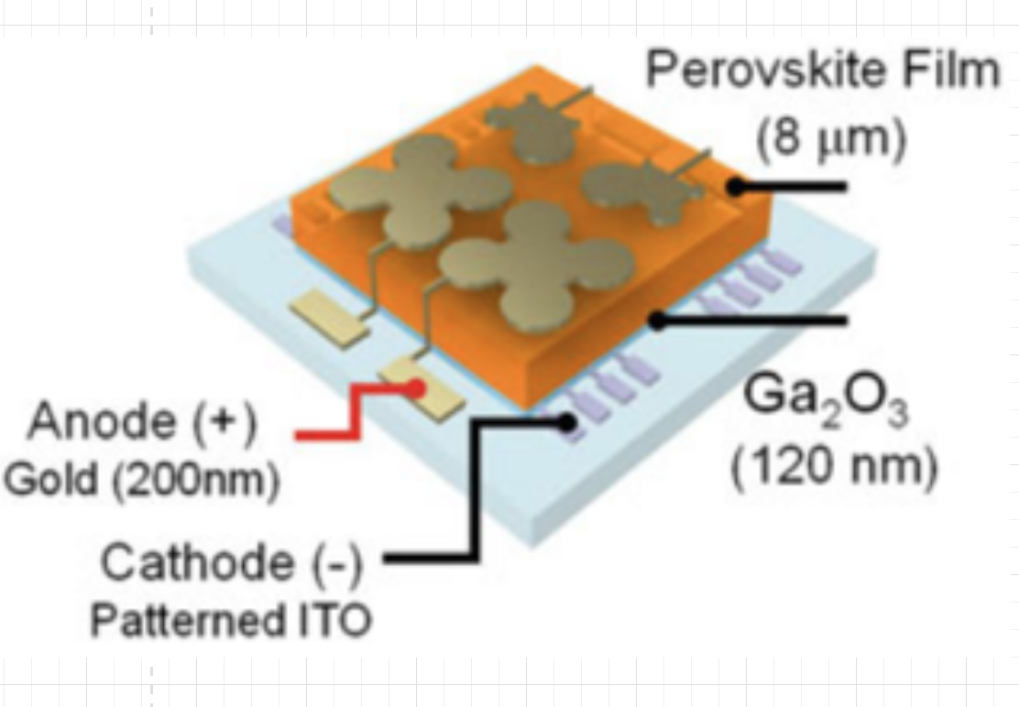

OBC and Payload Emulation
Micro-controller device with specific emphasis on
  Low power consumption
  Real-time operation
  Robustness and reliability

Slide 34
Unique Design Consideration for CubeSat
Build or Buy?
Rad-Harden or COTS?
TODO

Slide 35
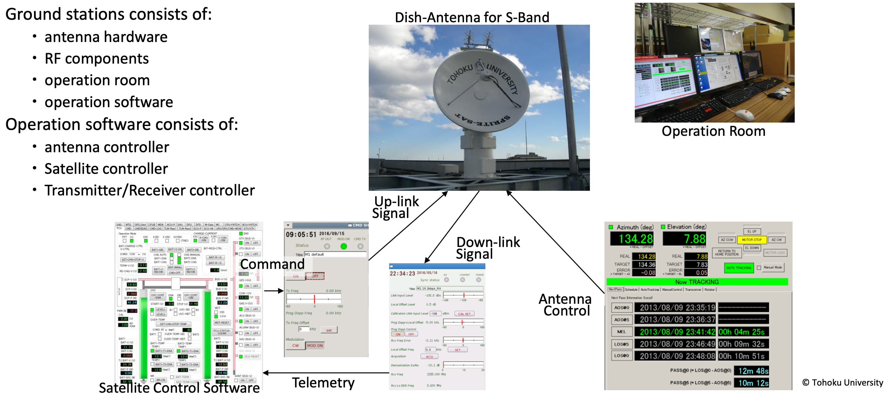
Ground Station Setup

Slide 36
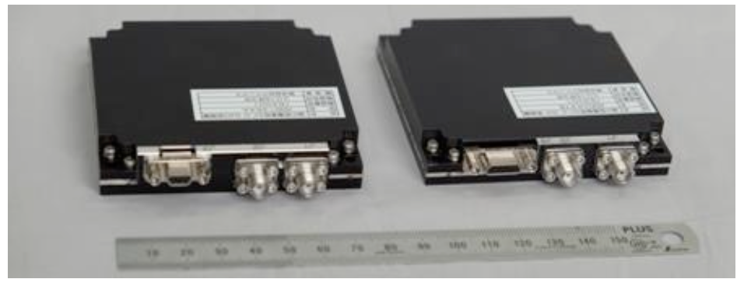
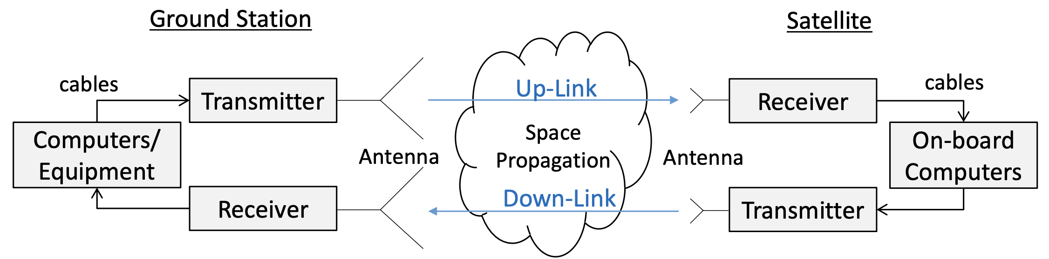
Communication System Components
Communication systems usually involve the following components in both directions - command up-link and housekeeping (HK) data/mission data down-link:
Computers
Transmitter and transmitting antenna
Receiver and receiving antenna
Cables
Other components such as power amplifiers
Radio frequency (RF) cables are thick, and their
connectors are relatively large.
Typical CubeSat RF Transmitter and Receiver © Addnics corp.

Slide 37
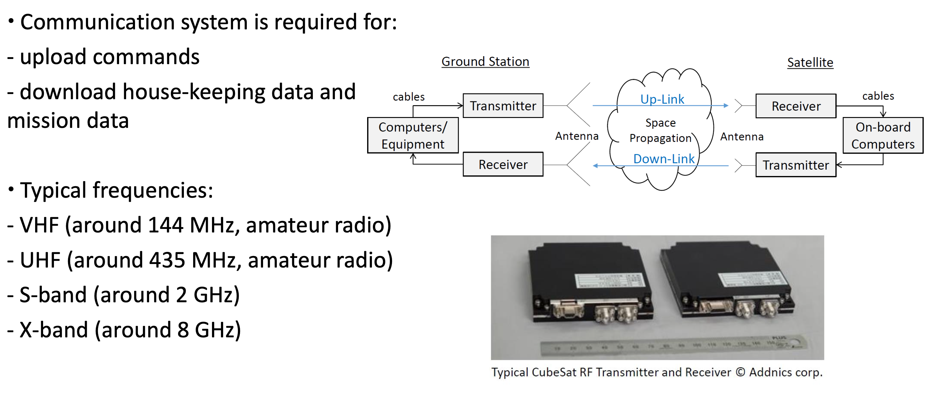
Components for Satellite and Ground Station

Slide 38
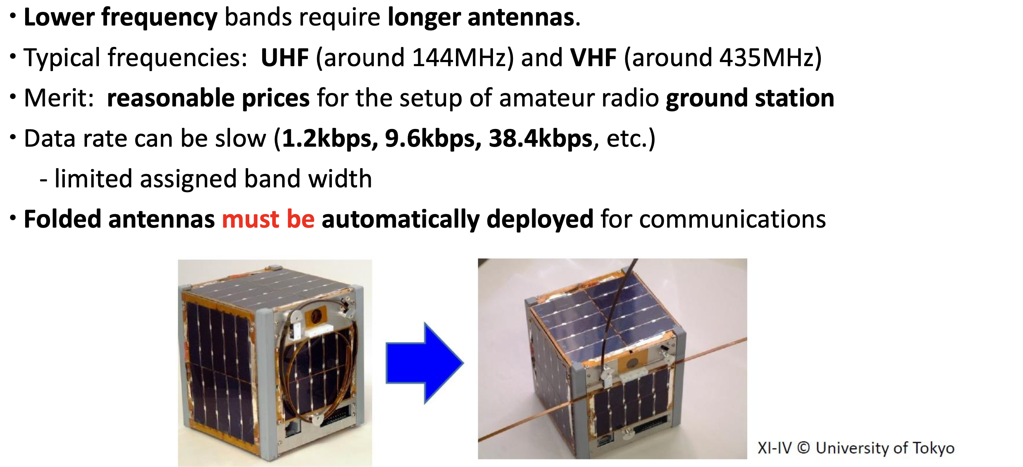
Deployable Antenna

Slide 39
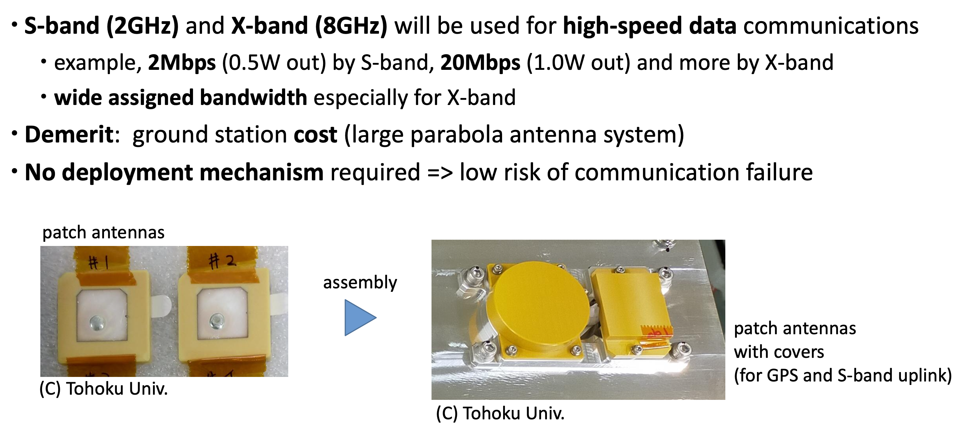
Patch Antenna
Notes:
Kibo17_16

Slide 40
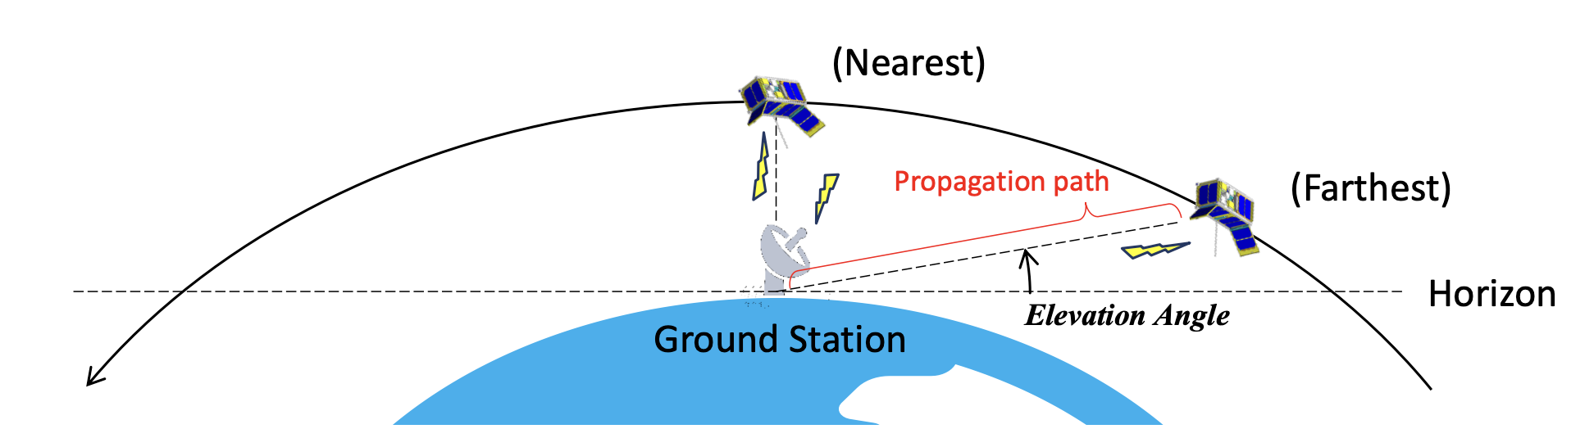
Link Budget
The communication channel in both directions between the satellite and ground station need to be carefully designed.
The received RF signal power at receivers shall be strong enough for a stable communication.
(Ensure a sufficient link margin!)
The link budget is the relationship between (1) data rate, (2) antenna size, (3) propagation path length, (4) transmitter power, and (5) losses through the communication channels.
The propagation path between the satellite and the ground station is the longest at lower elevation angles (at the beginning and the end of the satellite contact), which is one of the design criteria for the link budget design.
Notes:
Kibo07_40

Slide 41
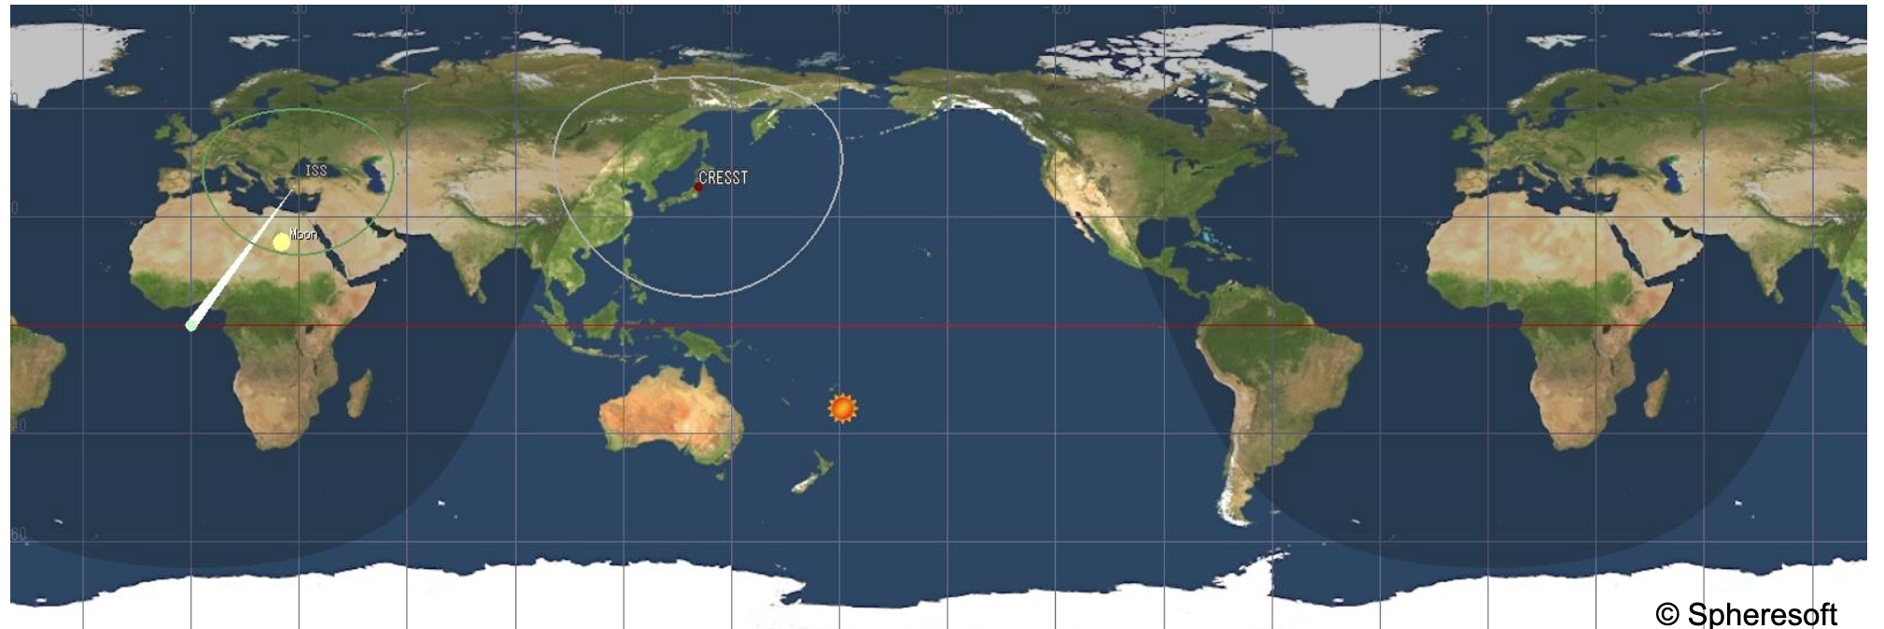

Geographical Position of the Ground Station
The latitude of the ground track of the CubeSats deployed from the ISS is between about ±51.6 degrees. Therefore, their ground stations need to be in that region.
In the low latitude region, CubeSats can approach to the ground station both from northwest and southwest. (different direction in day and night)
The duration of the ground contact is the longest when the CubeSat flies just above the ground station. (However, some ground stations cannot track satellites around the vertical direction!)
Ground contact time, i.e., the amount of communication data can be increased by using more than one ground station, which are geographically separated.
Kassing et. al. Exploring the “Internet from space” with Hypatia IMC 2021
Notes:
Kibo07_41

