Slide 1
Communication Systems
Small Satellite Workshop 2026

Slide 2

RF Communication For CubeSat
RF communication subsystem is the most powerful and mature option to get information or send command from/to long distance
Communication subsystem’s responsibility = very long-term activity
(Start with comm, finish with comm)
  Satellite project start from frequency coordination, and radio station license coordination
  Satellite project finish with sending RF transmit termination command
In the case of entry/research project, amateur station (UHF/VHF) is commonly considered
Higher bands (S-band/X-band) are considered for matured project (like Earth Observation, Science Mission)

Slide 3
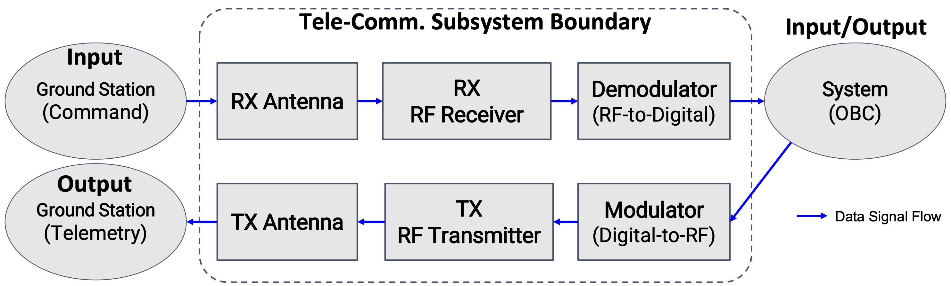
Communication Subsystem Architecture

Slide 4
Key Functions for Communication
Tele-Communication Objectives
  To confirm of the satellite survival (Beacon or CW Morse)
  To get telemetry (digital packet data of housekeeping of the satellite (like temperature, voltage, current, status, and attitude parameters),
  CCSDS in professional/commercial mission, AX.25 in amateur mission
To control the satellite (change operational mode, start mission camera shooting, registering the mission schedule)
To get the distance information between the satellite to ground (ranging, especially for deep space mission)
  LEO case: GPS/GNSS-based positioning is common

Slide 5
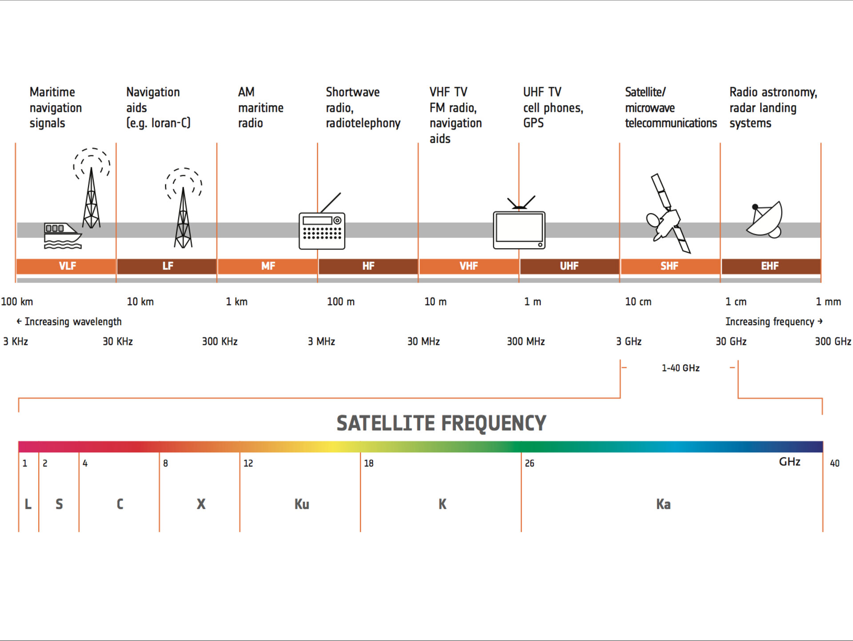
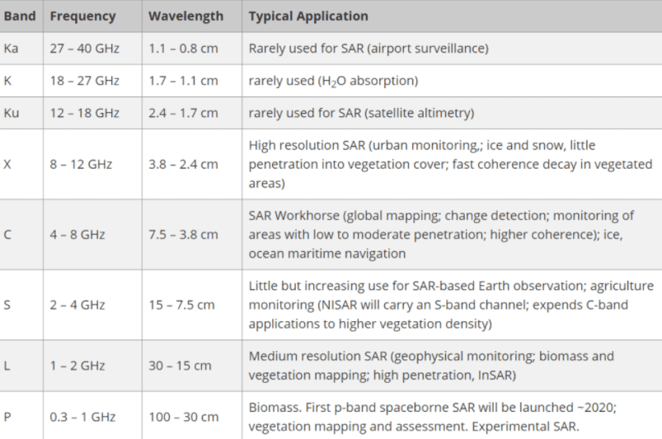
Satellite RF Frequency Band
Notes:
https://www.esa.int/Applications/Connectivity_and_Secure_Communications/Satellite_frequency_bands
https://www.satnow.com/community/what-are-satellite-frequency-bands

Slide 6
Notes:
https://upload.wikimedia.org/wikipedia/commons/c/c7/United_States_Frequency_Allocations_Chart_2016_-_The_Radio_Spectrum.pdf

Slide 7
RF Band Considerations
All key design features and constraints depend on which frequency is used
  RF band allocation is the most important and the first action to kickoff satellite projects
Lower frequency (VHF/UHF) is well-demonstrated
Higher frequency (5 ~ 20 GHz) is difficult to use (especially for first time developer like university mission)
New possible option is Specified Low Power Radio Station
  Such as LoRa (Long Range): a kind of LPWA (Low Power Wide Area) protocol
  → several CubeSats have already demonstrated the feasibility of the technology

Slide 8
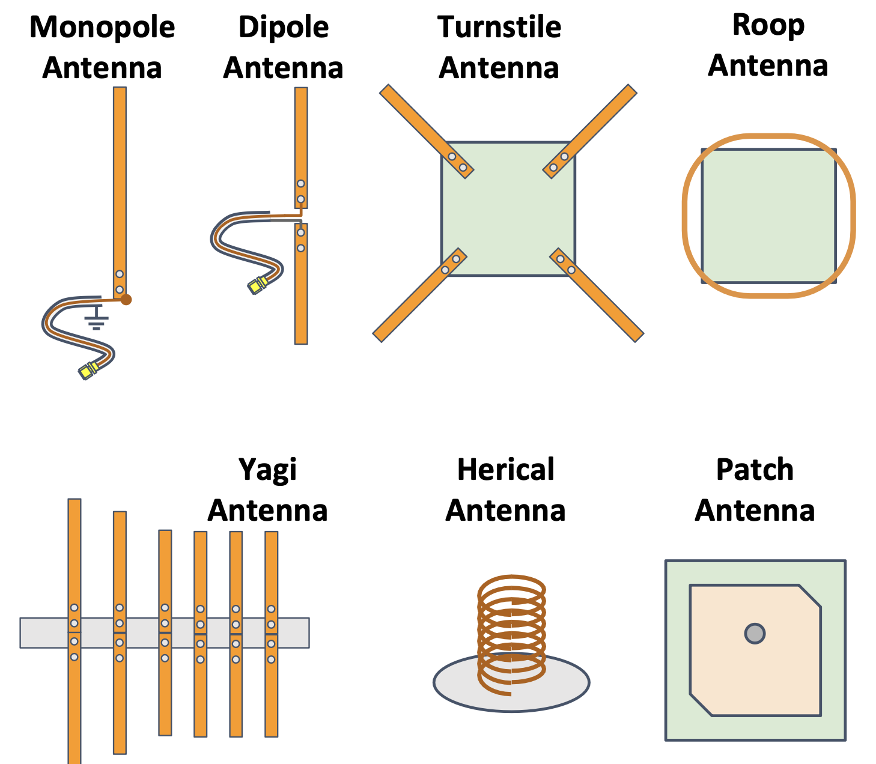
CubeSat Antenna
How to emit RF to space / correct RF from space
Antenna is a key component for satellite operation
(No antenna, no mission data from space)
Antenna design is based on studying the electromagnetic field, there are many kinds of antenna design
  All current-flowing conductors can emit RF potentially = micro-dipole model
  Even, tiny copper line on PCB is always emitting RF!
Antenna performance is affected by...
  Length (corresponding to target frequency)
  Material (permissiveness)
  Shape (rod, plate, circle, ring, cubic, corn …)
  Combination of multiple antennas (arraying)
  Relationship to GND plane (distance and angle)
Notes:
Kibo09_12

Slide 9
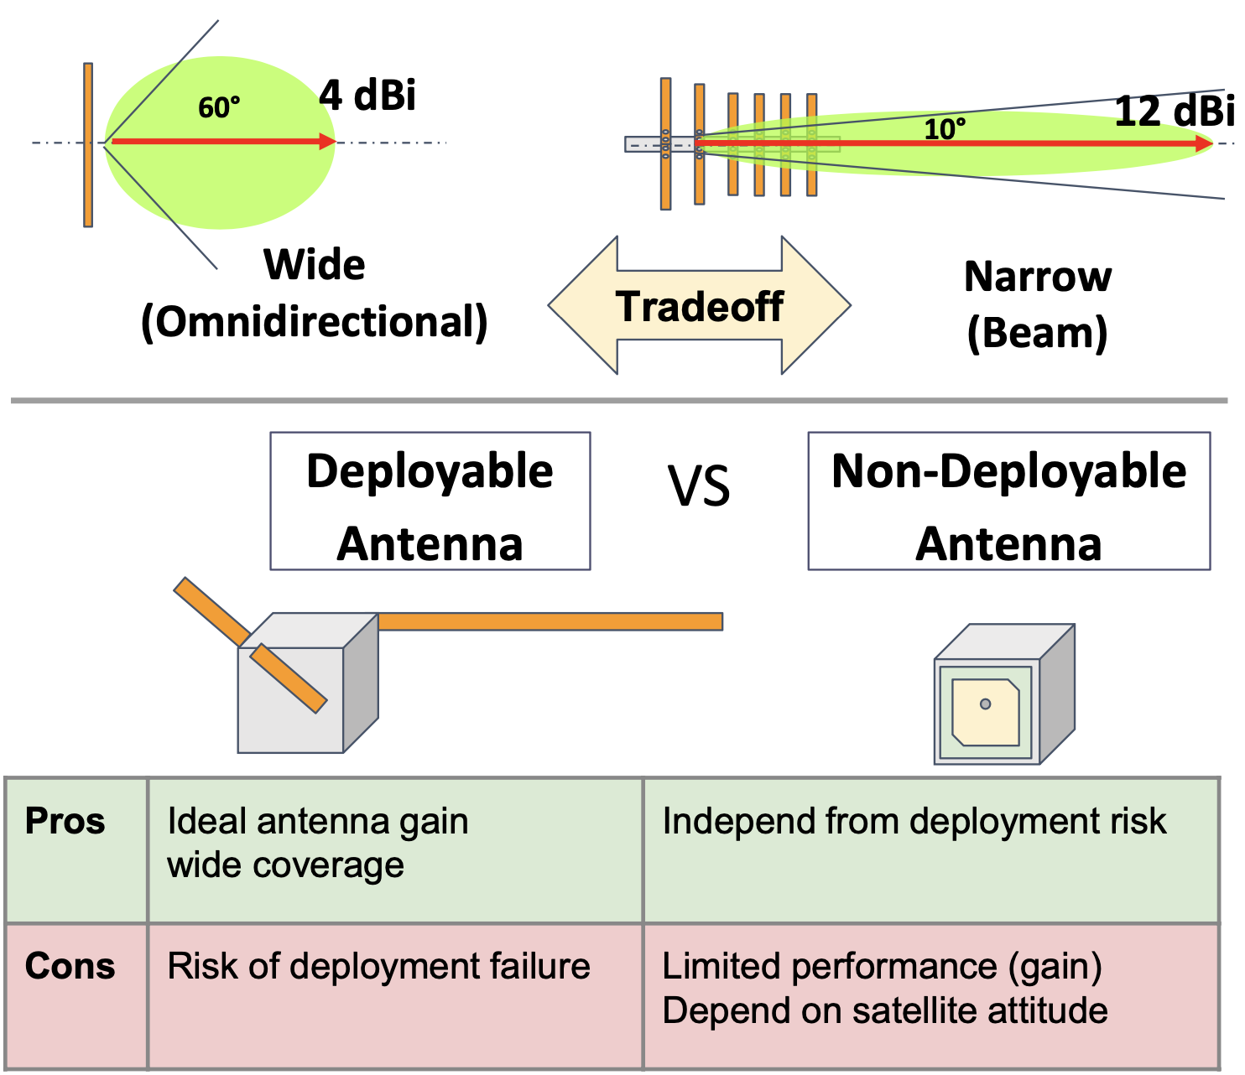
Antenna Characteristics
Antenna Gain : dBi [dB is logarithmic scale]
(i stands for Isotropic antenna)
  Antenna Pattern: Wide (broad) or narrow (beam)
  HPBW (Half Power Beam Width) [deg]
  EIRP (Effective Isotropic Radiated Power)
  G/T (Antenna gain-to-noise-temperature)
  VSWR (Voltage Standing Wave Ratio)
  Polarization: Linear or circular (RHCP, LHCP)
Deployable or non-deployable：
  Most Critical Decision for CubeSat Mission Success
  Major reason of “Dead on Arrival” status might be antenna deployment failure
  In the non-deployed state of the antenna, the performance of RF transmitting is few expected to nominal condition
Notes:
Kibo09_13

Slide 10
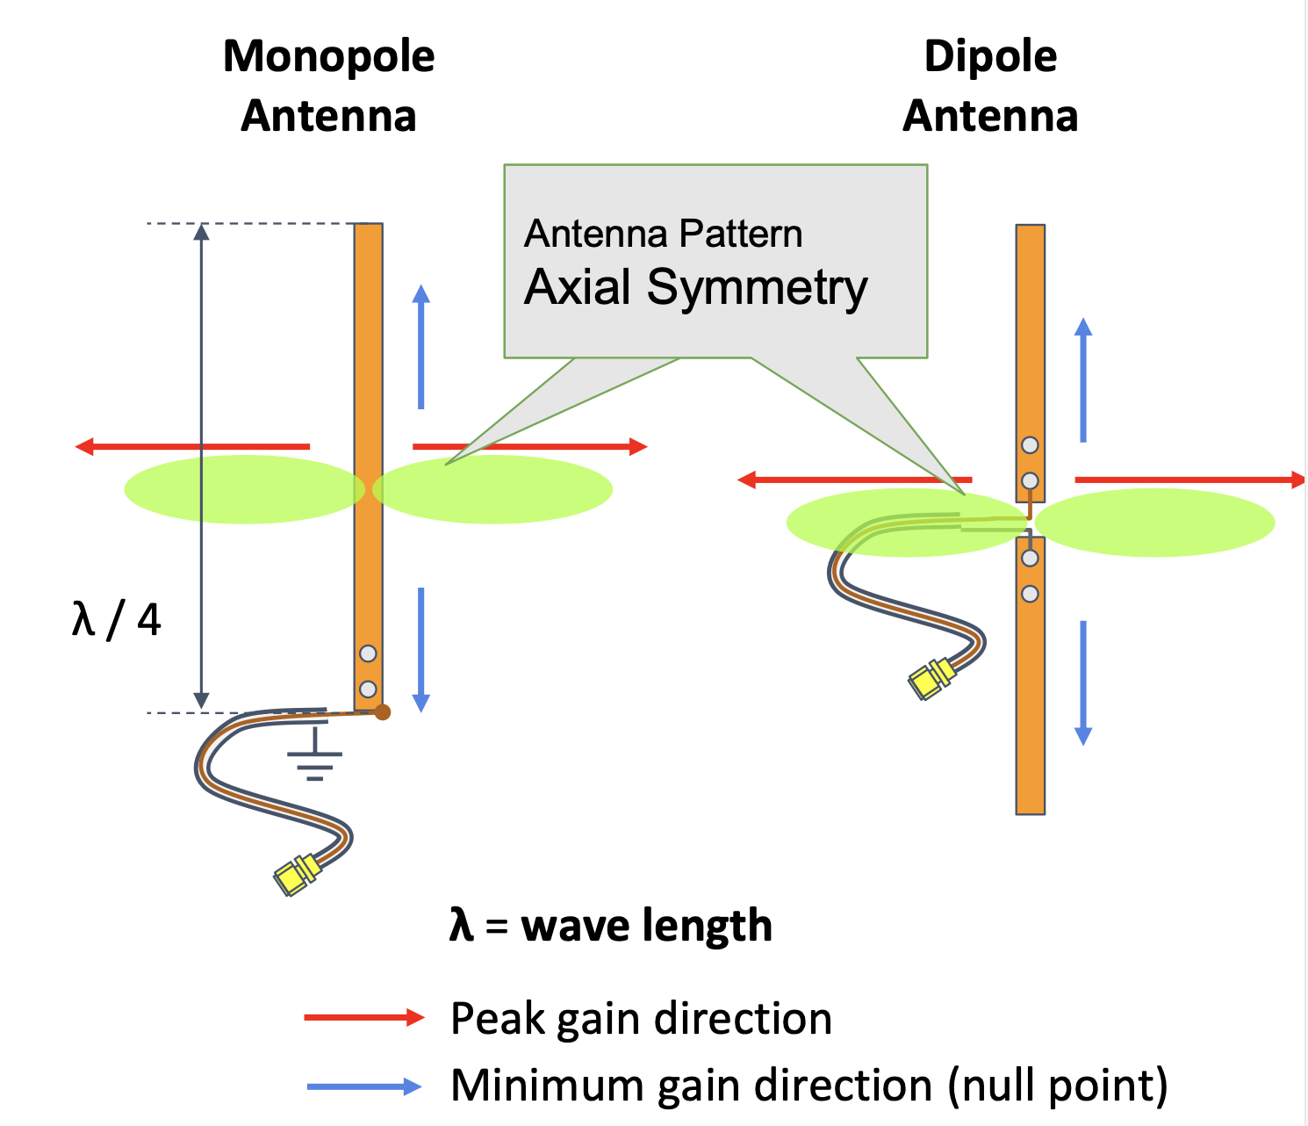
Antenna Design and Testing
Example : Typical monopole and dipole for CubeSat
Material: Thin ribbon steel tend to be selected for antenna element (to store inside envelope of CubeSat by bending)
Adjustable parameters are its length, width, thickness
(length is most important factor for performance)
One side is free end, the power feed point and mechanical interfaces are located on the other side
The center wire of the coaxial cable is attached to this power feed point of the antenna element by soldering or spot welding
  Monopole: the outer shield of coaxial cable is attached to GND
  Dipole: the outer shield of coaxial cable is attached to the other paired antenna element
Linear polarization: Electric field oscillating direction is kept in the same plane
Notes:
Kibo09_14

Slide 11
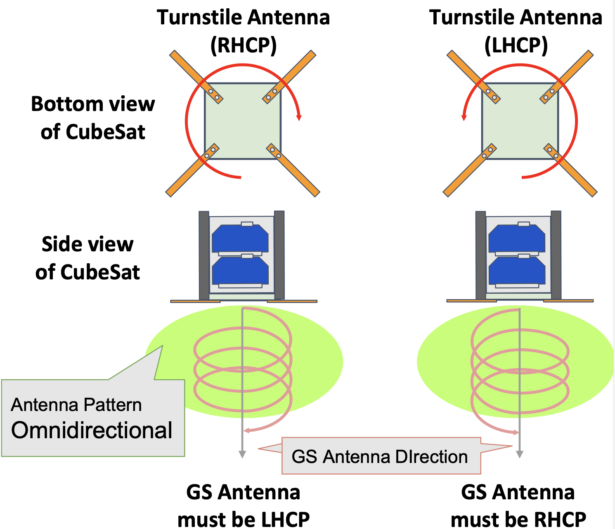
Antenna Design and Testing
Example : Turnstile Antenna for CubeSat
Combination of 4 antenna elements
(= a set of 2 dipole antennas = cross-dipole)
Single element’s properties are same as dipole case
Input RF power is fed to 4 antenna elements by changing the phase every 90 degrees
(0, +90, +180, +270)
Omnidirectional radiation pattern
Circular polarization: Electric field rotates in the direction of propagation
  RHCP: Right Hand Circular Polarization
  LHCP: Left Hand Circular Polarization
Circular polarization is much more robust for space telecommunication than linear polarization
GS antenna’s RHCP or LHCP must be match the satellite’s condition

Slide 12
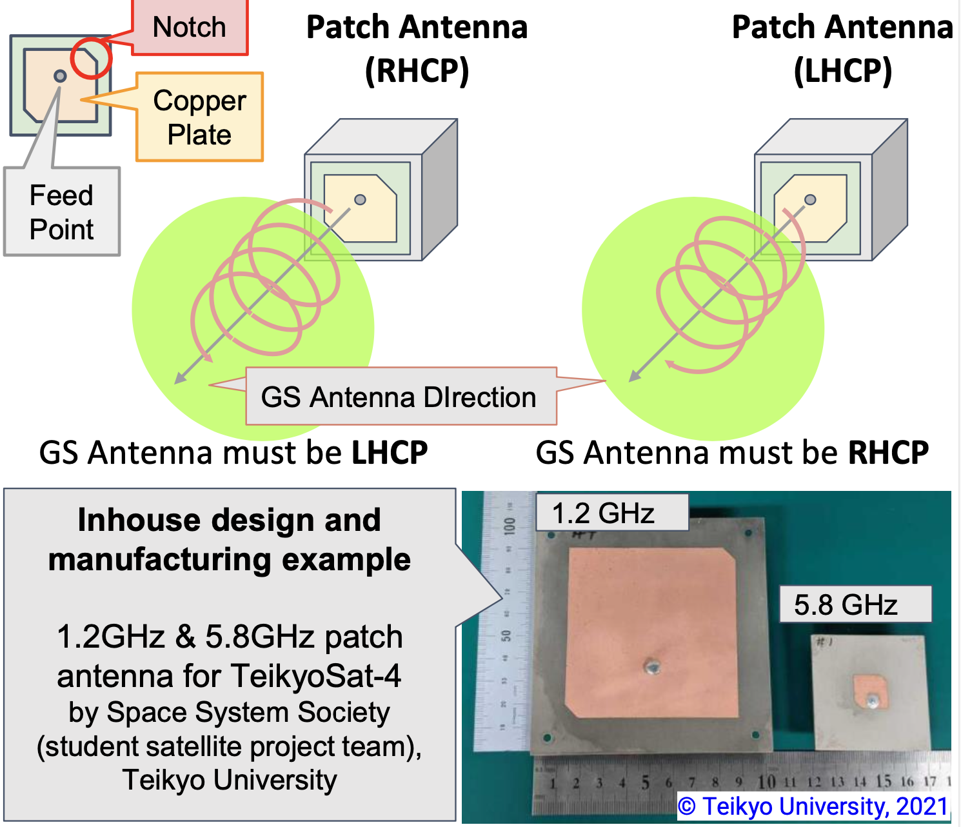
Antenna Design and Testing
Example : Patch Antenna for CubeSat
Plate style
(good for keeping within the envelope requirement)
PCB and copper plate sizes depends on frequency
  In the case of over 1.2GHz-band, the entire antenna size is suitable for typical 1U CubeSat Surface [10x10cm]
Omnidirectional radiation pattern
  Circular polarization: Electric field rotates in the direction of propagation depending on the position of a feed point and a paired notch
    RHCP: Right Hand Circular Polarization
    LHCP: Left Hand Circular Polarization
Circular polarization is much more robust for space telecommunication than linear polarization
GS Antenna’s RHCP or LHCP must be match the satellite’s condition

Slide 13
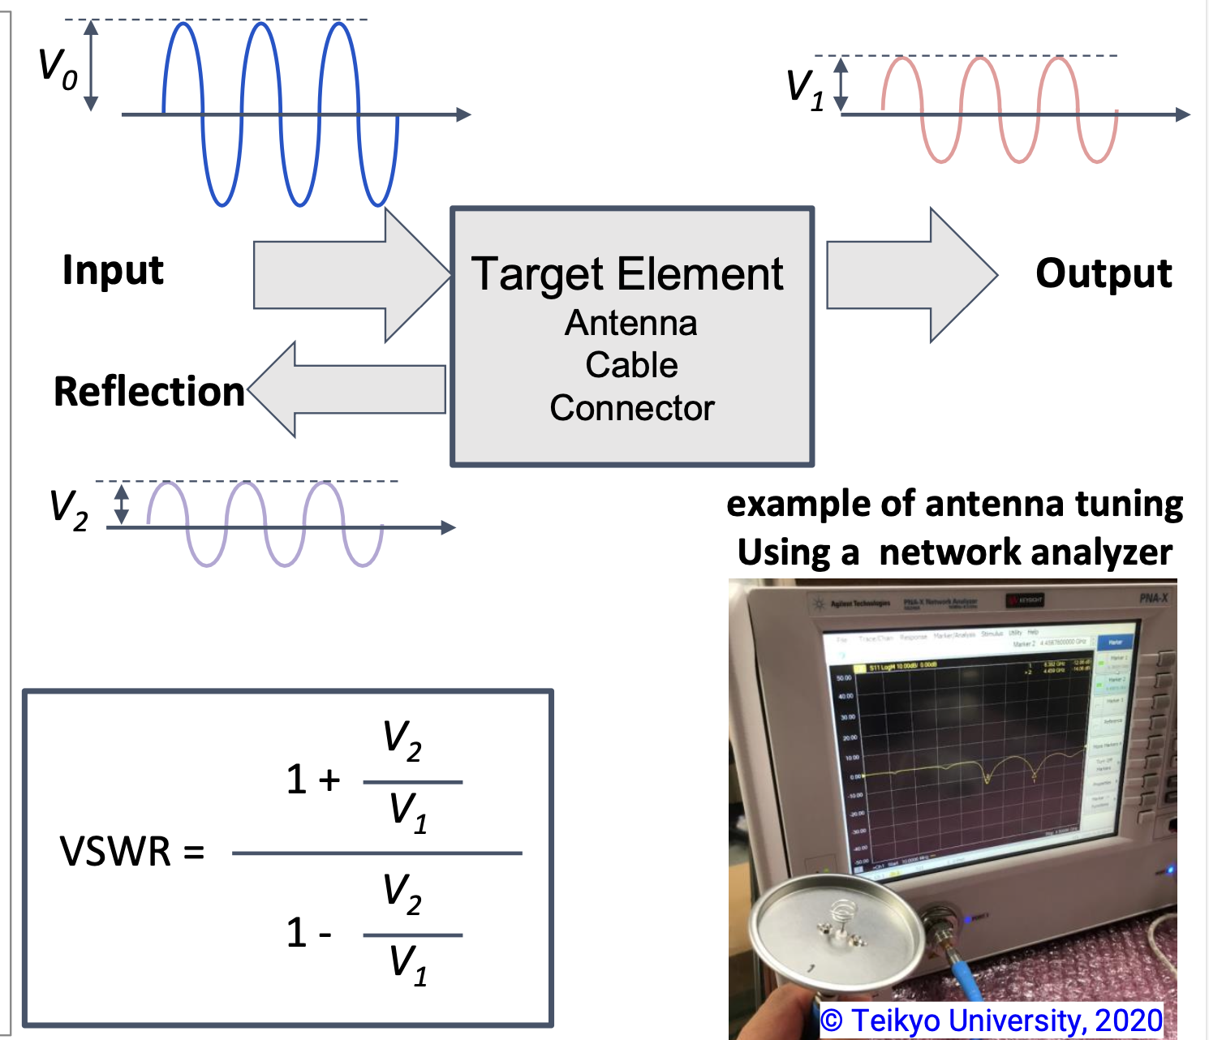
Antenna Design and Testing
Impedance Matching & Antenna Tuning
Impedance: the degree of signal flow (alternative current) easy or not
  ex) 50[Ω] or 75 [Ω] : standard RF component
Signal reflection happens at different impedance points
For effective signal transmission, this reflection should be as small as possible
VSWR (Voltage Standing Wave Ratio)
  At no reflection case → VSRW = 1.0
  At realistic case : VSWR < 2.0
  (especially for transmit antenna)
VSWR tuning can be made by cutting the antenna element or by adjusting circuit constant (discreet parts: R or C or L) with measuring by a network analyzer

Slide 14
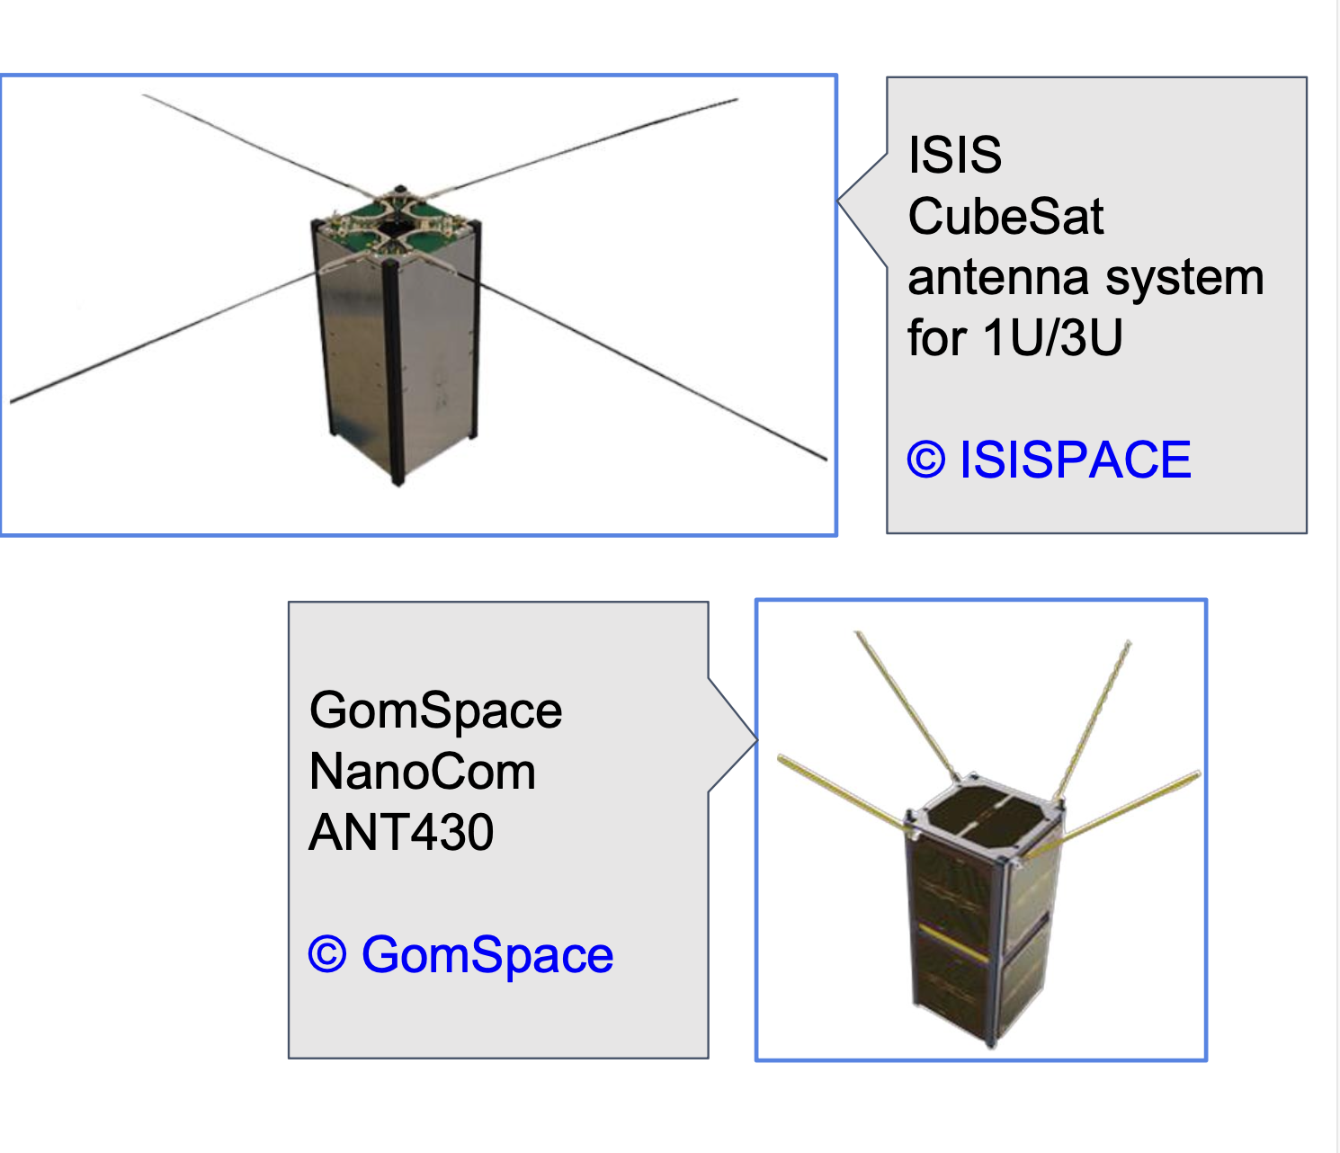
Example Antennas
CubeSat Kit Example
Deployable antenna integrated structure
Frequency and data rate are standardized for typical amateur (VHF/UHF) CubeSat missions
Users do not need to consider detailed design in the case of the combination of recommended TX/RX and Antenna
Example (right Images)
  ISISPASE: CubeSat Antenna System for 1U/3U
  GomSpace: NanoCom ANT430
If TX/RX or antenna were to be newly developed, users should verify the combined performance of antennas and TX/RX hardware
Structure + Solar Panel + Antenna = Standard Kit
(If user’s interest is NOT focused on these developments, this kind of standard CubeSat Kit is very useful to reduce the project workload)

Slide 15
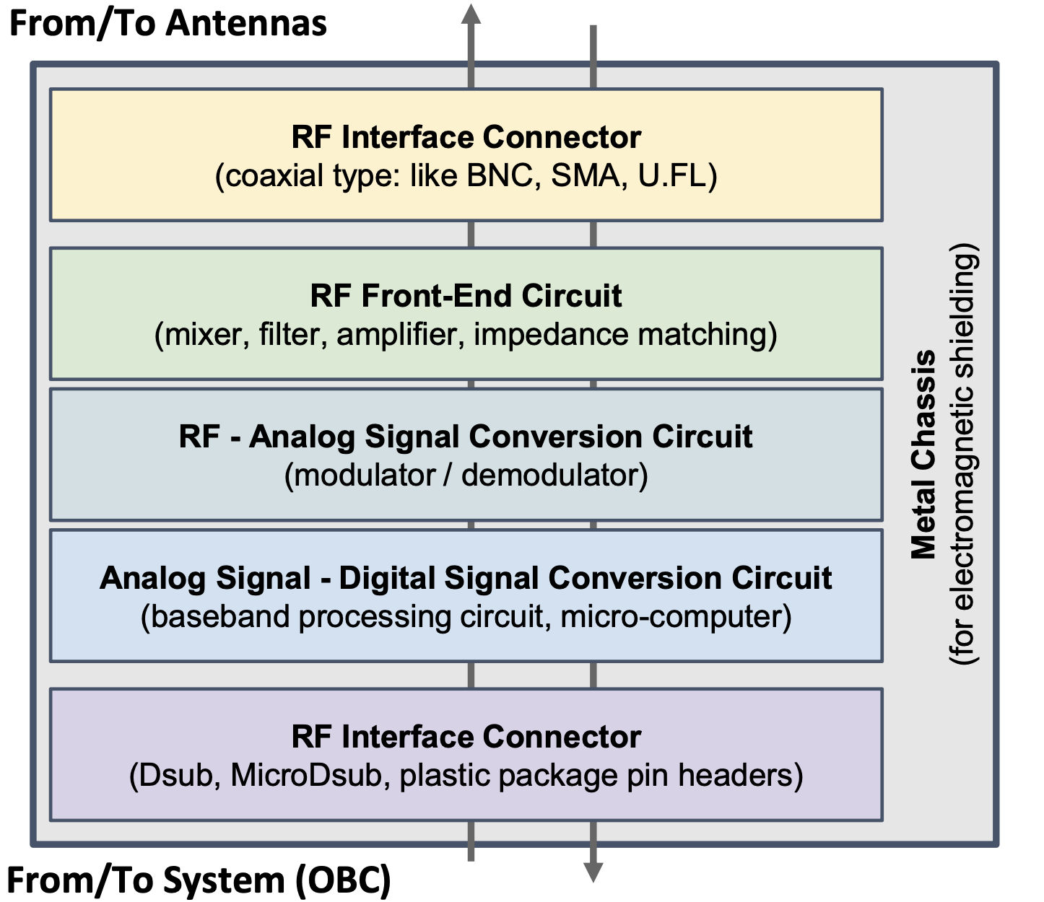
Radio Hardware (TX/RX)
Radio Hardware
Fundamental configuration (major functions)
  RF power amplify
  Frequency conversion (upconvert/down-convert)
  Modulation / demodulation: (D/A conversion or A/D conversion)
Baseband signal processing
Make or Buy
  Make: for mature projects, require experiences on digital, analog and RF)
  Challenging for first project
  Higher frequency, higher difficulty
  Amateur radio operators (HAM)’s support
  Alternative option: SDR (Software Defined Radio) supported by FPGA
Buy: CubeSat kit often includes packaged TX/RX

Slide 16
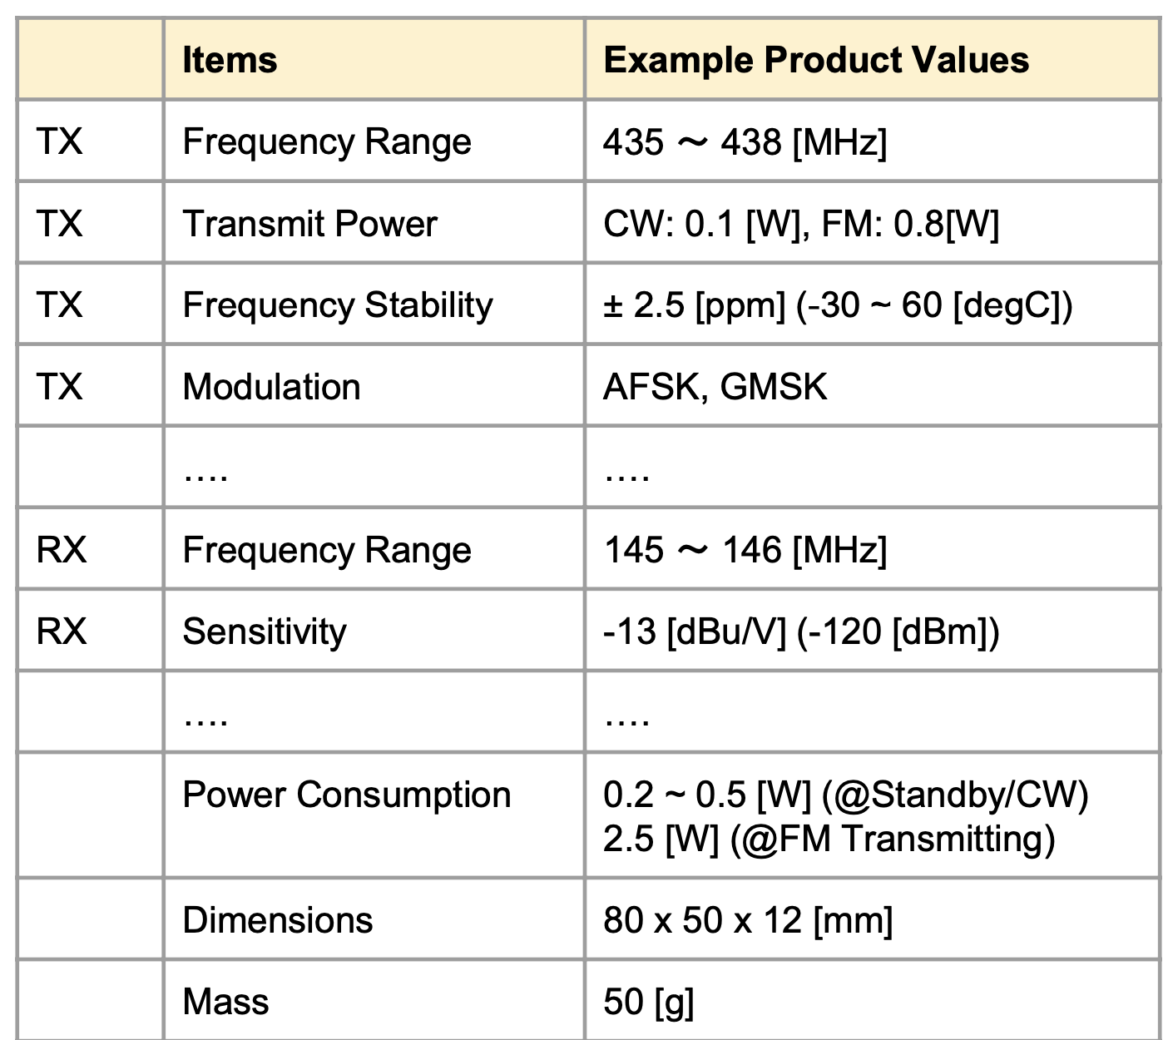
Radio Hardware (TX/RX)
TX (Transmitter)
  Transmit power [W]
  Frequency stability [Hz/degC] or [ppm]
  Bitrate (bps)
  Modulation
  Power efficiency (%)
  (= transmit power / power consumption of module)
RX (Receiver)
  Sensitivity (dBuV) or (dBm)
  RSSI (received signal strength intensity) [dBm/V]
  Modulation
Common
  Operational temperature range (degC)
  Operational voltage [V] ex) +5.0V or +3.3V
  Power consumption [W]
  Dimensions [mm]
  Mass [g]

Slide 17
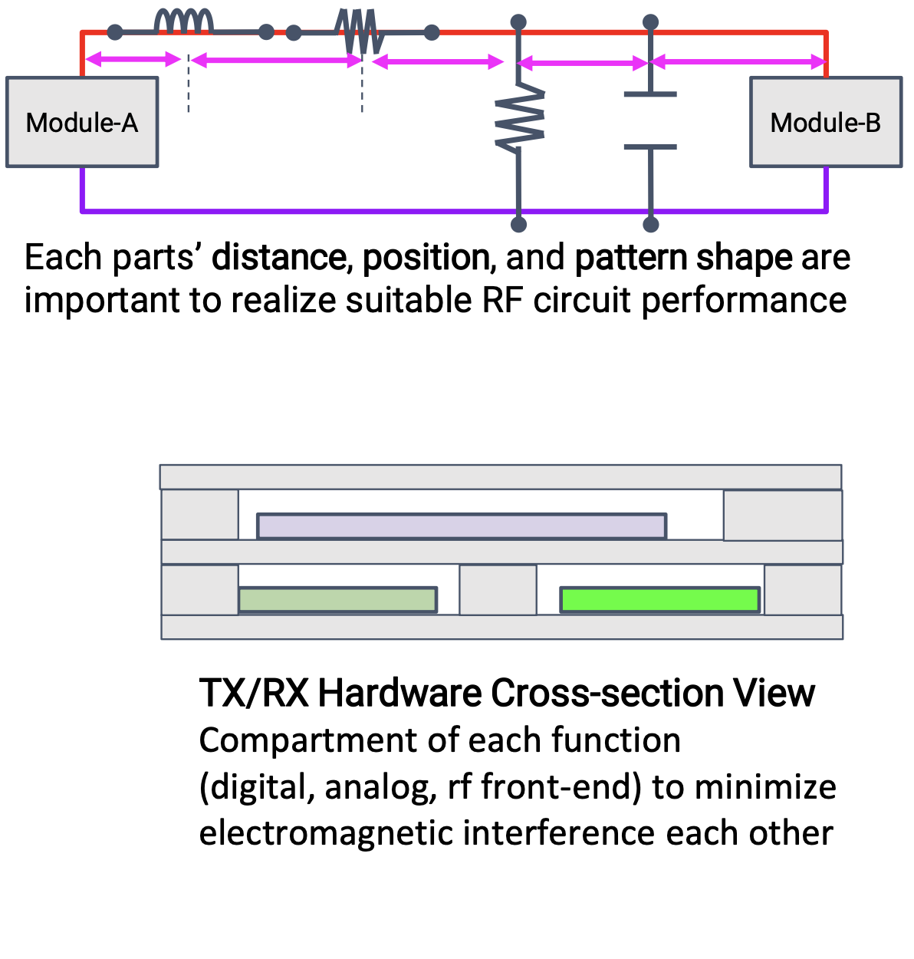
Radio Hardware (TX/RX)
Key Design Points of RF Components
Circuit impedance consideration:
  Dimensions and shape of signal line pattern on PCB should be designed with consideration for properties corresponding to wavelength of RF Signal
Shielding to improve S/N (signal-to-noise Ratio)
Connector selection corresponding to the frequency
Signal line filtering and power line decoupling to reduce noise effect from/to system
Testing Key Points of RF Components
TX frequency stability (corresponding to operational temp)
TX power stability (corresponding to operational temp)
RX frequency stability (corresponding to operational temp)
RX sensitivity stability (corresponding to operational temp)
TX/RX combined operation (TX’s effect to RX: EMC/EMI)

Slide 18
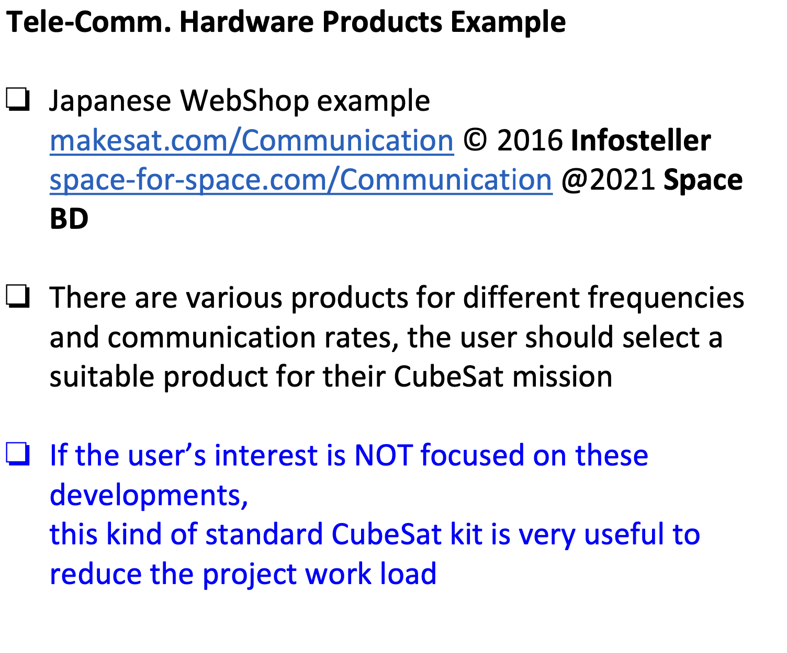
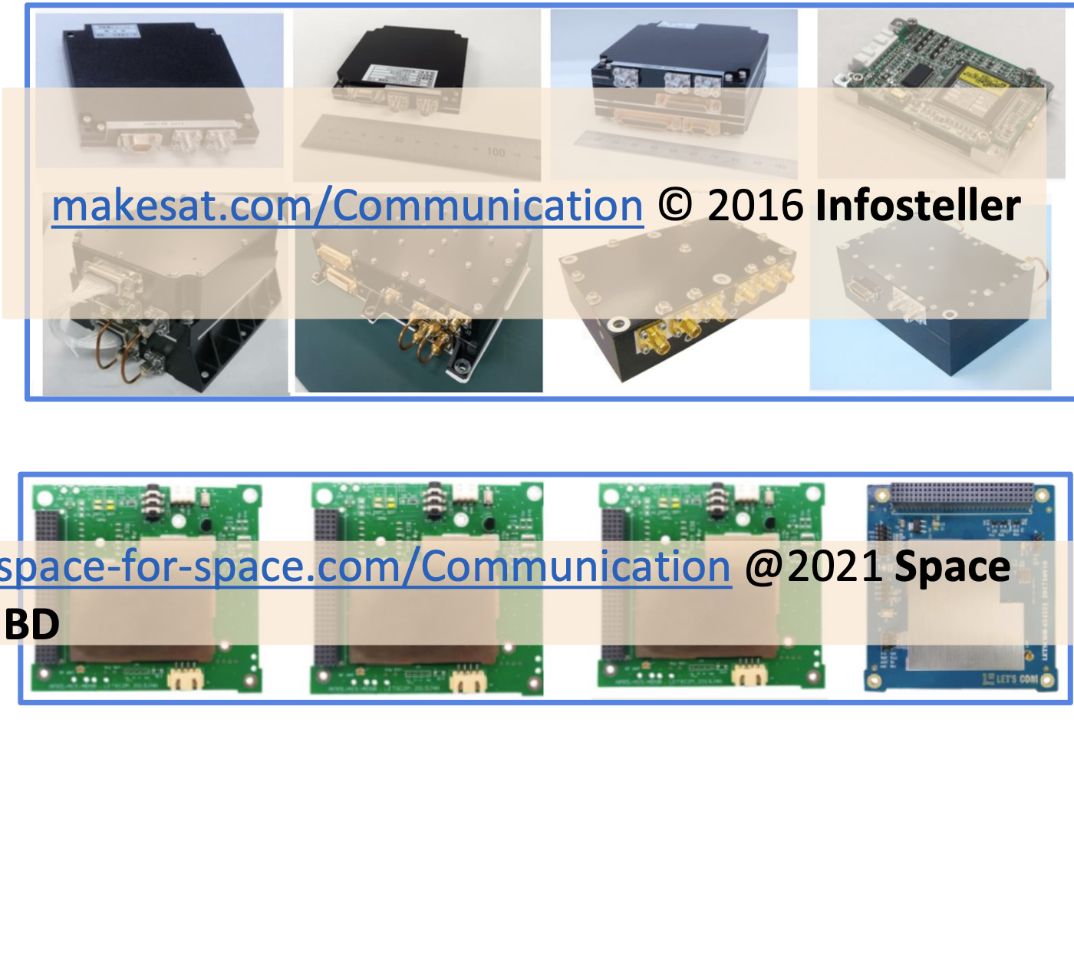
Radio Hardware (TX/RX)

Slide 19
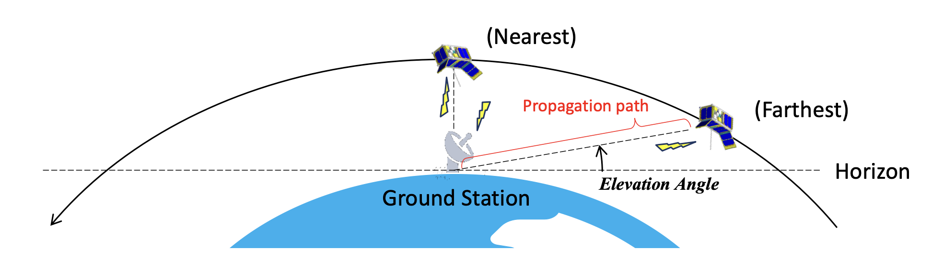
Link Budget
The communication channel in both directions between the satellite and ground station need to be carefully designed.
The received RF signal power at receivers shall be strong enough for a stable communication.
(Ensure a sufficient link margin!)
The link budget is the relationship between (1) data rate, (2) antenna size, (3) propagation path length, (4) transmitter power, and (5) losses through the communication channels.
The propagation path between the satellite and the ground station is the longest at lower elevation angles (at the beginning and the end of the satellite contact), which is one of the design criteria for the link budget design.
Notes:
Kibo07_40

Slide 20
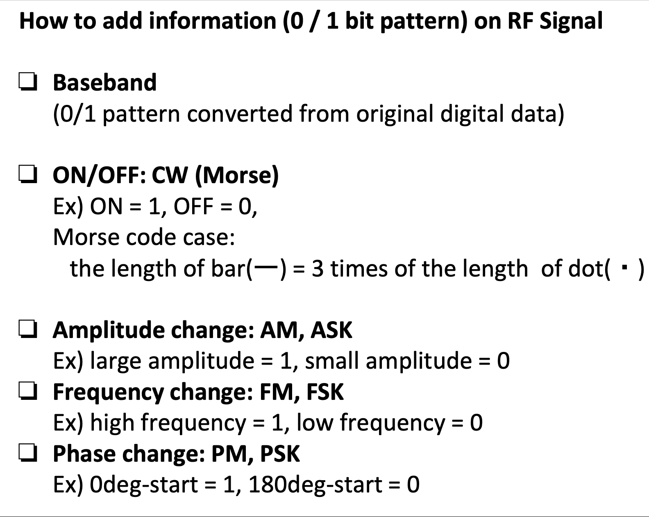
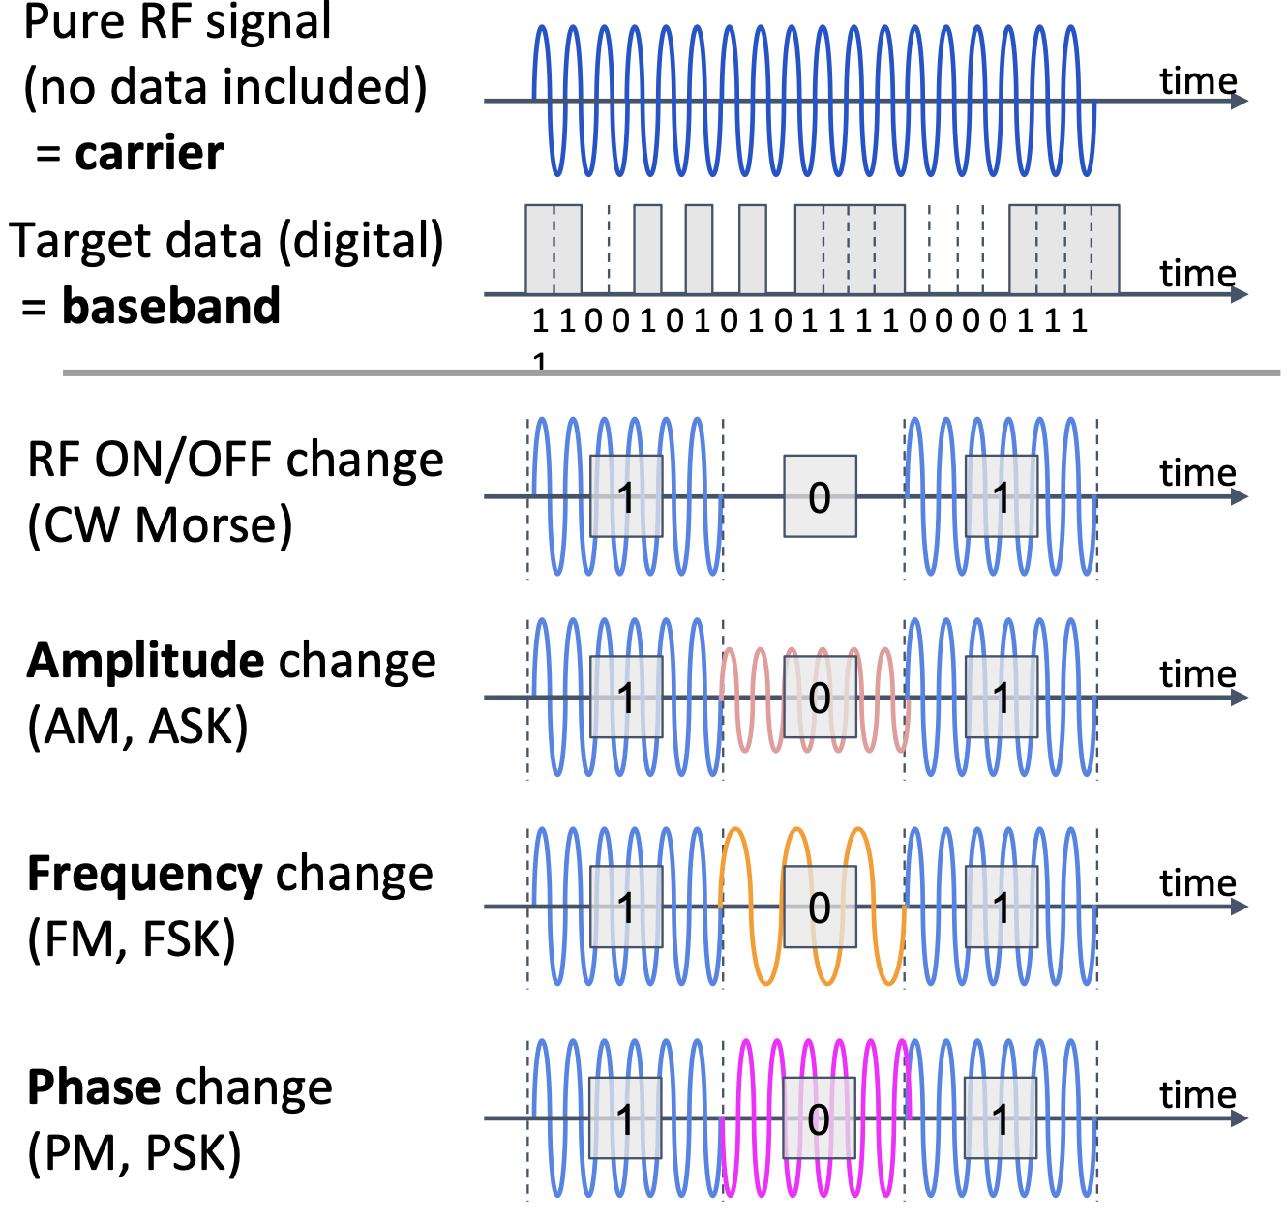
Signal Processing and Software Functions

Slide 21
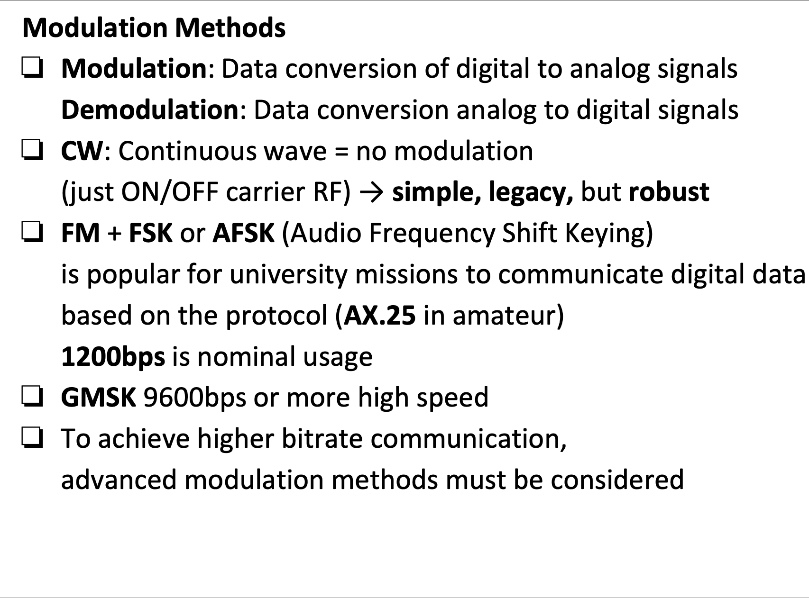
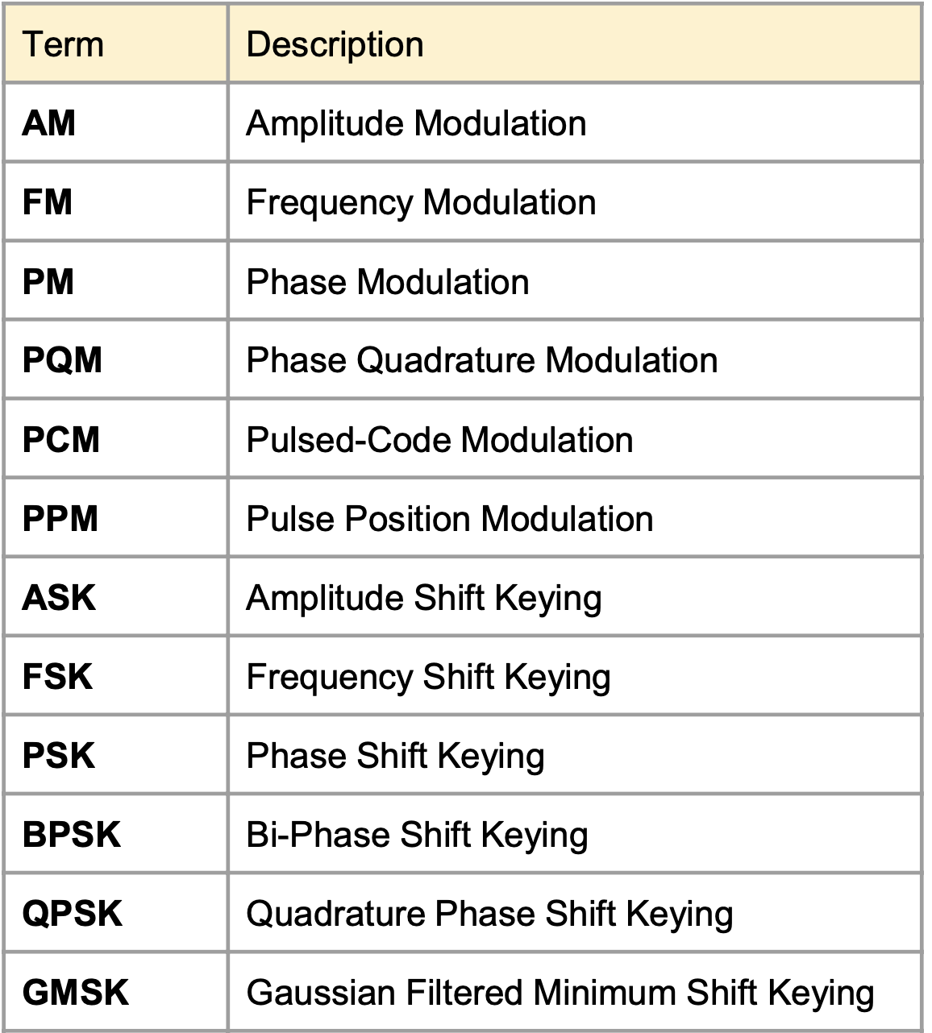
Major Characteristics of Signal Processing and Software Functions

Slide 22
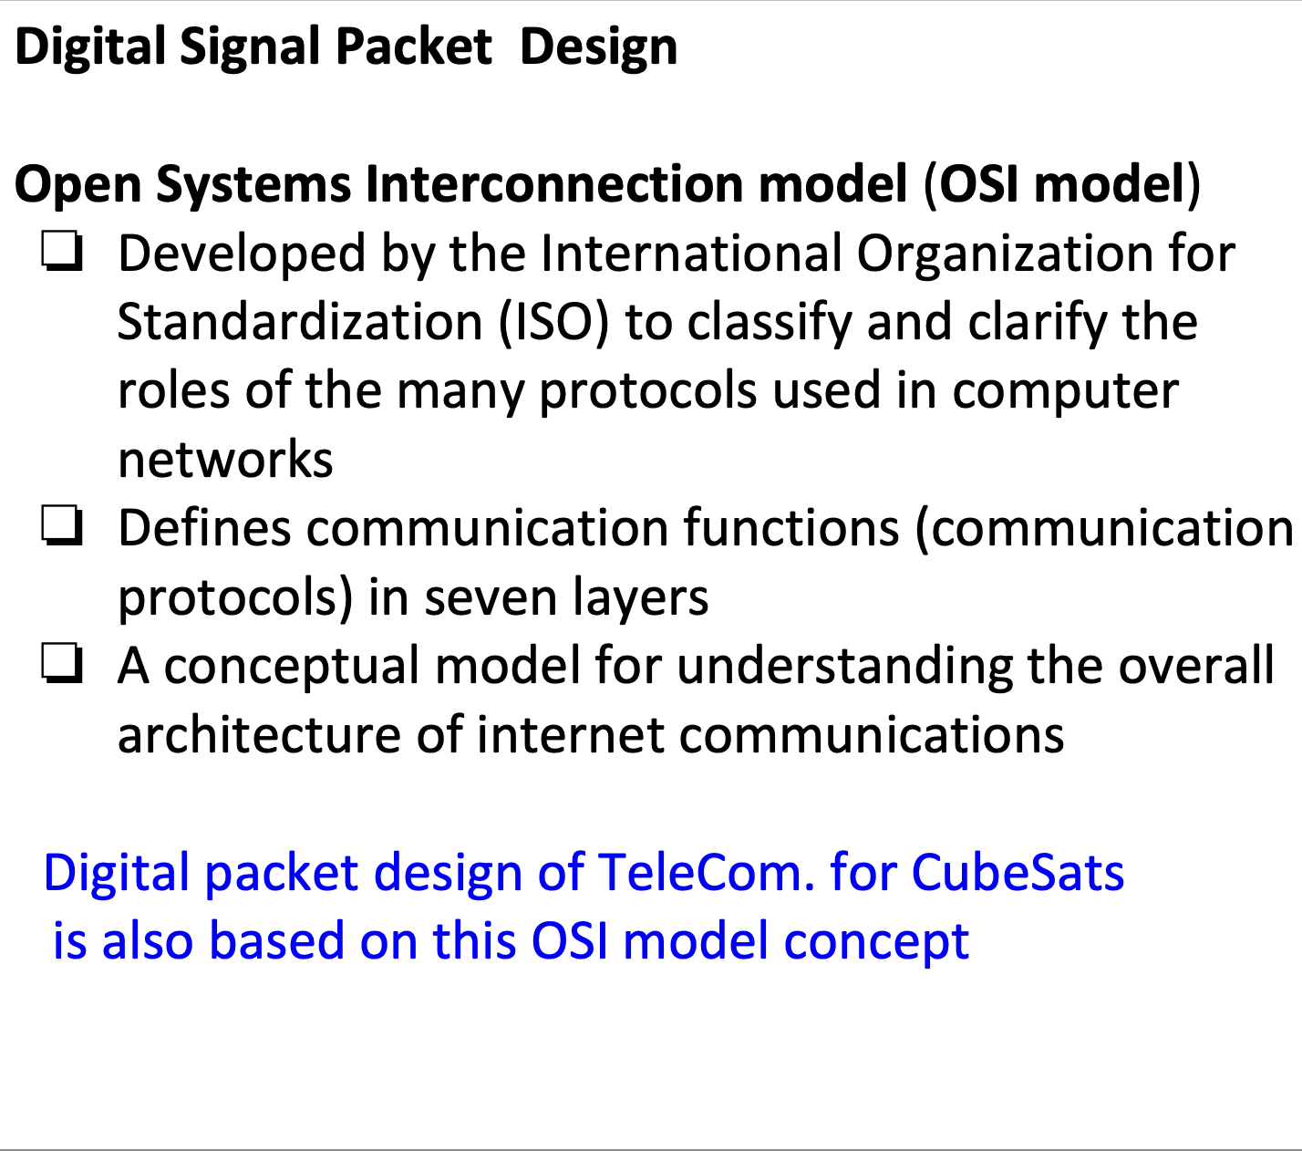
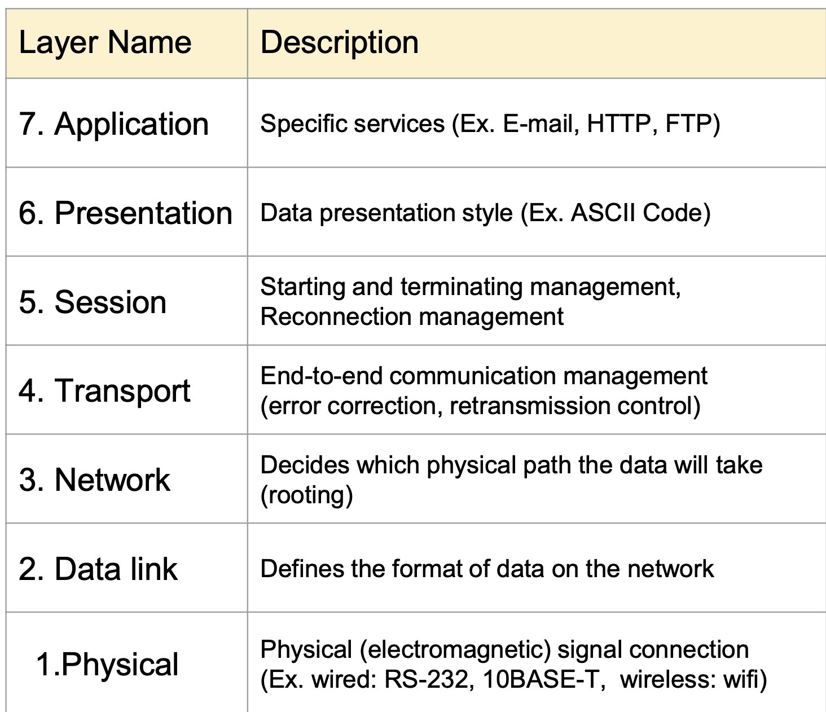
Design and Testing of Signal Processing

Slide 23
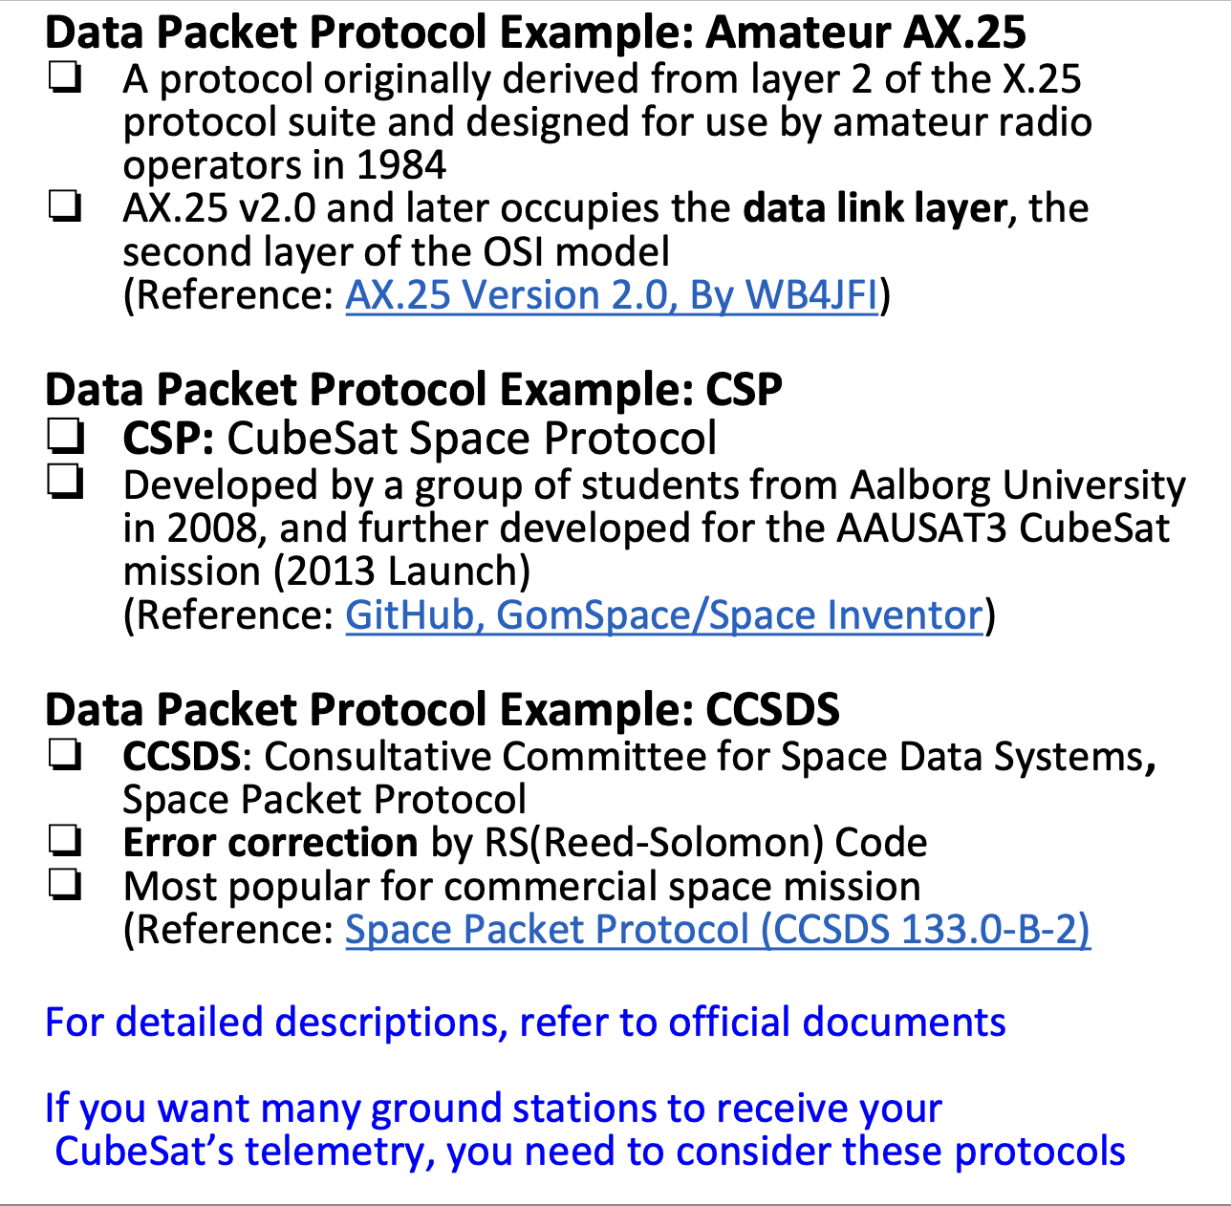
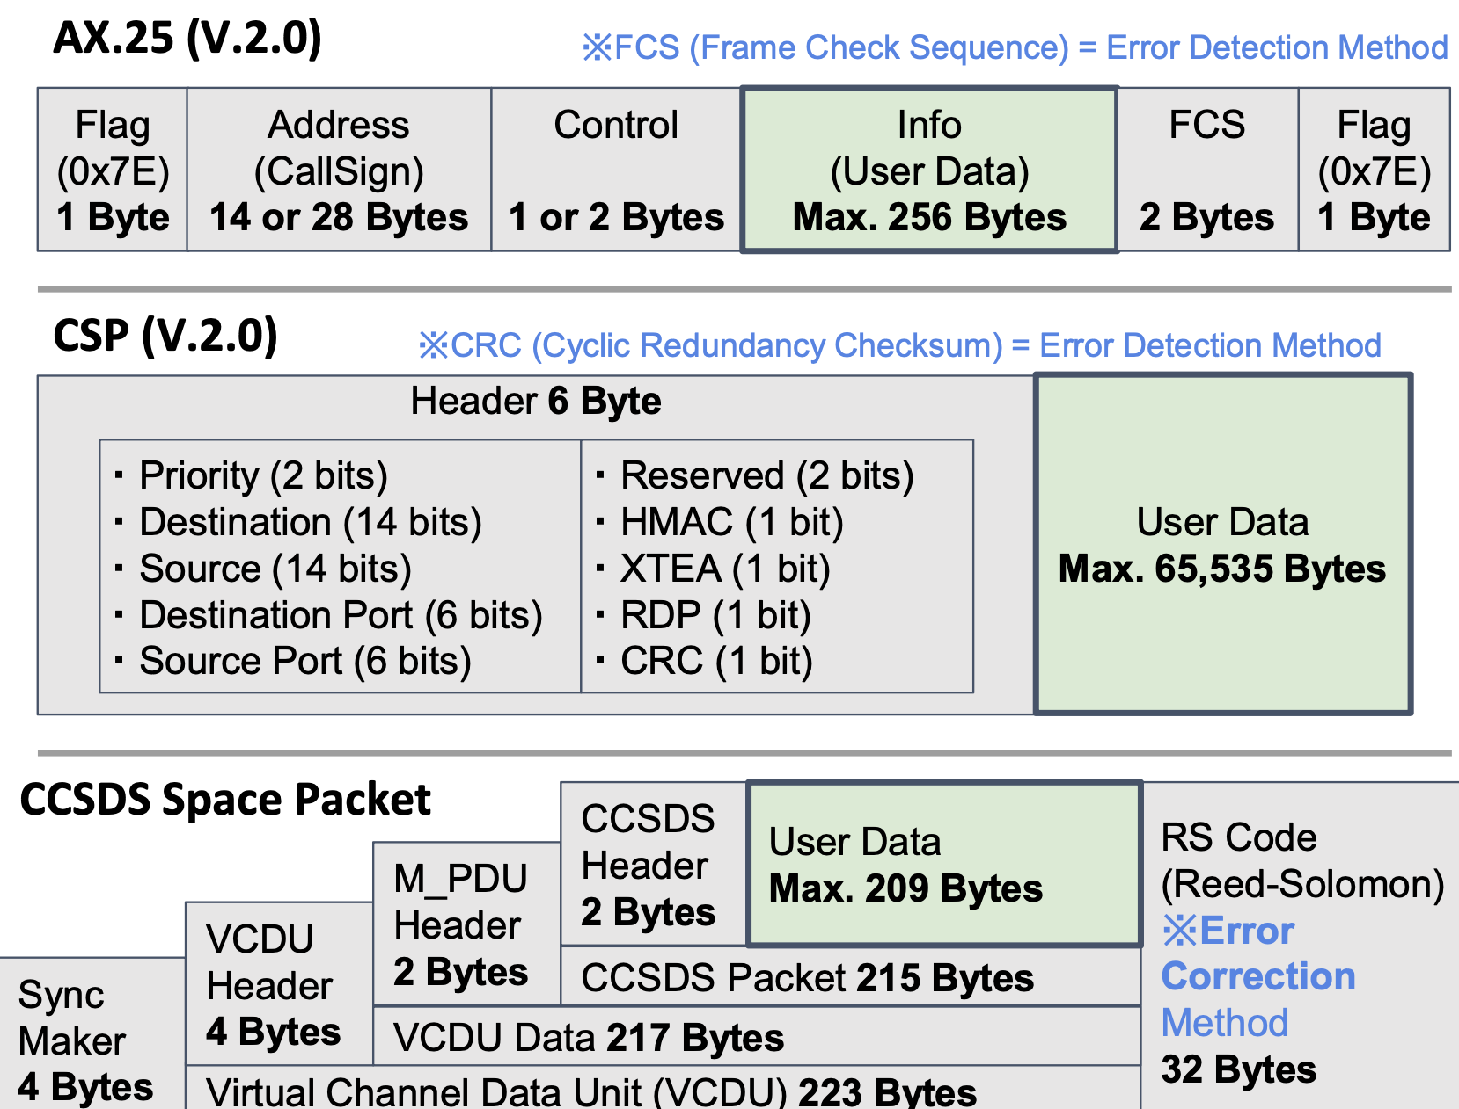
Design and Testing of Signal Processing

